Slide 1

FINDING MY PURPOSE IN WORK
Date here
WHAT’S OUT THERE FOR ME?

Slide 2
LEARNING OUTCOMES
Students will be able to (SWBAT)
1. Demonstrate understanding of the individual and societal purpose for work
2. Describe the evolution of work (and purpose of work) through history
FOCUS STANDARDS
Domain 2: Career Exploration (What’s out there for me?)
  Apply Self-Evaluation to the World of Work (Where do I fit in the world of work?)
A. Express the purpose and value of work

Slide 3
DEFINING TERMS
WORK: “Activity involving mental or physical effort done in order to achieve a purpose or result.” Oxford Dictionary
PURPOSE (#1): “the intention, aim or function of something”
PURPOSE (#2): “meaning that is important and valuable to you”
PURPOSE (#3): “the ability to plan something and work successfully to achieve it” Oxford Dictionary
When you consider your life’s “purpose” (FOR NOW), what comes to mind?
Notes:
INSTRUCTOR: Discuss the broad definition for “work”, and build the connection to the previous lessons and coursework. Compare and discuss the three different definitions of “purpose” – build connections between each of these definitions and the world of work.

Slide 4

QUICKWRITE
WRITE FOR THE FULL FIVE MINUTES
Question: Why do we work?
Consider:
Motivation
Lifestyle
Career Choice
Goals
Etc.
Notes:
INSTRUCTOR: Set a timer and have students write silently for the full time. They can make a list, write a paragraph, etc. They should just think of as many different reasons as they can for why people work or choose the work they do.
Have students share in partners first, then discuss as a whole.

Slide 5

WORK THROUGH THE AGES
LET’S INVESTIGATE
We will look through several different decades
What kind of work?
How did they work?
Why did they work?
How is this similar or different from our purpose for work in the world today?

Slide 6
EXAMPLE
ON YOUR ASSIGNMENT: Recent History of Work
This Decade: 1950s
HOW DO PEOPLE WORK IN THIS DECADE?
Desks placed close together (in view of the exec)
Women and African American men were starting to have a large impact
Technology was implemented
WHAT IS THE PURPOSE OF THEIR WORK?
Productivity
Vehicles, technology, opportunity
Finances
Work less, get paid more
Notes:
Instructor: Help students navigate the site, and walk through the information for the 1950s together. Help students engage by asking how these things are similar or different to why people work now.

Slide 7
WHY DOES THIS MATTER?
PURPOSE OF WORK CAN CHANGE
What consistent purpose can you see among the decades?
Do you notice other consistencies or patterns?
What things cause the purpose of work to change?
How important is it to have purpose for the work you do?
How important is it to fulfill your purpose through work?
Notes:
Instructor: Now is the time to bridge the gap and create the wider idea of how finding a purpose in work is relevant to students now. Start to encourage to think about their interests, skills, and career searches that they have done already – could they find a purpose in those things?

Slide 8
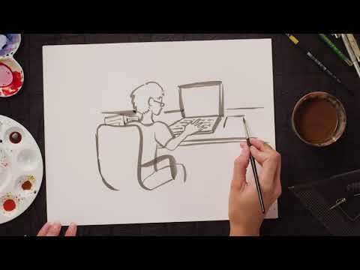
FIND YOUR PURPOSE
THE PURPOSE CHALLENGE
Based on:
This video The Purpose Challenge
Personality Tests
Self-inventory
Plan Smart Activity
CAN YOU IDENTIFY A PURPOSE YOU WANT TO FULFILL?
Notes:
INSTRUCTOR: This could be a beneficial moment to share/discuss your OWN “a-ha” with your students. (i.e. I knew I wanted to help people find their purpose so I became a teacher).
https://www.youtube.com/watch?time_continue=102&v=iRkhkO4fKAg&feature=emb_logo

Slide 9
PUT THEM TOGETHER
WHAT HAVE WE DISCUSSED ABOUT PURPOSE IN WORK AND PURPOSE IN LIFE?
In life, what I value most is…
My greatest passion in life is…..
I believe my purpose in life is to…
My highest goal in life is to …

Slide 10

EXAMPLE: PURPOSE STATEMENT
In life, what I value most is…bringing a positive influence to each person I meet.
My greatest passion in life is…..helping others to see the ways that they shine.
I believe my purpose in life is to…be an excellent wife, friend, mother, daughter, and sister.
My highest goal in life is to …help others find their purpose.
Notes:
INSTRUCTOR: Share this example with students and allow for feedback or questions. Encourage them to think about how this purpose statement translates to work. What will be the PURPOSE in this person’s work? What will help them to feel most fulfilled?

