Slide 1

YOUR GPA
Date here
WHERE DO YOU STAND?
Notes:
Career Activity: Your GPA
Activity Summary: This lesson will help students analyze where they currently stand with their GPA and tips to raise it.
Estimated Time: 30-45 minutes
Learning Plan Activity: 11th Grade Additional Activities: 12th
Learning Outcomes: Students will reflect on their academic progress using their current transcripts to calculate their GPA. Students will review the importance of their GPA and tips to raise it.
Materials Needed: Powerpoint, Pen, Computer, Transcripts*
Most recent transcripts for each student

Slide 2
“EDUCATION IS NOT THE LEARNING OF FACTS, BUT THE TRAINING OF THE MIND TO THINK.”
ALBERT EINSTEIN
Notes:
Academic Vocabulary
Grade Point Average (GPA): the average obtained by dividing the total number of grade points earned by the total number of credits.
Cumulative GPA: represents an average of all final grades students earned from the time they first enrolled in a school to the completion of their education

Slide 3

YOUR HIGH SCHOOL GPA
Notes:
Introduction: [Use powerpoint] This is usually the time when students start to realize just how important their GPA is, as it’s a major factor in which colleges, educational and certificate programs, scholarships, and internships you will eligible for after graduation and can affect your competitiveness for apprenticeships or jobs after graduation.
Watch the director of dual credit at the College of Western Idaho (CWI) talk about the GPA and its significance. Play Video: Your High School GPA by Next Steps Idaho. (~1.5 minutes)

Slide 4
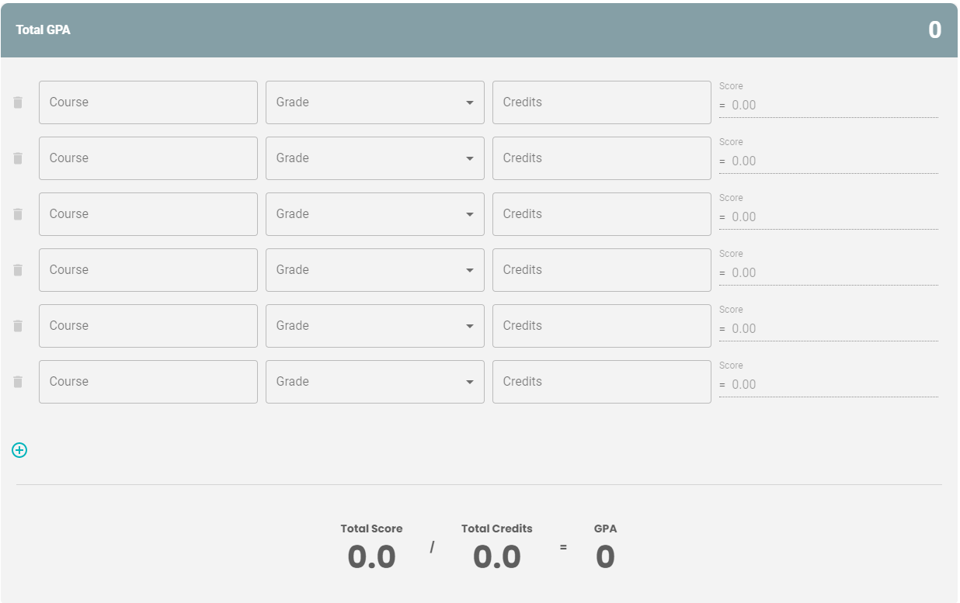
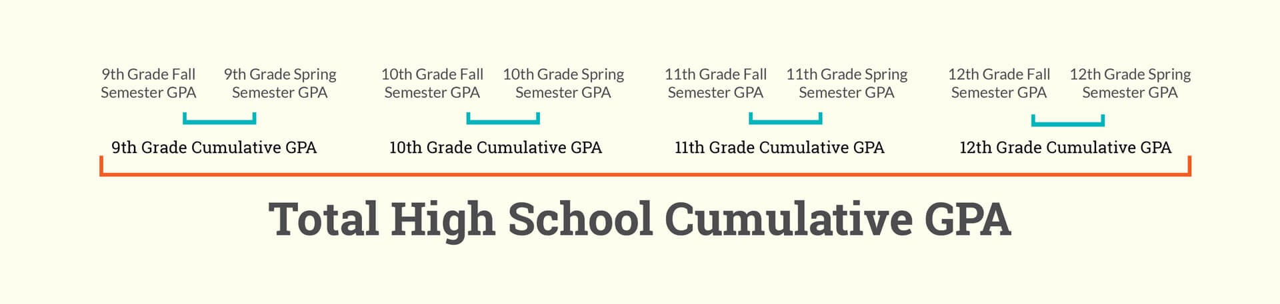
GPA CALCULATOR ACTIVITY
PRACTICE CALCULATING GPA
Go to:
  https://nextsteps.idaho.gov/gpa-calculator/calculator
Enter the Course, Grade, Credits from the transcript
  The GPA will auto calculate as you enter each.
CALCULATING CUMULATIVE GPA
Add up each years’ GPA and divide by how many years you added up
  Example: 9th + 10th / 2 = Cumulative GPA
Notes:
Activity: GPA Calculator: Use the Next Steps’ GPA Calculator to find out where you stand. Go to Next Steps GPA Calculator: https://nextsteps.idaho.gov/gpa-calculator/calculator
Use your current high school transcript to calculate your GPA for each grade level and then find your cumulative GPA. *Note: If students are using their own transcript: Share the importance and confidentiality of their transcript and that, per FERPA, they are not permitted to see a classmate’s transcript.

Slide 5
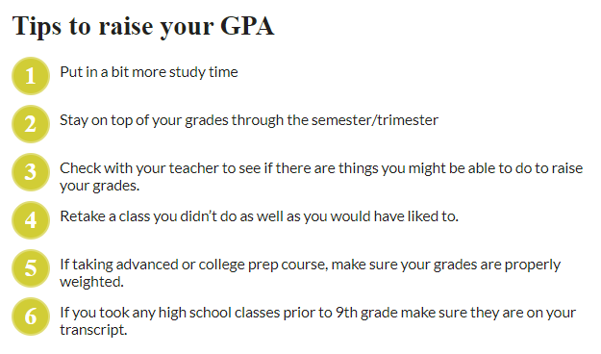
LOW GPA?
Notes:
Tips to raise your GPA: Is your GPA not where you want it? Here are some tips you can use to help you improve or keep your GPA high throughout your high school years.
Closing: Your GPA can also be a major factor in which colleges, educational and certificate programs, scholarships, and internships you will be eligible for after graduation. Keeping your grades up will give you the widest array of opportunities for taking the next step in your education and career after high school. Utilize the tips to raise your GPA and finish strong!

