Slide 1

SCHOLARSHIP TRACKING
Date here
HOW TO RESEARCH AND TRACK SCHOLARSHIPS
Notes:
Career Activity: Research and Track Scholarships
Estimated Time: 55 minutes
Learning Plan Activity: 11th Grade: Scholarship Tracking; 12th Grade: Financial aid and Scholarship Tracking
Activity Summary: This lesson will help students explore how to research scholarships most effectively.
Learning Outcomes: Students will demonstrate knowledge of where to find scholarships, when and how to do so in order to earn as many as possible.
Materials Needed: Powerpoint, Handout, Pen, Computer, Scholarship Tracking Form*
*(Digital Copy or paper)

Slide 2
“THE ONLY IMPOSSIBLE JOURNEY IS THE ONE YOU NEVER BEGIN.”
Anthony Robbins
Notes:
Academic Vocabulary:
Scholarships: Free money awarded to students who apply and meet certain requirements based on criteria determined by various individual entities.
Weighted GPA: Weighted GPAs take the difficulty of a class into account. More challenging courses, like honors or AP classes, can be worth more than a 4.0 – up to a 5.0, actually – depending on a student’s grade.
Unweighted GPA: An unweighted GPA relies on a 4.0 scale and, on that scale, no grade is worth more than a 4.0, regardless of the type of class involved.

Slide 3

TYPES OF SCHOLARSHIPS
MERIT-BASED
NEED BASED
STUDENT-SPECIFIC FACTORS
MAJOR RELATED
COLLEGE SPECIFIC
COMMUNITY AND STATE SPECIFIC
NATIONWIDE MISCELLANEOUS
  CREATE A TUX OR PROM DRESS OUT OF DUCT TAPE (Stuck At Prom: Duct Tape Attire Scholarships | Duck Brand)
Notes:
Introduction: [Use Powerpoint] One of the challenges you’re probably facing right now is figuring out how to pay for college. In addition to grants and loans, you may also be eligible for scholarships to help pay for your expenses. Today we are going to explore different types of scholarships, who should apply, what you need, when to start, and where to find scholarships. Before we get started, take a few minutes on the Scholarship Knowledge Inventory Handout to identify some things you may already know! We will fill this in today together as we gain more understanding.
Scholarships aren’t just for your school’s star athletes or people with really high grades. Awards can be need-based, meaning that they require students to demonstrate that they need financial assistance beyond what their family is able to contribute. There are also scholarships you may qualify for based on an affiliation you or your parents have, like from a religious organization you belong to, or from a nonprofit you volunteer for. Finally, you might find organizations that are interested in helping students of a particular ethnicity or other intrinsic characteristic.
Types of Scholarships: Play video: What is a Scholarship? - Quick and Easy Explanation (~ 3 minutes)
Class Discussion:
Who has started to look for scholarships?
Do you plan on applying for scholarships? –Why or Why Not?
By your senior year and within the senior year you may change your mind on college and trade schools –Apply anyway as lots could happen and you may get a lot of money!
Idaho has students who have received full rides numerous times –Ex. Full ride to Brown University, quarter of a million dollars, school paid for flights home, clothing, food, board, tuition, books, etc.
This is an extreme, but there is money out there to be received if you put your name in the pot.

Slide 4
WHO SHOULD APPLY FOR SCHOLARSHIPS?
Everyone!
What if your parents are paying for your college?
  Apply anyway!
    If you have done the work (good grades, volunteer work, extra curriculars, etc.) why would you not?
    Your college choice may be more expensive than you planned.
    You could use any extra money for living expenses
Don’t have good grades?
  Apply anyway!
    You’ll be surprised to find all different kinds of scholarships out there.
    Not all scholarships are academic based!
Going out of state for college?
  Apply anyway!
    Western Undergraduate Exchange Program (WUE)
      An agreement among some Western states, through which 160+ participating public colleges and universities provide steep nonresident tuition savings for Western students.
      Alaska, Arizona, California, Colorado, Hawaii, Idaho, Montana, Nevada, New Mexico, North Dakota, Utah, Washington, Wyoming
      wiche.edu can provide more information

Slide 5

WHEN TO START LOOKING FOR SCHOLARSHIPS?
Don’t procrastinate!
Start getting organized early!
Scholarship deadlines vary by type but most fall between September and May of your Senior Year
Notes:
When to start looking?
How many of you have started to look?
Get Smart! Start Early, Prepare Ahead of Time, and Get More Scholarships!
Research heavily during the Junior year especially in the spring and through the summer

Slide 6
WHERE DO YOU FIND SCHOLARSHIPS?
Idaho Scholarships
  www.nextsteps.Idaho.com (Idaho Specific)
National Scholarships
  www.scholarships.com
  www.bigfuture.collegeboard.org
  www.unigo.com
  www.fastweb.com
Counselor
Your employer/Parent’s employer
Community organization (Ex. Elk’s Club)
Notes:
Where do you find scholarships?
•High School Website (not just your own high school, look at others)
•Google “Scholarships” and see what you find
–Do not ever provide personal information (especially your Soc. Sec. Number)

Slide 7

TRACKING YOUR SEARCH
Why would be important to track your research of scholarships?
How might you stay organized and keep track?
How many scholarships can you apply for?
Notes:
Tracking your Search:
•Why would it be important to track your research or scholarships?
–Save time later
–Could forget info or not remember how to find scholarships you found
–Can better organize when you will start working on the various ones found
•How might you do so?
–Paper format
–Document on Your Computer
–Look online for examples and on your school website
•How many scholarships can you apply for?
–Apply for as many as you qualify for, as this will increase the likelihood of you receiving money
-You are allowed to get as many as awarded

Slide 8
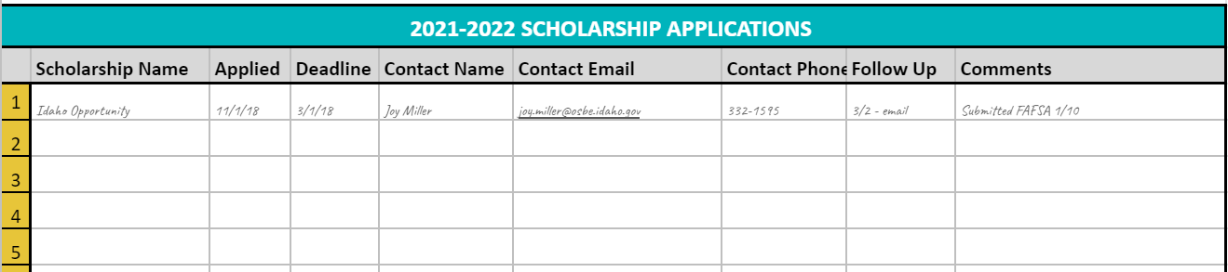
ORGANIZING YOUR SEARCH
Notes:
Organizing your Search: Have each student open the digital handout_Next Steps Scholarship Application Tracker Fillable or have them create their own digitally or on paper. Use this tool or create your own to keep track of the scholarships that you find and want to apply for.

Slide 9
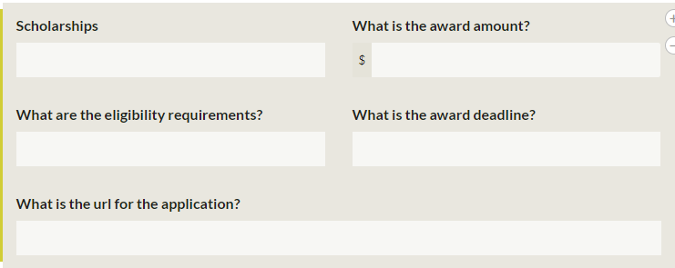
SCHOLARSHIP ACTIVITY
Use any of the websites below to locate 3 scholarships and include the following information:
www.nextsteps.Idaho.com
www.bigfuture.collegeboard.org
Create a way to “track” or organize the information you find!
Notes:
Scholarship Activity: Use any of the websites listed below to locate 3 scholarships and include the following information for each: Scholarship Name, Award Amount, Eligibility Requirements, Award Deadline, URL for application.
Have students use computers in pairs or individually and use the websites:
www.nextsteps.Idaho.com [ https://nextsteps.dev.s360.is/scholarships/ ]
www.bigfuture.collegeboard.org
Encourage students to write down/organize the information they find so they can apply before the deadlines!
Closing: Now that you have explored locating scholarships, what ways do you think would be easiest to track or organize what you need to apply and when it needs to be submitted? Remember that all of you can apply and find scholarships that will help you go on!
Scholarships Knowledge Inventory Handout Answer Key:
A, B
A
A, B, C, D
D
Answers will vary
Answers will vary
Answers will vary
A, B, D
B

