Slide 1

SCHEDULE AND TAKE THE ACT/SAT
Date here
WHAT IS THE ACT AND SAT?
Notes:
Career Activity: Schedule and Take the ACT/SAT
Activity Summary: This lesson will help students understand the how, what, when, and where of college entrance exams.
Estimated Time: 30-45 minutes
Learning Plan Activity: 11th Grade
Learning Outcomes: Students will become knowledgeable of the format for the ACT and SAT and know how and when to register and to be best prepared.
Materials Needed: Powerpoint, Handout, Pen, *School’s SAT/ACT Dates

Slide 2
“THERE IS NO ELEVATOR TO SUCCESS. YOU HAVE TO TAKE THE STAIRS.”
UNKNOWN
Notes:
Academic Vocabulary
SAT: College Entrance Exam provide by College Board (collegeboard.org) testing writing, critical reading, and math
ACT: College Entrance Exam provided by ACT (actstudent.org) testing reading, math, writing, and science reasoning

Slide 3
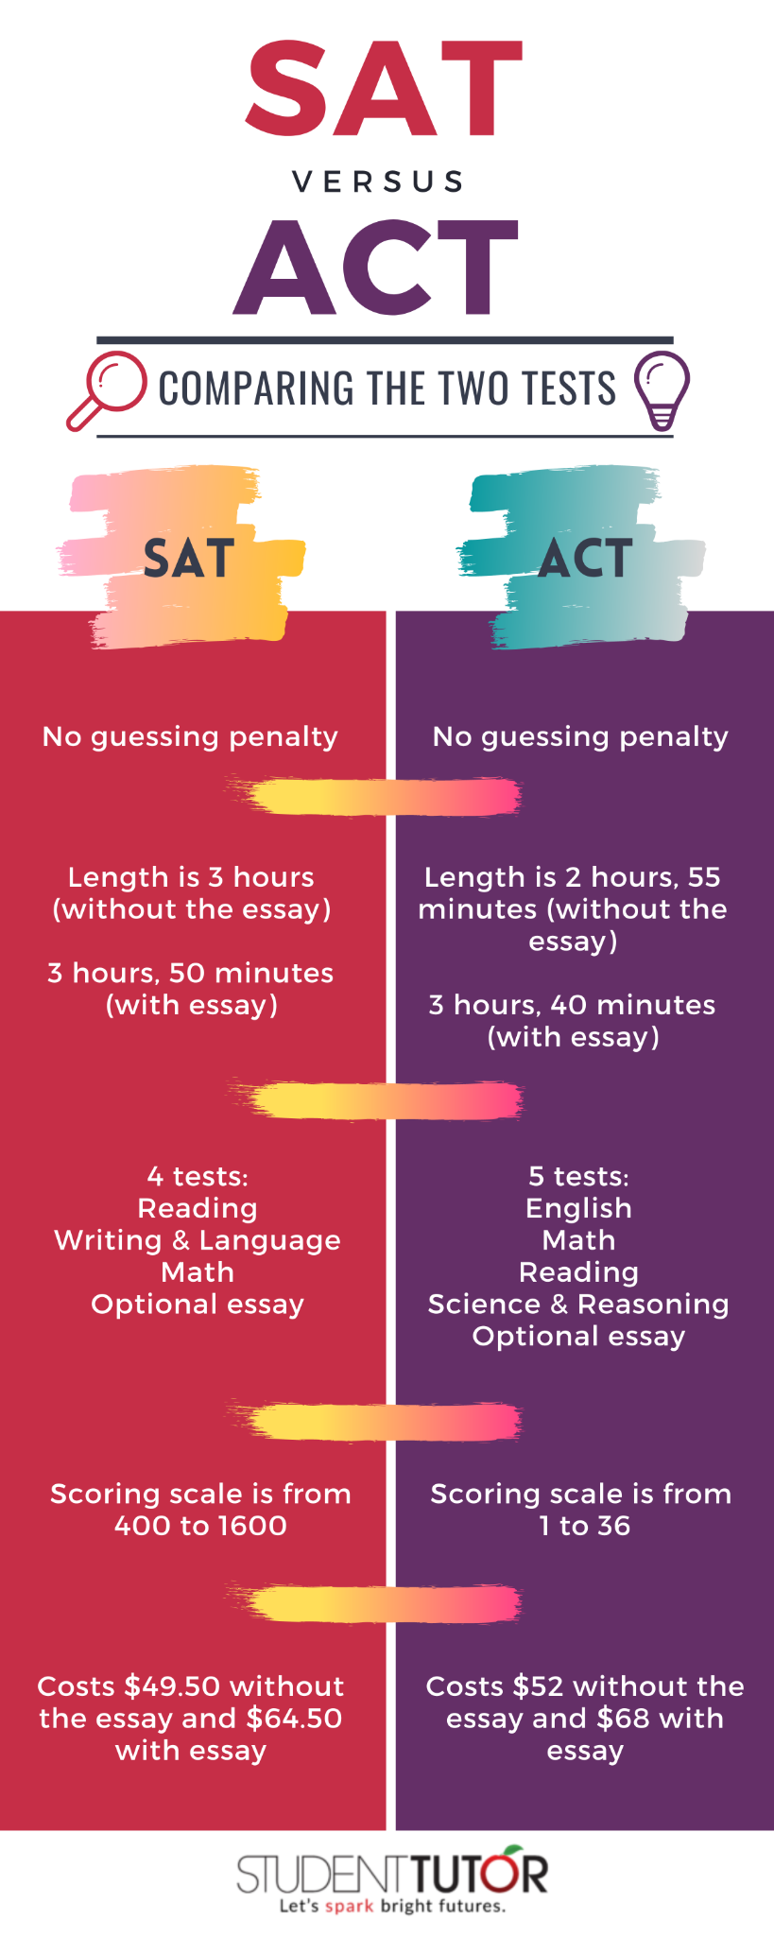
WHAT IS THE ACT OR SAT?
COLLEGE PLACEMENT EXAMS
The SAT is a nationally administered college entrance exam that evaluates math, reading, and writing skills.
The ACT is a standardized test used for college admissions that evaluates English, math, reading, and scientific reasoning.
  It is accept by all 4-year colleges and universities in the U.S.
Notes:
Introduction: [Use Powerpoint] Today we are going to learn about everybody’s favorite topic..drum roll please..Testing! Every student in Idaho is required to take the SAT or ACT before the end of their eleventh grade year as a graduation requirement. Every eligible student receives one state-paid testing opportunity. Idaho offers the SAT to all public high school juniors at no cost to districts, schools, parents, or students.
What is the ACT or SAT?
In order to graduate, you must take either the SAT or ACT. There is no set score you have to have to grade from high school. So even if you are not planning to go to college, you need to make sure you take one.
Some of you will and often do change your mind even after high school. Set yourself up well so you have options! Don’t forget that colleges hold other options like trades you may not have thought of yet. The scores are used for class placement for English and Math in College. University admissions and College Scholarships typically use scores and GPA.
Your results will be used to measure your readiness for college and provide personalized feedback and connect students to valuable resources supporting their next steps. That being said, colleges expect that many students will take the exam more than once. In fact, it’s encouraged. You have up until the first few months of your senior year to reach your target score.

Slide 4

SCHEDULING YOUR TEST
Take advantage of your school’s free SAT day for Juniors!
Need to register or take it again?
    SAT: Find testing sites and register at Collegeboard.org or click the banner below!
    ACT: Find testing sites and register at act.org
Make sure you use your full legal name that matches your photo ID!
Notes:
Scheduling Your Test
Share Junior SAT testing day information, if available

Slide 5

TIPS FOR TAKING YOUR TEST
CREATE A SCHEDULE AND PRACTICE!
SAT Practice on Khan Academy
    Personalized Practice
    Full Length Digital Practice Tests
SAT Practice Paper Tests
    College Board has several versions to print and practice
Study Groups
    Find one at your school or start one!
    Get familiar with the test: Utilize Sample Questions from Khan Academy or College Board or Test Prep books
ACT/SAT/AP Test Prep
Have a library card?
  Utilize Idaho’s Library Linking Idaho (lili.org) for Free College Admissions Test Preparation
    Go to Learningexpresshub.com and register for a free account to access ACT/SAT/AP practice tests
Notes:
Tips for Taking Your Test
Practicing on Khan Academy® can help you improve your SAT scores—and could lead to college scholarships. More time spent on Official SAT Practice is associated with greater SAT scores. But how you spend your time on the platform really matters. Make the most of your time on Official SAT Practice with these three best practices: Follow your personalized practice recommendations, Take a full-length practice test, Level up your skills.
On average, students who used Official SAT Practice for 6+ hours and demonstrated at least one of these best practices scored an additional 39 points higher on the SAT than students who didn't use Official SAT Practice.
If you would prefer a paper test, find some on the College Board. (https://collegereadiness.collegeboard.org/sat/practice/full-length-practice-tests)
The ACT does not have test prep on Khan Academy but there are several test prep books and if you have a library card, you can utilize the Library’s network for free access to ACT practice tests for each subject section.

Slide 6

TEST DAY
ARE YOU READY?
Get a good night’s rest and make sure to eat breakfast!
Bring:
    No. 2 Pencils
    Calculator
      Most Graphing allowed
      All Scientific Calculators Allowed
    Water Bottle
    Snacks
    NO CELL PHONES/SMART DEVICES
  Do your best! Remember there is no penalty for wrong answers so a guess is better than leaving blank!
Notes:
Test Day: A great way to lower test anxiety is to be prepared! Keep up with your learning schedule. Pack what you need the night before.

Slide 7

GETTING SCORES
SAT Scores
Scoring Scale is 400-1600
    Average Score is 1000
Access Scores online
    Sign in to collegeboard.org
    Scores available Approximately 2-4 weeks
ACT Scores
Scoring Scale is 1-36
    Average Score is 20
Access Scores Online
    Sign in to myACT.org
    Scores available Approximately 2-8 weeks
Notes:
Make sure you have an account with College Board or My ACT in order to receive your scores. If you can’t access your account you will need to contact College Board. There is a college Board app if you have a cell phone!
Remember: If you take the ACT or SAT again you will need to make sure the registrar has your new scores on your high school transcript!

Slide 8
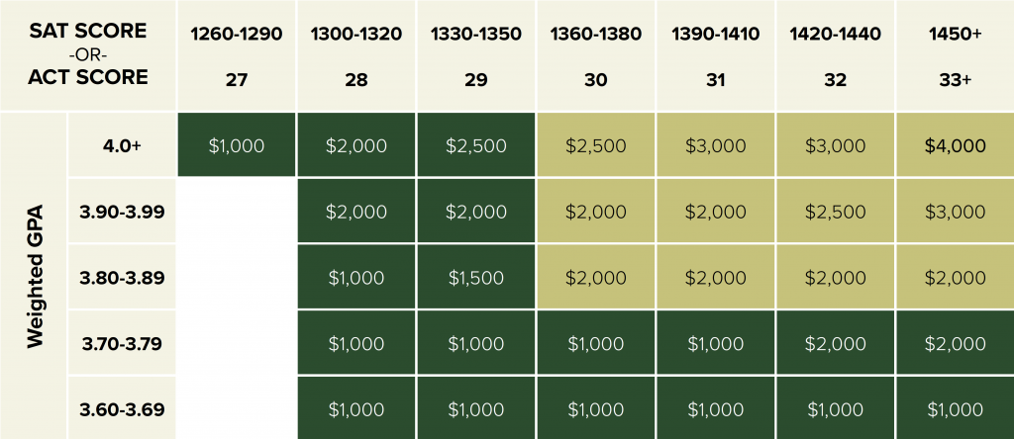
SCORES
Example of how a college may offer scholarships based on SAT/ACT scores and GPA
Notes:
Source: https://blog.prepscholar.com/guaranteed-scholarships-based-on-sat-act-scores
Some scholarships are based on your college placement exam scores, so it pays to practice and retake the test as needed to get the best options for your next steps.
Closing: Students you are now aware of some of the key points for the SAT and ACT requirements for your high school graduation requirement, as well as college admission requirements.
Prepare as if you are going to go to college, as some of you who are not sure yet, will change your mind and decide to go. It is best to set yourself up right so you have options.

