Slide 1

TRANSCRIPTS: WHAT, WHEN, AND WHY
Date here
REQUESTING TRANSCRIPTS
Notes:
Career Activity: Requesting Transcripts: How, When, What, and Why
Activity Summary: This lesson will help students learn the process and importance of requesting transcripts.
Estimated Time: 30-55 minutes
Learning Plan Activity: 11th Grade; Additional Activities: 12
Learning Outcomes: Students will learn the differences between various transcripts, how and when to send them, what they are used for, and why they are so important.
Materials Needed: Powerpoint, Handout, Pen, Paper, Computer (Optional)

Slide 2
“IT ALWAYS SEEMS IMPOSSIBLE UNTIL IT IS DONE.”
NELSON MANDELA
Notes:
Academic Vocabulary:
Rigor: When using this term in reference to coursework it means taking more credits/classes than are required for a general diploma at a higher level such as Advanced Placement classes, Dual Credit, CTE (Career and Technical Ed) classes such as with the trades (Ex. Automotive, Welding, Cosmetology).
Prerequisite: A class that is required be passed before a higher-level class can be taken
Co-requisite: A class that is required be taken at the same time as another class.
Common Application: An application that some colleges allow to be used (or is required) when you apply to more than one college. In using this application, you need only fill the application out once instead of individual applications for each college.
Class Rank: Where you fall in line with your grade level classmates based off of your GPA. Most schools use a weighted GPA to determine rank (more points are given for taking AP and/or Dual Credit Classes)

Slide 3
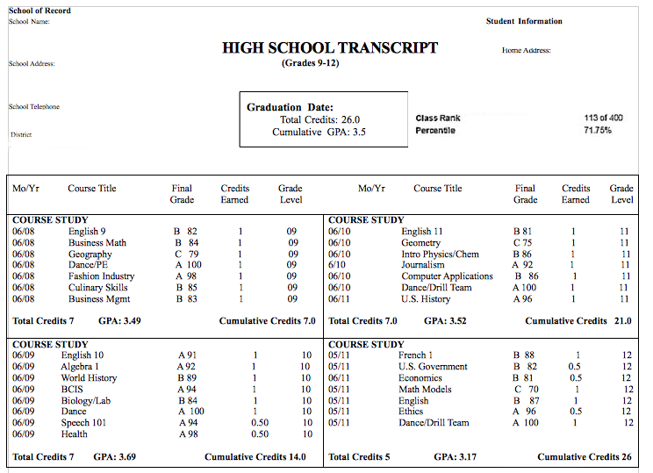
WHAT IS A TRANSCRIPT?
A PERMANENT RECORD OF ALL CLASSES AND GRADES YOU HAVE TAKEN WHILE IN HIGH SCHOOL OR IN COLLEGE
High School vs. College Transcript
Unofficial vs. Official Transcript
Notes:
Introduction: [Use Powerpoint] Today we are going to learn about requesting transcripts, and the importance of knowing when and how to send a transcript, and what they are used for.
What is a transcript?
High School Transcript:
Only holds high school classes/grades & Does NOT hold any Dual Credit college classes/grades (Credits that count for both high school)
Also typically shows SAT/ACT scores and class rank.
College Transcript:
Does NOT hold any high school classes/grades. Only holds Dual Credit classes/grades and General College Course classes/grades
Unofficial Transcript:
A document holding all of your classes and grades without a seal that has not been signed by the registrar or other school official
Official Transcript:
An official permanent record holding all of your classes and grades with a seal that has been signed by the registrar or other school official

Slide 4

WHY ARE TRANSCRIPTS SO IMPORTANT?
High school transcripts are necessary for almost every college application.
They give college admissions officers a quick overview of a student's academic performance and help them decide who to admit.
Notes:
Why are transcripts so important?
Colleges will look at the following on transcripts:
That you completed High School
Community college typically require a high school diploma or a GED only
Classes you have taken:
Rigor is important (Higher level classes)
AP classes, Dual Credit, Program Classes in CTE (Ex. Dental Assisting, Automotive)
Universities typically will require specific core classes be completed for admission
Weighted Vs. Unweighted GPA
For admittance and scholarship purposes

Slide 5
WHERE CAN I FIND RECORDS OF ALL OF MY DUAL CREDIT COURSES?
Log in to your account on the Advanced Opportunities (Fast Forward) Portal and go under “Student Landing”
    Click on the “Previous Course Application” Page
    Page lists all Dual Credit courses you have taken that you used funding for and what college you took each class from
    This page does NOT list the amount of credits (you may need this information for application and scholarships)
Need Help?
  Talk to your Dual Credit Teacher and Counselor
  Or contact the college admissions office from the school where you took the course for more information
Notes:
Where can I find records of all my dual credit courses? Good to look at this record now and to keep your own record (including credits) to save time during your senior year!

Slide 6

HIGH SCHOOL TRANSCRIPT: WHEN TO SEND IT AND HOW?
CHECK YOUR TRANSCRIPT FOR ACCURACY
  Ask your registrar or personal counselor for an unofficial copy
  Make sure weight/unweighted GPA looks right
  Make sure ACT/SAt scores are recorded, updated, and accurate
SEND AN OFFICIAL TRANSCRIPT TO A COLLEGE (2 TOTAL)
  When you commit to a college, send current transcript (Usually after 7th semester)
  After Graduation, send your final transcript
REQUEST TRANSCRIPTS TO BE SENT BY YOUR SCHOOL REGISTRAR (MAIN OFFICE)
  Complete the request form either in writing or digitally (May have a small fee)
  Some scholarships or the common application may have your school counselor attach a transcript to their recommendation piece
Notes:
High School Transcript: When to send it and how? Lost? See your school counselor or look on your school and/or district website for transcript request information

Slide 7
COLLEGE TRANSCRIPTS: WHEN TO SEND IT AND HOW?
TALK TO THE COLLEGE ADMISSION RECRUITER TO FIND OUT THE BEST TIME TO SEND A TRANSCRIPT
  If the course is not finished yet, wait until grades post to send a transcript
GET YOUR TRANSCRIPTS IN BEFORE REGISTERING FOR COLLEGE CLASSES, AS YOU MAY BE BLOCKED FROM A HIGH LEVEL COURSE IF THERE IS A PRE-
YOU WILL NEED TO SEND A COLLEGE TRANSCRIPT FROM EACH COLLEGE YOU TOOK A DUAL CREDIT CLASS FROM TO THE COLLEGE YOU WILL BE ATTENDING.
  Most colleges have an online process to request a transcript that will cost you a small fee
    You will need a bank card
Notes:
College transcripts: When to send it and how?
Most recruiters visit schools often
Ask your counselor for contact information
Call the college (especially if out of state and recruiter is not known)
Google the college web page and locate the admissions phone number.
Call Admissions for any questions about transcripts or general questions about the college.
This is often the case for Math courses
-
Find the page and the process by doing one of the following:
Google the college you will be sending a transcript from and the words” Request Transcript” to locate the page to do so (Ex. ”BSU Request Transcript”)
Go to the college’s webpage that you took the dual credit class from
In the search box type in “Request Transcript”
Call the college admissions office
Phone # is usually at the bottom of the main webpage
Ask for assistance from your School Counselor/College and Career Counselor

Slide 8

REQUESTING TRANSCRIPTS:
WHAT, WHEN, AND WHY?
QUESTIONS?
See your School Counselor (Guidance and/or College and Career)
Talk to your high school registrar (by email that can be found on your school website or ask to speak with that person on the main office)
Call the college(s)!
  College Dual Credit Reps and Admission Recruiters work for you.
    Call the main line if you aren’t sure who to talk to.
Notes:
Requesting transcripts: What, When, and Why? Do you know how to get your high school transcripts to go along with your college applications?
If you’ve taken dual credit classes, do you know how to request your official transcript(s) to go along with your college applications?
Closing: Remember to take notes and keep a file just for college and career information. There is a lot to remember about the process for preparing after high school and it is good to have reminders in writing. Transcripts are an important part of your journey right now. It is critical you make sure they are accurate, updated, and sent on time. Hopefully you are ending this activity today feeling more confident about the process and who to go to if you have questions.
Answers to assessment questions: 1.c, 2.b, 3.c, 4.d, 5.c, 6.a, 7.d

