Slide 1

PLAN SMART
Date here
EXPLORE YOUR FUTURE
Notes:
Career Activity: Plan Smart
Activity Summary: This lesson will help sophomore students explore and plan for their futures through the Plan Smart tool.
Estimated Time: 45-60 minutes
Learning Plan Activity: 10th Grade
Learning Outcomes: Sophomores will be better informed of possible financial needs and learn how to plan for their futures. Students will explore careers that match the income they would need to afford the lifestyle.
Materials Needed: Powerpoint, Handout, Pen, Computer

Slide 2
“MAKE EACH DAY YOUR MASTERPIECE.”
JOHN WOODEN
Notes:
Academic Vocabulary
Gig Economy: Economic activity that involves the use of temporary freelance workers to perform jobs typically in the service sector.
Renter’s Insurance: Renters insurance is a policy designed for people who don't own their own home. It covers your personal belongings in case of disaster and pays out if you're found at fault for injuries or property damage to others.
Utilities: Utility expenses include electricity, gas, water/sewage, and garbage disposal. Other services such as internet, cable TV and phone services are additional utilities since they are now considered standard in most American households.

Slide 3

FUTURE EXPENSES
GROUP BRAINSTORM
What will we need to pay for when we live on our own?
How much would each item cost monthly?
Notes:
Introduction: [Use powerpoint] Today we will explore how to prepare for life after high school. Life costs money so we will spend time using tools to help you better understand how much your desired lifestyle may cost. Time permitting, we will also explore the careers that support that lifestyle. Brainstorm with the class of all the things they can come up with that they will need to pay for when they live on their own. Have them think about how much each of these would cost.

Slide 4

LET’S PLAY A GAME!
https://ig.ft.com/uber-game/
Notes:
ACTIVITY 1: Making Choices: Pull up The UBER Game: https://ig.ft.com/uber-game/ . Have students take turns making choices in the game until the end of the week.
Alternatively you could have each student open and play the game on their own.
Planning your future is a lifelong journey that requires many decisions along the way. Many of you are thinking about future careers and some may be interested in working in the gig economy because the thought of being your own boss and setting your own hours is appealing. An example of this type of job is an Uber driver. Let’s play a game to see if we can make it as an Uber driver and in the gig economy.

Slide 5

DID WE MAKE IT IN A GIG ECONOMY?
HOW DID WE DO?
Were you able to pay your mortgage?
Throughout the game, you had to make choices between work friends, and family. What did you choose? Was this an easy choice?
Do you think we were fairly compensated for the number of days and hours worked?
Do you think you would want to be a driver for a ride-sharing app such as Uber?
Notes:
After the week, discuss how you did with each decision as an uber driver during that week.
Questions at the end of the game:
How many of you were able to pay your mortgage?
Throughout the game, you had to make choices between work and friends and family. What did you choose? Was this an easy choice?
Do you think we were fairly compensated for the number of days and hours worked?
Do you think you would want to be a driver for a ride-sharing app such as Uber?

Slide 6
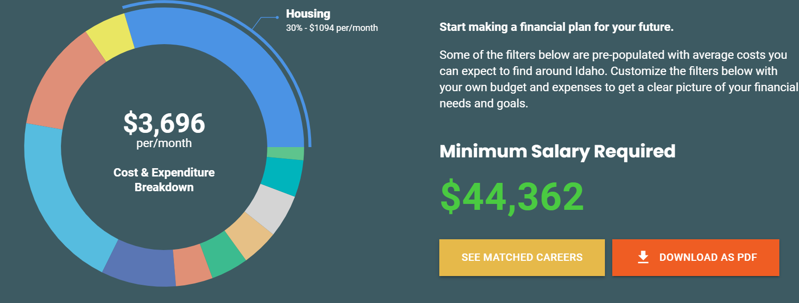

PLAN SMART TOOL
GO TO: https://nextsteps.idaho.gov/plan-smart/intro
Choose your town and how you would describe our lifestyle, in terms of how much you spend OR skip and explore the tool.
Adjust the filter to fit you.
  Use the ? to help understand each filter.
Once you have adjust the filters, go back up to the top and select the “See Matched Careers”.
Use the Career Cluster Filter on the left side to narrow career results based on your interests.
Select a career and click the yellow plus sign to see the education and training required.
Notes:
Activity: Plan Smart Tool: Someday you will be living on your own. Now is a good time to think about what that means. How much money do you need to buy the things that you want – like a house, a car, or concert tickets?
Give students the Handout_Plan Smart to complete as they are exploring the Plan Smart Tool. If students want to try a second scenario, there is space to see what happens if they adjust their expenses.
Do you know what it’s going to take to live your ideal lifestyle? Take the Plan Smart assessment to find out! You can choose your town and how you would describe your life, in terms of how much you spend or skip and explore the tool. Scroll down and you can adjust the filters to fit your own future. Use the ? to help understand the different sections. Once you have adjusted the filters, go back up to the top and select the “See Matched Careers” below the Minimum Salary Required.
Use the Career Cluster Filter on the left side of the screen to narrow the results based on your interests. Select a career and click the yellow plus sign to see the education and training required.

Slide 7
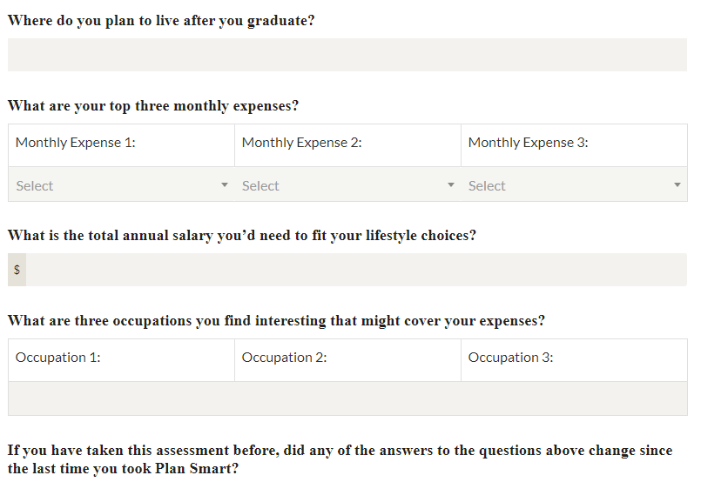
REFLECT ON YOUR SOMEDAY
Notes:
Closing: Finding career matches involves thinking and dreaming about what you would like your life to be like one day. Knowing what to expect can set you on the best path to attaining your career and lifestyle dreams. Continue to explore how you would like your lifestyle to be and explore education and career options that can make that dream a reality!

