Slide 1

PLAN SMART INTRO
Date here
DESIGN YOUR OWN FUTURE
Notes:
Career Activity: Plan Smart Intro
Activity Summary: This lesson will guide students through the Plan Smart tool. Students will compare different lifestyle choices and matching careers to meet the lifestyle.
Estimated Time: 45-60 minutes
Learning Plan Activity: 8th Grade* Additional Activities: 9th
*After Career Clusters Interest Survey
Learning Outcomes: Students will be introduced to lifestyle vocabulary and choose what lifestyle fits their personal desires. Students will compare careers within varying levels of education and understand how the level of education may impact their chosen lifestyle.
Materials Needed: Powerpoint, Handout, Pen, Computer

Slide 2
“YOUR SUCCESS AND HAPPINESS LIES IN YOU.”
HELEN KELLER
Notes:
Academic Vocabulary
Lifestyle: describes how much money you want to spend on clothing, entertainment, food/dining, personal care, transportations, and savings.
Salary: money you get from your employer for doing your job

Slide 3

LIFESTYLE GOALS
IN THE PLAN SMART TOOL, LIFESTYLE IS DIVIDED INTO THREE CATEGORIES:
$ Minimum
$$ Average
$$$ Maximum
Using the Plan Smart Tool, you will go through a scenario for one lifestyle and make some of your own selections along the way.
Go to the Next Steps website Plan Smart Tool:
https://nextsteps.idaho.gov/plan-smart/intro
Notes:
Introduction: [Use powerpoint] One great thing about living on your own is you get to make A LOT of choices. Some people like to go on vacations, buy clothes, and have the latest technology. Other people only need a few things to be happy. In this lesson we are going to get an overview of all the choices you get to make when you live on your own and then see how much money you will need to make in order to have the lifestyle that you would enjoy.

Slide 4
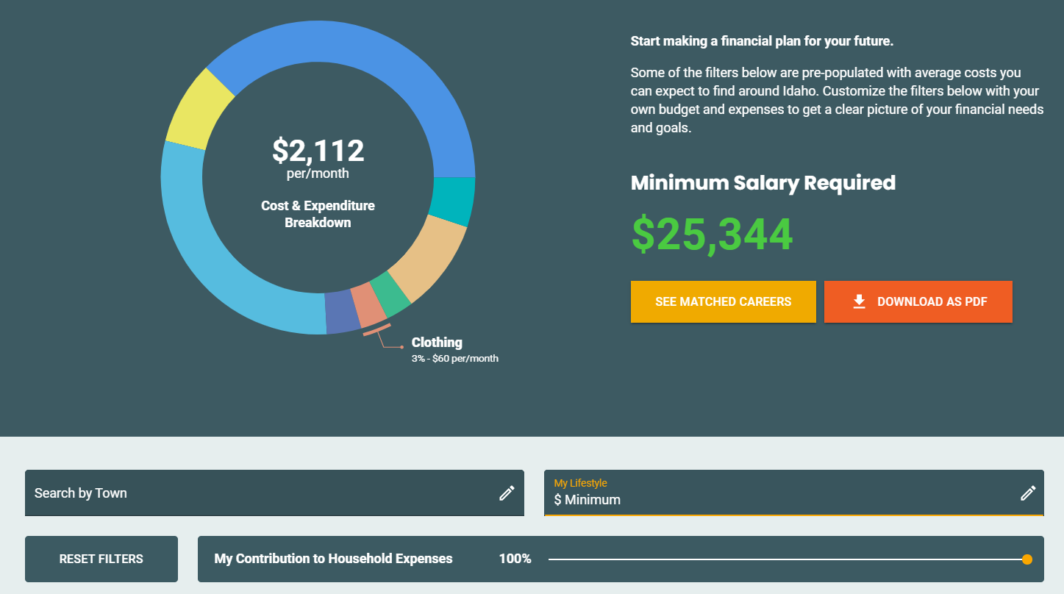
CHOICE #1:
THE MINIMUM LIFESTYLE
Notice the minimum salary for this lifestyle
Edit My Lifestyle to show
$ Minimum
Select any Idaho town or leave this blank
If you want to live alone, leave your contribution at 100%. If you want to have a roommate, you can split household expenses in half so move the slider to 50%
Notes:
Activity: Plan Smart: Have all students log into the Next Steps Plan Smart Tool: https://nextsteps.idaho.gov/plan-smart/intro. Use the slides to walk through all of the choices students can make in the Next Steps Plan Smart Tool.
Someday you will be living on your own. Now is a good time to think about what that means. Planning your future is a lifelong journey that requires many decisions along the way. How much money do you need to buy the things that you want – like a house, a car, or concert tickets?
Do you know what it’s going to take to live your ideal lifestyle? Take the Plan Smart assessment to find out! The following slides will show you how to use this tool to make financial (money) decisions.
As students finish up, give them the Handout_Plan Smart Intro to answer the questions. If time allows, they can try the Plan Smart Tool again with a Scenario 2 and see what they find!

Slide 5
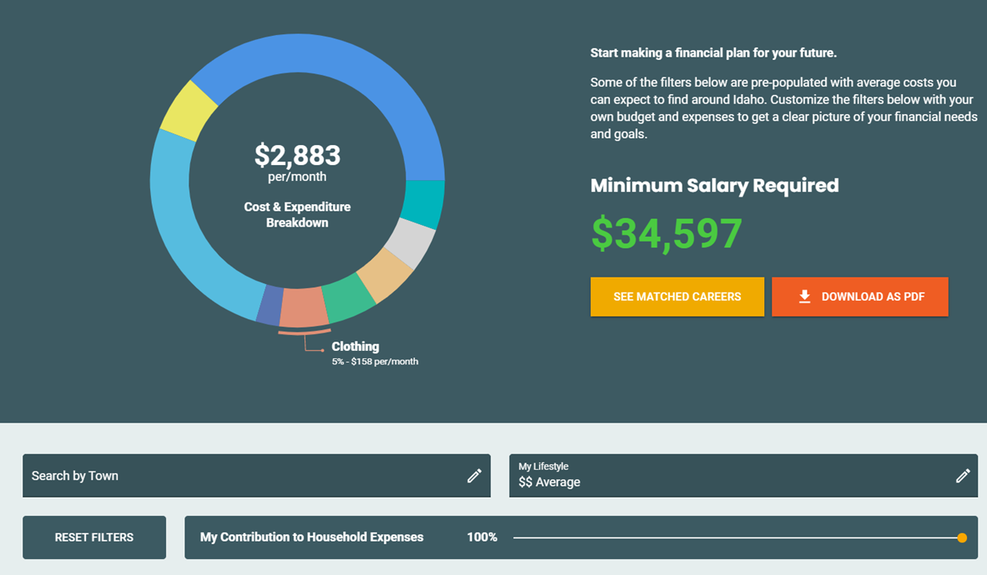
CHOICE #2:
THE MINIMUM LIFESTYLE
Notice the minimum salary for the average lifestyle
Edit My Lifestyle to show $$ Average
Select any Idaho town or leave this blank
If you want to live alone, leave your contribution at 100%. If you want to have a roommate, you can split household expenses in half so move the slider to 50%

Slide 6
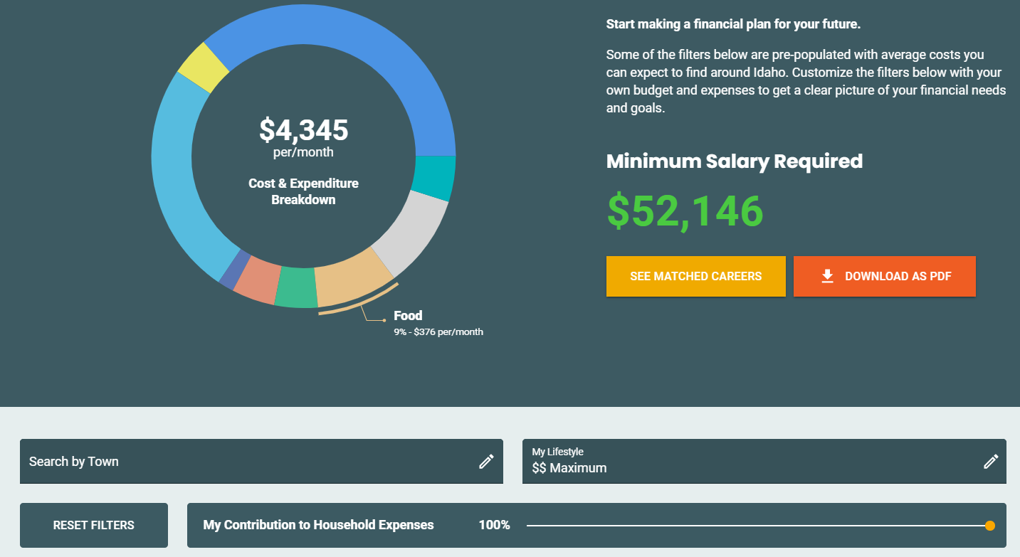
CHOICE #3:
THE MINIMUM LIFESTYLE
Notice the minimum salary for the maximum lifestyle
Edit My Lifestyle to show $$$ Maximum
You can select any Idaho town or leave this blank
If you want to live alone, leave your contribution at 100%. If you want to have a roommate, you can split household expenses in half so move the slider to 50%

Slide 7
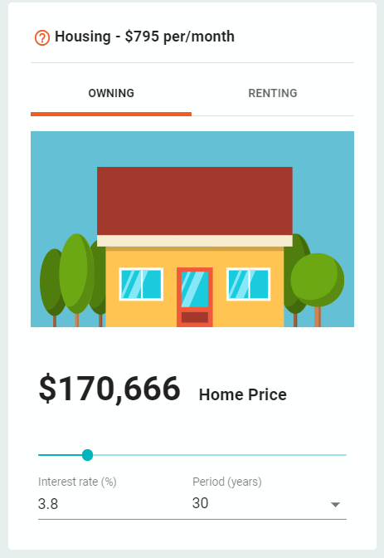
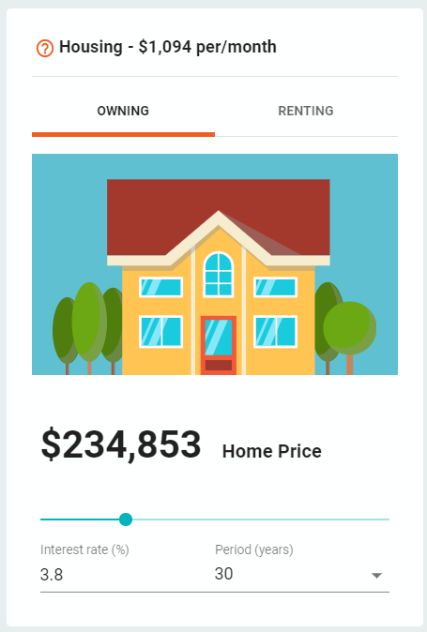
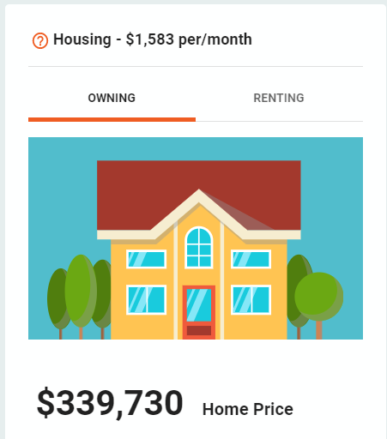
HOUSING
One of the biggest monthly costs for most people is housing. You may choose to rent an apartment or house, buy a home, or live with roommates.
If you selected minimum lifestyle,
you pay a smaller amount to rent or own.
If you selected
average lifestyle,
you pay an average amount to rent or own.
If you selected maximum lifestyle,
you pay the most to rent or own.
Select owning or renting. Renting costs less for all lifestyles

Slide 8
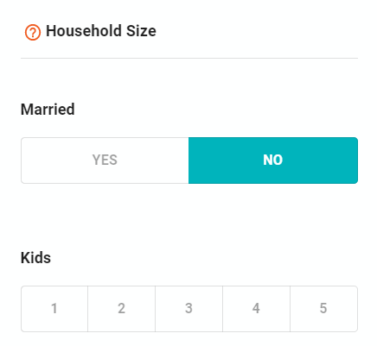
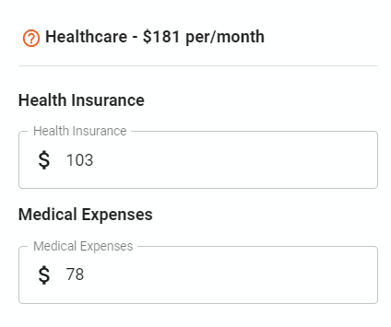
Household size and Healthcare are categories that can be adjusted, but for this scenario, they will not be changed.
HOUSEHOLD SIZE
HEALTHCARE
Household size includes the number of people for whom you are financially responsible.
At some point in your life, you will need to see a doctor, dentist or optician.

Slide 9
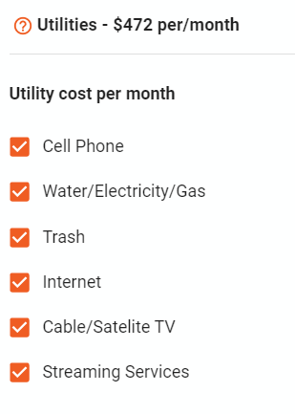
UTILITIES
Select which utilities you would like to have. The first three are basic. The final three can be choices for any level of lifestyle.
Utilities go hand-in-hand with housing. Basic utilities to get your house or apartment up and running typically include water, trash, electricity and gas. Other utilities you might want to consider including in your monthly budget are internet, cable/satellite TV, streaming services (TV and/or music), video game subscriptions as well as a cell phone plan.

Slide 10
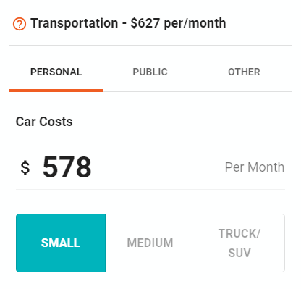
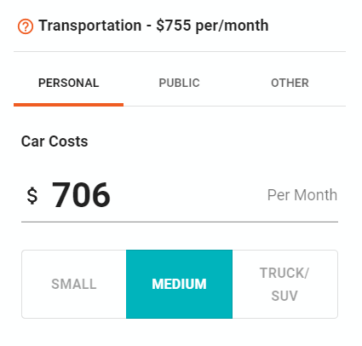
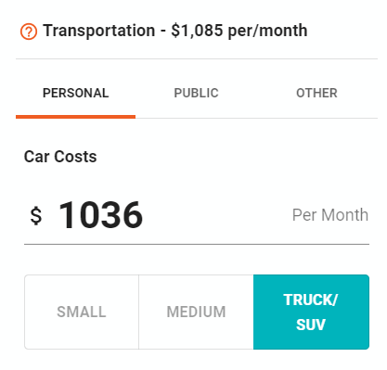
TRANSPORTATION
To own your own car or truck you must have enough set aside for monthly payments, gas, insurance and maintenance. Fares for public transportation can vary depending on the number of trips you plan on taking each month and the options available in the town or city where you live.
If you selected minimum lifestyle, you pay a smaller amount.
If you selected
average lifestyle, you pay
an average amount.
If you selected maximum lifestyle,
you pay the most.

Slide 11
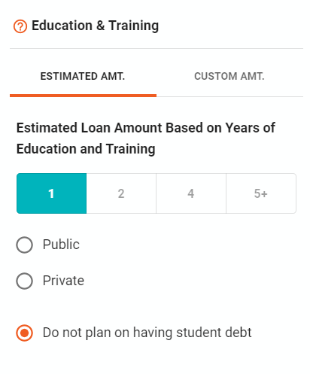
EDUCATION & TRAINING
Reaching your educational and professional goals may mean you need to take out a loan to help cover the costs of tuition, training, books or supplies, and housing while you are in school.
For this this scenario, the cost of education will not be included.

Slide 12
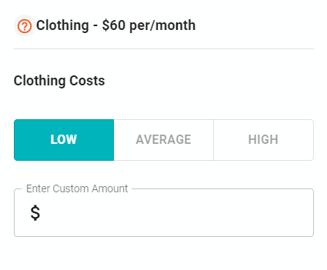
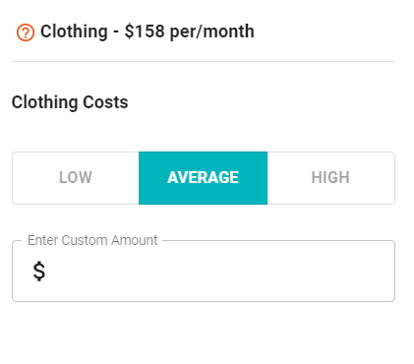
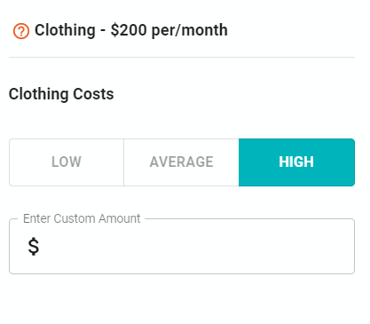
CLOTHING
We all need clothing for daily life, but some occupations require a professional wardrobe. How much do you want to spend on clothes?
Minimum Lifestyle
Average Lifestyle
Maximum Lifestyle

Slide 13
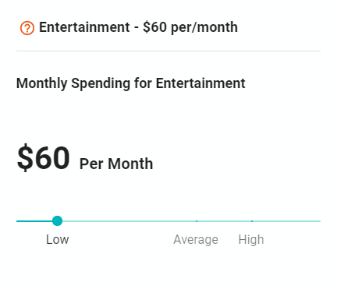
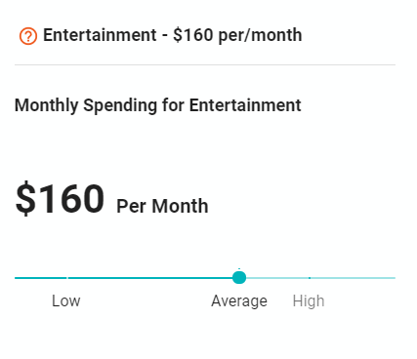
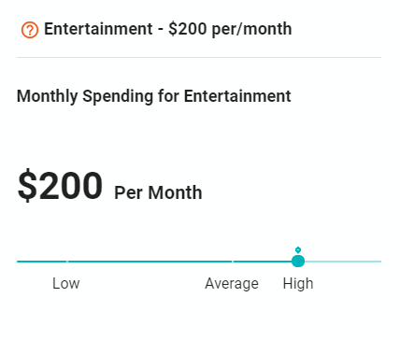
ENTERTAINMENT
THINK ABOUT WHAT YOU LIKE TO DO IN YOUR FREE TIME. DO YOU ENJOY...
Streaming movies or playing video games at home
Going to movies and eating popcorn and candy
Visiting amusement parks
Hiking, camping, or backpacking
Playing tennis, gold, ultimate frisbee, billiards, or other games
Attending live sporting events, concerts, plays, or music festivals?
Minimum Lifestyle
Average Lifestyle
Maximum Lifestyle

Slide 14
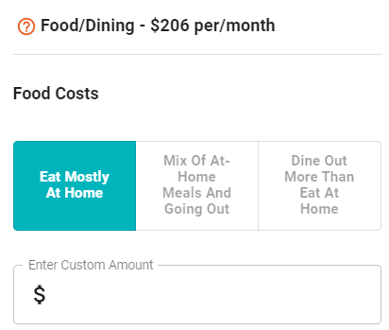
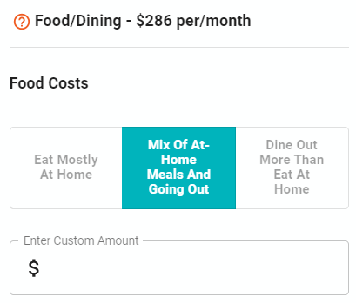
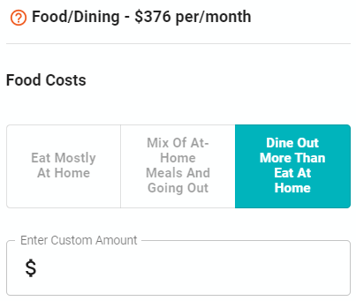
FOOD & DINING
Trips to the grocery store, takeout or fast food, and restaurant trips can cost a lot of money. That is why having a plan on how often you’re going to cook at home, grab fast food, or eat at a restaurant is an important decision to make when planning how to spend your money.
Minimum Lifestyle
Average Lifestyle
Maximum Lifestyle

Slide 15
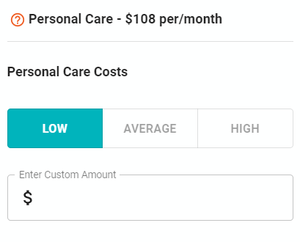
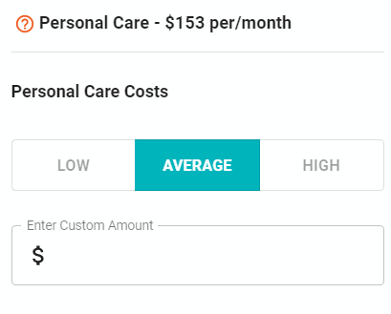
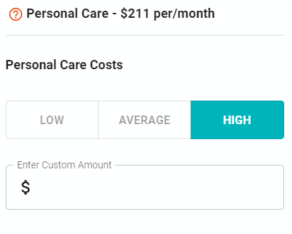
PERSONAL CARE
Personal care expenses include anything you need (or would like) to take care of yourself, such as:
Personal hygiene: soap, shampoo, toothpaste, deodorant, makeup.
Health and fitness: gym membership, activity tracker, yoga class and/or fitness clothes and shoes.
Professional services: haircuts, manicures/pedicures, massages, and spa treatments.
Minimum Lifestyle
Average Lifestyle
Maximum Lifestyle

Slide 16
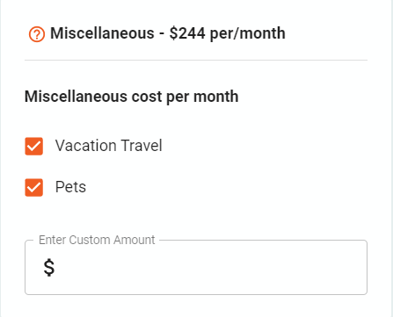
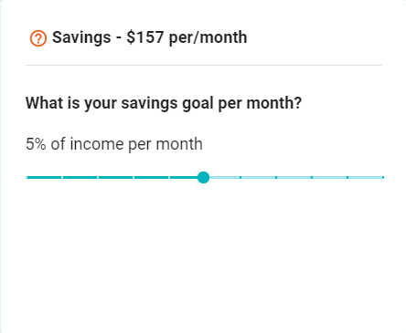
Miscellaneous and Savings are categories that can be adjusted, so you can select what fits you best.
MISCELLANEOUS
SAVINGS
Miscellaneous expenses are items that don’t fit into any other category. Some examples are pet care, travel, and furniture.
Any money you set aside for a specific goal or to help cover unexpected expenses is considered savings.

Slide 17

SEE MATCHED CAREERS
Now that you have reviewed all the lifestyle categories, you can discover what careers would allow you to have the lifestyle you would enjoy! Select the See Matched Careers button at the top of the web page.

Slide 18
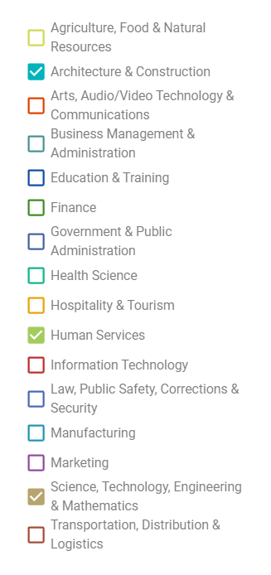
SELECT YOUR TOP THREE CAREER CLUSTERS

Slide 19
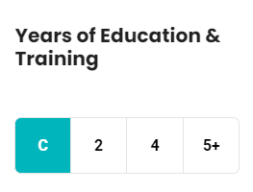
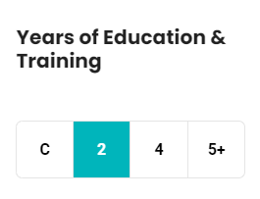
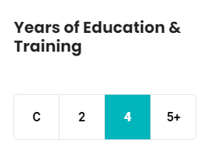
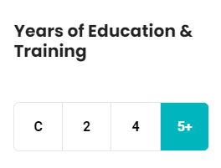
SORT BY EDUCATION
Some careers require a few months of training or education. Other careers require at least 5+ years of training and education.
These jobs require less than 2 years of training. These careers may require a specialized certificate.
These jobs require at least 2 years of education. These careers may require an Associate’s Degree.
These jobs require at least 4 years of education. These career may require a
Bachelor’s Degree.
These jobs require more than 5 years of education. These careers may require a Master’s Degree or Doctoral Degree.

Slide 20
CAREER CLUSTER + LIFESTYLE + YEARS OF EDUCATION = A CAREER MATCH!
Career Cluster
CAREERMATCH
Lifestyle
Years of
Education

