Slide 1

PAYING FOR COLLEGE
Date here
PLANNING AHEAD
Notes:
Career Activity: Plan Ahead: Paying for College
Activity Summary: This lesson will help students understand how to look ahead and make decisions now that will help them pay for college.
Estimated Time: 45-60 minutes
Learning Plan Activity: 9th Grade
Learning Outcomes: Students will learn about the local and national resources available to them to help offset the cost of college. They will also learn about the importance of getting involved in extracurricular activities and/or volunteer service and how that connects to scholarships. In addition, students will learn the advantages of using Fast Forward funding for advanced opportunities.
Materials Needed: Powerpoint, Handout, Pen, Paper

Slide 2
“DO SOMETHING TODAY THAT YOUR FUTURE SELF WILL THANK YOU FOR.”
SEAN PATRICK FLANERY
Notes:
Academic Vocabulary
Advanced Opportunities: An Idaho program that allows students to get a jump start on their futures by paying for concurrent credit, AP, CTE, and CLEP exams.
Resume: A document that lists your education, work experience, accomplishments, skills, and future goals.
ROTC: Reserved Officer Training Program. Assists students with the cost of college in exchange for military service after graduation.
Scholarship database: A service that matches student’s profiles with a database of scholarships.
Spam emails: Unwanted junk email.
IDEAL 529: Idaho’s college savings program designed to help families set aside money for college

Slide 3

YOUR FUTURE
ON A SHEET OF PAPER, ANSWER THE FOLLOWING QUESTIONS:
What future career are you interested in?
What will you have to do to become this?
What are you most excited about when thinking about your future high school?
What are you most unsure or nervous about when thinking about your future after high school?
Create a list of at least three things that you can do, right now, to prepare for your future.
Notes:
Introduction: [Use powerpoint] Today we will explore some ideas to help you pay for college. I will share resources, ideas, and tips for you to consider. (Share stories about students using scholarships to pay for college, or job earnings, or ROTC scholarship, etc.)
Activity: “Your future” Brainstorm: Give students time to answer the questions. Ask for volunteers to share from each question.

Slide 4

TIPS AND IDEAS
GET A JUMPSTART ON PAYING FOR COLLEGE
#1 - Get involved
#2 - Get a job
#3 - Use a Scholarship database
#4 - Take advantage of Advanced Opportunities
Notes:
Tips & Ideas: Give each student a copy of the Handout_Paying for College. Explain handout and review the content via the Powerpoint. Suggest students make notes on the handout.
#1 – Get involved : Many scholarships require extracurricular activities and leadership experience. Get involved NOW.
#2 – Get a job: Open a savings account and start saving NOW.
#3 – Use a Scholarship Database: Find scholarships you are eligible for NOW.
#4 – Take advantage of Advanced Opportunities: These opportunities start NOW.

Slide 5

IDEA # 1 -
GET INVOLVED
9 REASONS FOR GETTING INVOLVED
Discover new possibilities
Ease transitions
Relieve boredom
Relieve academic pressure
Increase academic performance
Build important skills
Make connections
Improve college applications
Find others with similar interests
Notes:
Idea # 1 - Get Involved: Education Next reports being involved in activities outside the classroom may play a role in improving grades and standardized test scores. If college is the next step after high school, a record of involvement over several years can demonstrate a continued interest in a particular cause, activity or event. Colleges and universities appreciate seeing applicants who demonstrate that they are successful outside the classroom and will become active members of their academic communities.
HOW CAN I GET INVOLVED?
Join a club: Apply for a leadership position within the club your junior and/or senior year
Join a sport: School teams, club teams, or community teams.
Volunteer: Examples: American Red Cross, Zoo, Boy & Girls Clubs/Daycares, Food Pantry, Hospital, Senior Center

Slide 6

IDEA #2 -
GET A JOB
GET A JUMPSTART ON PAYING FOR COLLEGE
Check the jobs board in the Career Center
Look for jobs on the Idaho Department of Labor website
Create/update your resume
Use an employment website
    Example: Indeed.com
Notes:
Idea #2 - Get a Job: Use your network of family and friends to get a part time job to start saving your own money for college.

Slide 7

IDEA #3 -
SCHOLARSHIP DATABASES
GET A JUMPSTART ON PAYING FOR COLLEGE
Can match your interests and accomplishments with national/local scholarships
Ask your parents for help
Most databases offer the same service, so find one and stick to it.
Notes:
Idea # 3 - Use a Scholarship Database: Your parents will know things you may not know: military service, tribal affiliation, Rotary or Kiwanis memberships, etc.
Database ideas: BigFuture by the College Board, Cappex, Fastweb, Scholly, or the Next Steps website

Slide 8
IDEA #4 -
ADVANCED OPPORTUNITIES
UTILIZE HIGH SCHOOL TO KNOCK OUT COLLEGE COURSES
Take honors courses your 9th/10th grade years to prepare you for AP and/or dual credit courses
Explore the AP and dual credit options at your school
Use your $4,125 in Fast Forward funding to pay for AP exams and Dual Credit Courses
Notes:
Idea # 4 - Take advantage of Advanced Opportunities: Check our Next Steps Overload and Dual Credit Courses - What are they? Learning Plan Activity to gain more knowledge about Idaho’s advanced opportunities programs. You can also go to the Idaho State Department of Education and look at the Advanced Opportunities that are available to you.

Slide 9

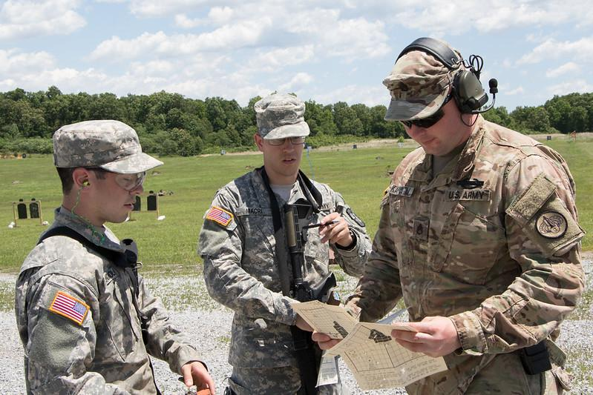
BONUS IDEAS
IDEAL IDAHO COLLEGE SAVINGS PROGRAM
Talk to your parents/grandparents about the Idaho 529 Saving Plan
CHECK OUT ROTC SCHOLARSHIPS
Many Idaho institutions offer ROTC programs.
ROTC scholarships can be competitive, so plan ahead and take rigorous courses.
Notes:
Bonus Ideas: Ideal 529 - is Idaho’s college savings program designed to help families set aside money for college.
ROTC - is a Reserved Officer Training Program. It can assist students with the cost of college in exchange for military service after graduation.

Slide 10

KAHOOT REVIEW
Students go to:
https://kahoot.it/
Enter the game pin provided by your teacher!
Notes:
Teacher Link to the Kahoot Game: https://create.kahoot.it/share/planning-ahead/de7e640b-b96e-4f8f-9ab2-3b5123331a55
Click “Play” and then choose a way to play. “Teach” will allow all students to play together synchronously. Change game options if needed, if 1:1 devices choose “Classic”, if shared devices choose “Team Mode”. Share the unique game pin with the students so they can join.
Closing: Know that I am a resource for you if you have any further questions in the future about planning ahead to pay for college. Reach out, If you want to explore more about jobs or volunteer options in the community or if you would like to know more about the Advanced Opportunities program in Idaho and how to utilize that money to pay for advanced courses in High School. It is common to feel unsure about your future. Remember to start exploring options and planning ahead!

