Slide 1

LOOKING AT SCHOOLS
Date here
WHAT SCHOOL MATCHES YOUR MAJOR CHOICE?
Notes:
Career Activity: Looking at Schools
Activity Summary: This lesson will help students with looking at and choosing a school based on their career and major choices.
Estimated Time: 45-60 minutes
Learning Plan Activity: 11th Grade (To be completed after Looking at Careers and Looking at Majors)
Learning Outcomes: Students will use their top 3 majors found based on their interests for careers to find more information about schools that offer it.
Materials Needed: Powerpoint, Handout, Pen, Computer

Slide 2
“MAKE EDUCATION A CONTINUING, NEVER-ENDING PROCESS.”
NIDO R. QUBEIN
Notes:
Academic Vocabulary
College: Colleges are often smaller institutions that emphasize undergraduate education in a broad range of academic areas.
University: Universities are typically larger institutions that offer a variety of both undergraduate and graduate degree programs
Certification Program: A certification program is a defined set of components or training programs offered by your organization to members to prove that they have achieved a measured level of knowledge within a designated timeline.
Apprenticeship: An apprenticeship is a system for training a new generation of practitioners of a trade or profession with on-the-job training and often some accompanying study. Apprenticeships can also enable practitioners to gain a license to practice in a regulated profession.
Public School: A public school is a college or university primarily funded by a state government.
Private School: A private school is a college or university that often operates as an educational nonprofit organization. It does not receive its primary funding from a state government.
Proprietary School: Proprietary colleges are for-profit colleges and universities. They are operated by their owners or investors, rather than a not-for-profit institution.

Slide 3
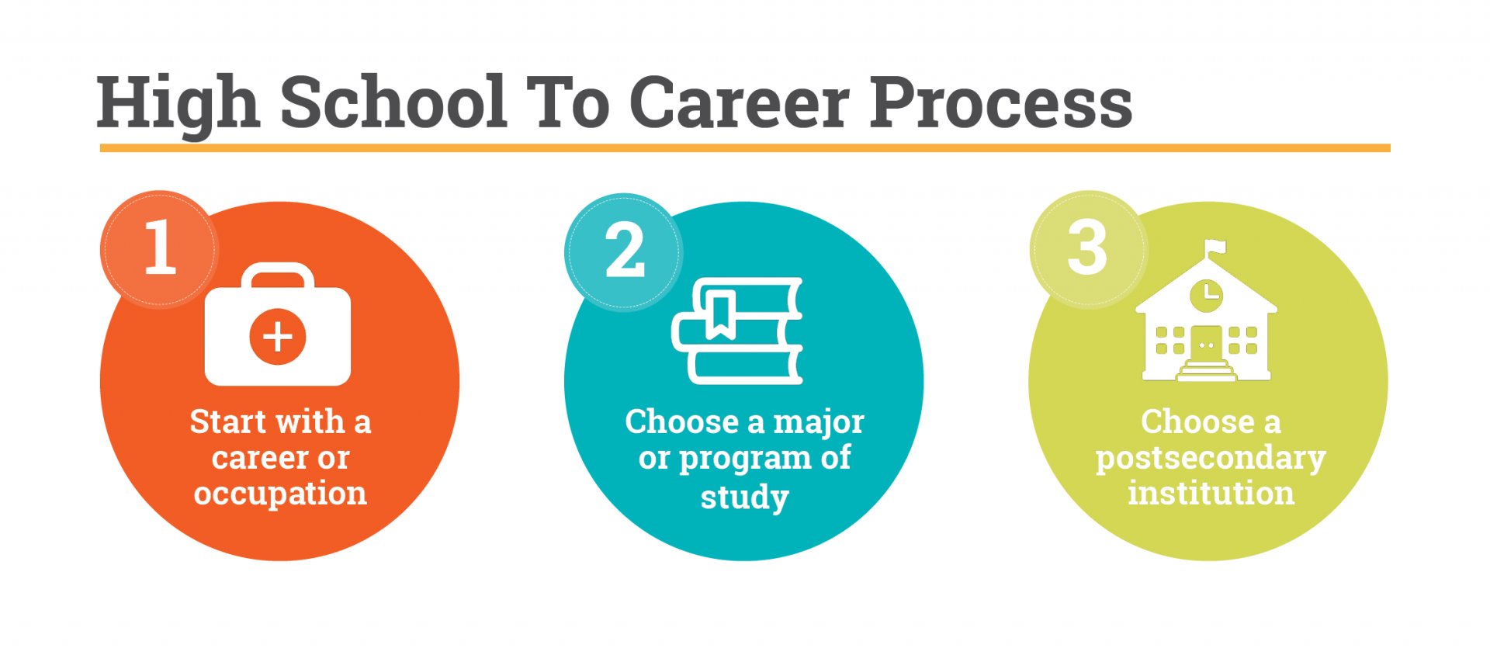
THE HIGH SCHOOL TO CAREER PROCESS
STEP 3: CHOOSE A POSTSECONDARY INSTITUTION
What is your current major choice to pursue after high school?
Use your major choice to help you explore and choose a school
Notes:
Introduction: [Use powerpoint] Success starts with taking a step. The path to education and/or career after high school is not always a straight one. A traditional 4-year college is not for everyone, and not all careers require a 4-year degree. Consider looking at your plan from a different perspective. Instead of thinking of education as the first step necessary – think about your goal or the career you might want to pursue and work backwards to find out what education and training opportunities exist. You might be surprised at what you find. Now that you have found a major or program of study that would lead to your desired career based on your interests, it is time to choose a college, university, certification program, apprenticeship, etc. Not all colleges and universities have the degree or program that you are wanting to pursue. Explore the programs and schools that best fit your goals.

Slide 4

EXPLORE SCHOOLS
AS YOU SEARCH, TAKE INTO CONSIDERATION
Does the school offer the major you’re interested in pursuing?
Do you want to study in Idaho or look for new opportunities out of state?
Does the cost of attendance fit your budget?
Notes:
Explore Schools: Another step in developing your plan for life after high school is to find a school or training center that will best support your career and life aspirations. There are many things to consider when identifying the best fit for you.
Does the school offer the major you’re interested in pursuing?
Do you want to study in Idaho or look for new opportunities out of state?
Does the cost of attendance fit your budget?

Slide 5
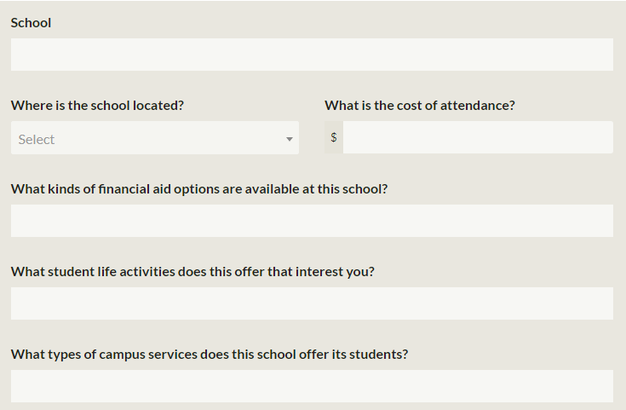
LOOKING AT SCHOOLS ACTIVITY
EXPLORE THE SCHOOLS
Go to Big Future College Search
  https://bigfuture.collegeboard.org/college-search
Use the filter features to search by major or location
COMPLETE THE ACTIVITY
Once you get find three schools that matches your desired major, answer the questions about each school
Notes:
Looking at Schools Activity: Use the filter features on Big Future’s College Search to help you discover schools nationally that are right for you. Start with selecting the filters ‘Majors & Learning Environment’ to see which school offers the major you are searching for.
[ https://bigfuture.collegeboard.org/college-search ]
If you would prefer to look at schools only in Idaho or in the Pacific Northwest, you can use the ‘Location” filter. Or you can browse degrees and programs from specific Idaho public, private, and proprietary schools. [ https://careerinfo.nextsteps.idaho.gov/resource-category/future-you/education/ ]
Or for more search options, try Peterson’s College Search Tool [ https://www.petersons.com/college-search.aspx ].

Slide 6
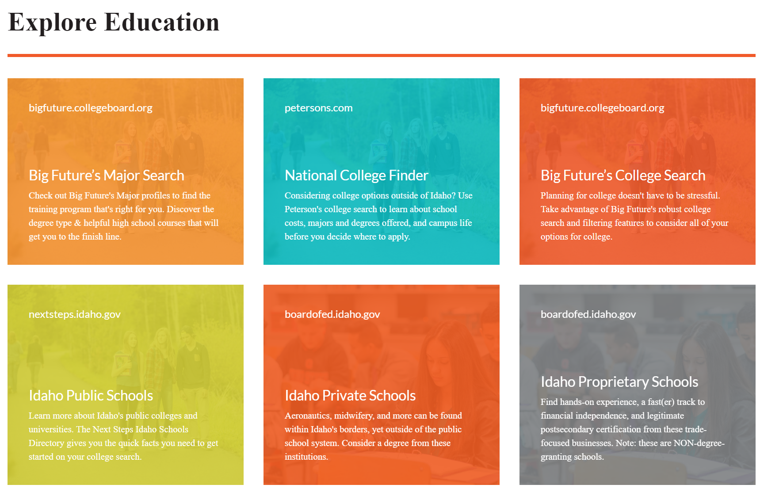
ADDITIONAL SEARCH RESOURCES
Notes:
Want to explore more? Explore education by going here: https://careerinfo.nextsteps.idaho.gov/resource-category/future-you/education/
Closing: You have now looked at schools that match the majors from your selected careers. As your interests change, keep in mind how you can continue to search for what is a best fit for you and your future.

