Slide 1

LOOKING AT MAJORS
Date here
WHAT MAJOR MATCHES YOUR CAREER CHOICE?
Notes:
Career Activity: Looking at Majors
Activity Summary: This lesson will help students with looking at and choosing a major based on their career interest areas.
Estimated Time: 45-60 minutes
Learning Plan Activity: 11th Grade (To be completed after ‘Looking at Careers’)
Learning Outcomes: Students will use their top 3 careers from “Looking at Careers” to continue to dig deeper into the high school to career process by finding out the education experience needed for their chosen careers.
Materials Needed: Powerpoint, Handout, Pen, Computer

Slide 2
“YOU DON’T HAVE TO HAVE IT ALL FIGURED OUT TO MOVE FORWARD.”
UNKNOWN
Notes:
Academic Vocabulary
Major: A focus of study in college that requires specific classes and credits to earn a degree
Minor: a way to specialize in a certain field without all of the work of a major to explore another area of interest
Associate’s Degree: a two-year undergraduate degree
Bachelor’s Degree: a four-year undergraduate degree
Undergraduate: a student at a college or university who has not yet earned a degree
Postgraduate: a student who has successfully completed an undergraduate degree level course at a college or university and is continuing to study at a more advanced level
Difference between a major and a degree: A major is the specific program of study and the degree is a general term used for college education

Slide 3
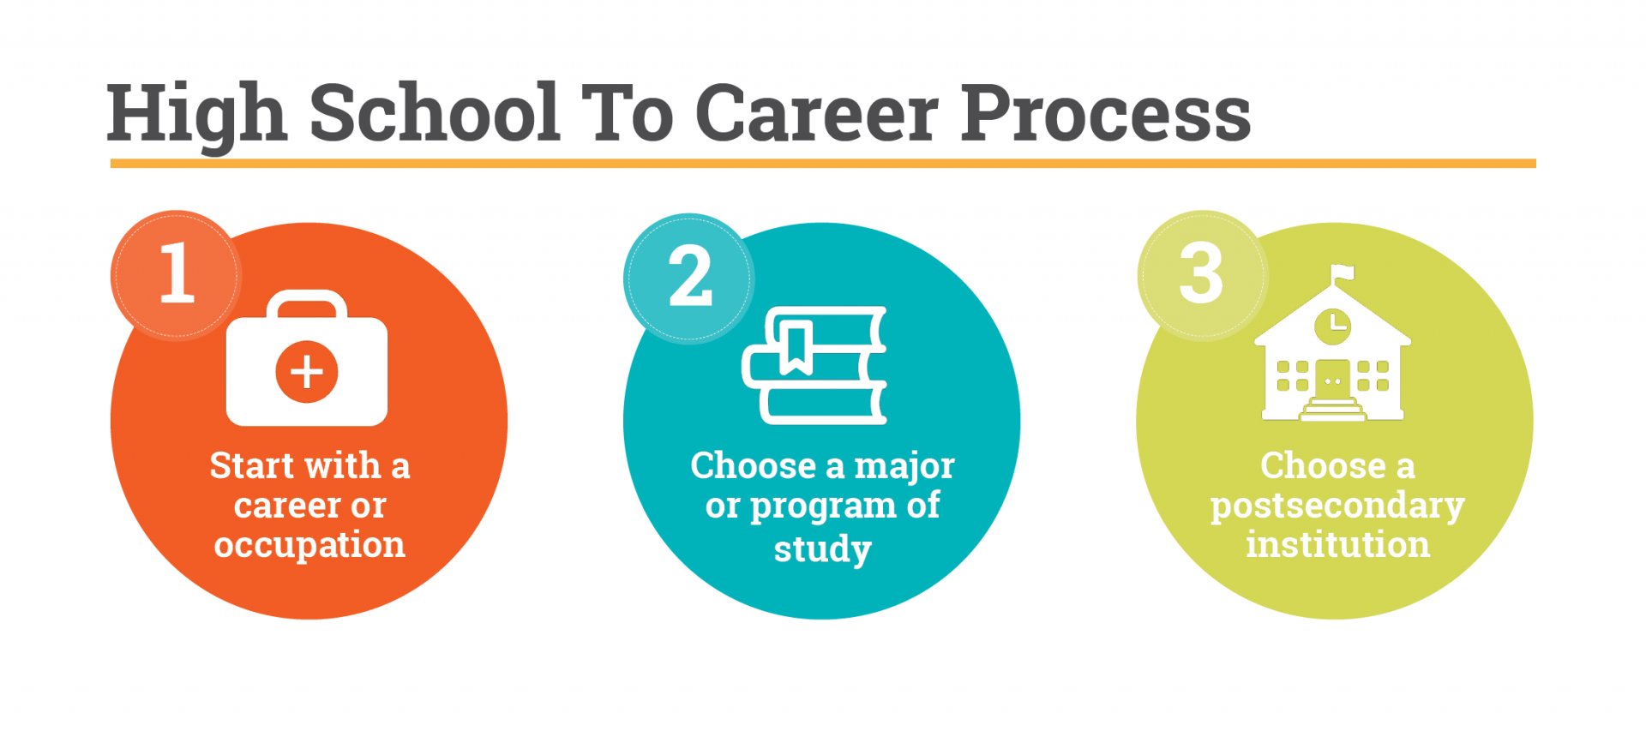
THE HIGH SCHOOL TO CAREER PROCESS
STEP 2: CHOOSE A MAJOR OR PROGRAM OF STUDY
What is your current choice for a career after you graduate high school?
Use your career choice to help you explore and choose a major
Notes:
Introduction: [Use powerpoint] Success starts with taking a step. The path to education and/or career after high school is not always a straight one. A traditional 4-year college is not for everyone, and not all careers require a 4-year degree. Consider looking at your plan from a different perspective. Instead of thinking of education as the first step necessary – think about your goal or the career you might want to pursue and work backwards to find out what education and training opportunities exist. You might be surprised at what you find. Now that you have found 3 careers that match your interest and skills.
Choose a major or program of study. Determine what programs of studies/majors lead to your desired career. Keep in mind that there is not always one correct answer.

Slide 4
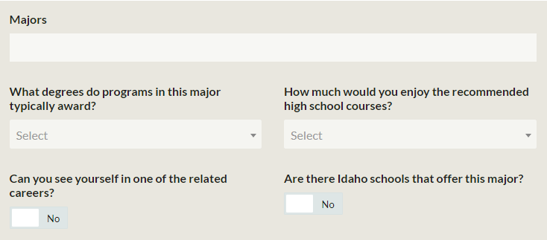
EXPLORE MAJORS ACTIVITY
EXPLORE THE MAJORS
Go to https://bigfuture.collegeboard.org/majors-careers
Use the dropdown options on the ‘MAJOR CATEGORIES’ and ‘CAREER CATEGORIES’
Use the tools on the right to search by keyword or interest
COMPLETE THE ACTIVITY
Once you get find the major that matches the career, answer the questions about each major
Notes:
Explore Majors: It’s time to get serious about what you want to study after high school and how these plans will help you realize your vision for your future. Remember majors and programs of study are specific areas that students specialize in after high school. They can be as short as 3-6 months or as long as six years. Once you complete the requirements of a major or program of study, you’re typically awarded a certificate or a degree.
Looking at Majors Activity: One way to start narrowing down potential majors is to identify the careers you think you’re most interested in and then look for majors that would provide you with the skills and training to reach that goal. Now that you have a career in mind, spend some time exploring majors at Big Future from the College Board. [ https://bigfuture.collegeboard.org/majors-careers ]
Closing: You now are aware of some of the careers and the salary, education, and related careers. As you continue in your education, continue to think of ways that you can build your knowledge to help you on your path to that career. You may change interests OR you may want to dig deeper so continue to explore your own

