Slide 1

LOOKING AT CAREERS
Date here
WHAT CAREER MATCHES YOUR INTERESTS?
Notes:
Career Activity: Looking at Careers
Activity Summary: This lesson will help students with looking at and choosing careers based on their career interest areas.
Estimated Time: 45-60 minutes
Learning Plan Activity: 11th Grade Additional Activities: 10
Learning Outcomes: Choose a career that matches your interests and skills. Students will examine their career interest areas to find suggested careers that match their interests. Students will explore different careers and choose three that seem satisfying and rewarding to explore.
Materials Needed: Powerpoint, Handout, Pen, Computer

Slide 2
“A CAREER CHOICE IS AN EXPRESSION OF PERSONALITY.”
DR. JOHN HOLLAND
Notes:
Academic Vocabulary
Realistic: The “Doers”
Investigative: The “Thinkers”
Artistic: The “Creators”
Social: The “Helpers”
Enterprising: The “Persuaders”
Conventional: The “Organizers”

Slide 3
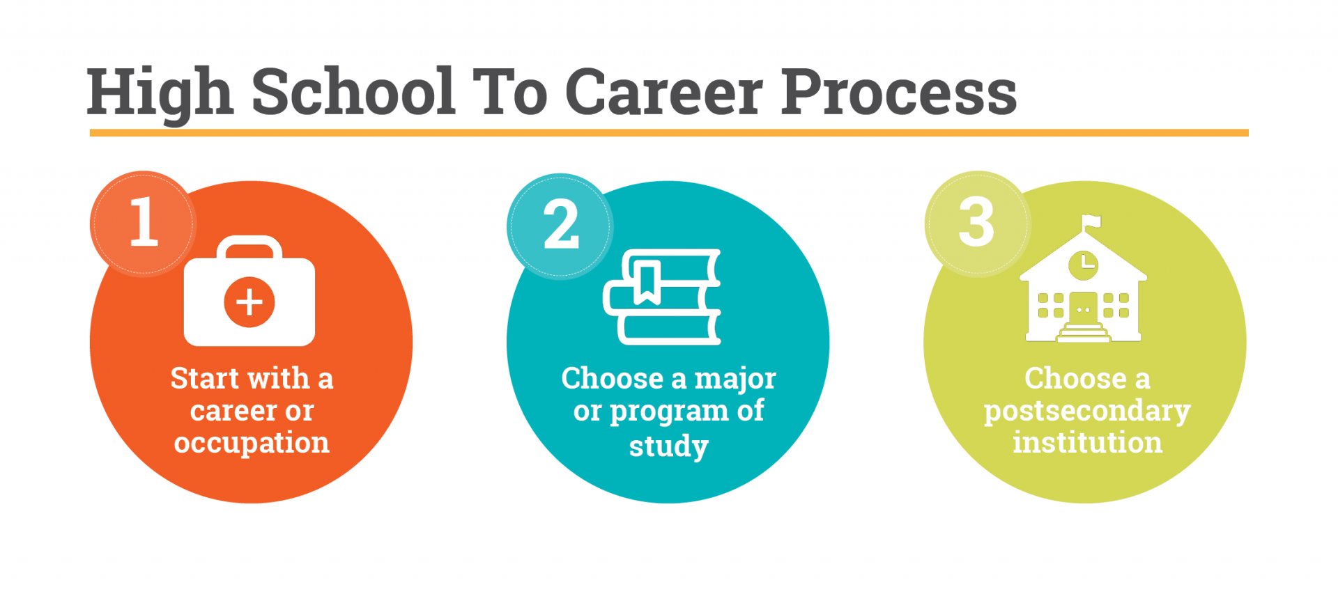
THE HIGH SCHOOL TO CAREER PROCESS
STEP 1: START WITH A CAREER OR OCCUPATION
What is your goal or a career that you might want to pursue?
Use your interests to help you explore and choose a career
Notes:
Introduction: [Use powerpoint] Success starts with taking a step. The path to education and/or career after high school is not always a straight one. A traditional 4-year college is not for everyone, and not all careers require a 4-year degree. Consider looking at your plan from a different perspective. Instead of thinking of education as the first step necessary – think about your goal or the career you might want to pursue and work backwards to find out what education and training opportunities exist. You might be surprised at what you find. Start with a career. Choose a career that matches your interests and skills.

Slide 4
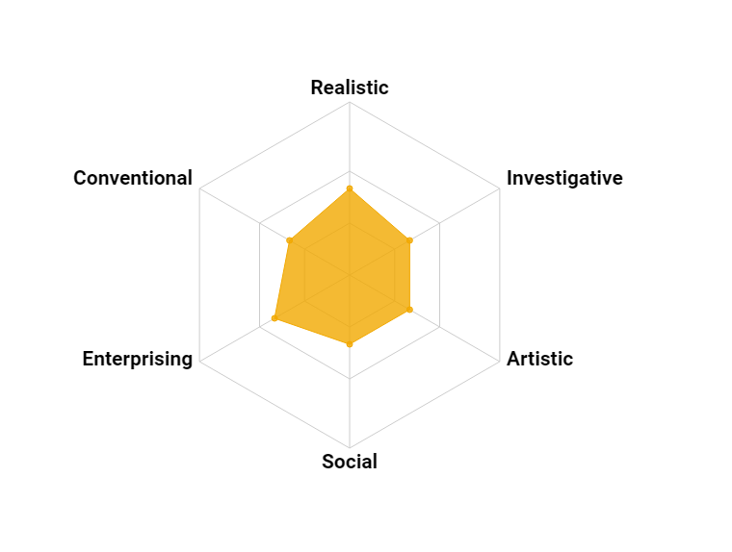
CAREER INTEREST AREAS
Realistic: The “Doers”
Investigative: The “Thinkers”
Artistic: The “Creators”
Social: The “Helpers”
Enterprising: The “Persuaders”
Conventional: The “Organizers”
Notes:
Interest Profiler: The interest profile activity uses Holland codes or career interest areas, which are a set of personality types developed by psychologist John L. Holland in the 1970s. There are six personality types in Holland’s Model: Realistic, Investigative, Artistic, Social, Enterprising, and Conventional. Dr. Holland reasoned that people work best in work environments that match their preferences. Most people are some combination of two or three of the Holland interest areas.

Slide 5
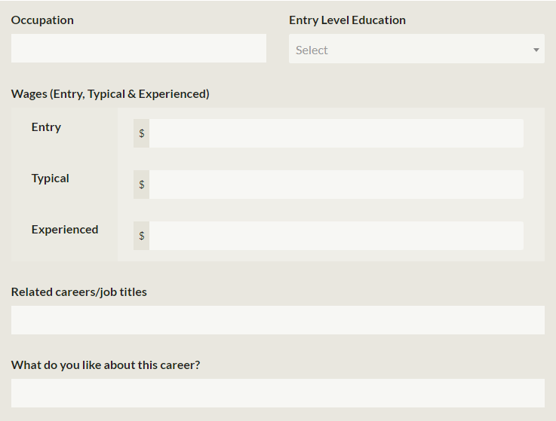
INTEREST PROFILER ACTIVITY
TAKE THE QUIZ
Go to https://nextsteps.idaho.gov/interest-profiler
Begin the quiz
Use the results to help you explore careers
COMPLETE THE ACTIVITY
Once you get your top 3 career interest areas, scroll down and explore careers.
Choose 3 careers to find and fill out the information for the learning plan activity
Notes:
Interest Profiler Activity: Discover what your interests are and how they relate to the world of work. [ https://nextsteps.idaho.gov/interest-profiler ]
In this quiz, you will answer 60 questions about work activities that some people perform in their jobs. Read each activity. Then choose the response that best describes how you feel about the activity. There are no right or wrong answers.
When you finish the quiz, you will receive a report on your top career interests. Use the results to help you decide what kinds of careers you might want to explore.

Slide 6



LOOKING AT CAREERS
Notes:
Looking at Careers: Now that you have your top three career interest areas and the related careers, explore a few out of each interest area and choose 3 that are the most appealing to you to complete your learning activity. Use the listed ones or find out more by searching them using the Career Search Tool on JobScape [ https://www2.labor.idaho.gov/JobScape/ ].

Slide 7




OTHER WAYS TO EXPLORE
Notes:
Closing: You now are aware of some of the careers and the salary, education, and related careers. As you continue in your education, continue to think of ways that you can build your knowledge to help you on your path to that career. You may change interests OR you may want to dig deeper so continue to explore your own characteristics and identify other qualities that connect with careers that you may choose for your future!

