Slide 1

INTEREST PROFILER
Date here
WHAT CAREER MATCHES YOUR INTERESTS?
Notes:
Career Activity: Interest Profiler
Activity Summary: This lesson will help students discovering what their interests are and how they relate to the world of work.
Estimated Time: 30-45 minutes
Learning Plan Activity: 9th Grade Additional Activities:
Learning Outcomes: Explore careers that match your interests and skills. Students will examine their top three interest areas and explore different occupations that best fit based on their interests.
Materials Needed: Powerpoint, Handout, Pen, Computer

Slide 2
“PASSION IS ENERGY. FEEL THE POWER THAT COMES FROM FOCUSING ON WHAT EXCITES YOU.”
OPRAH WINFREY
Notes:
Academic Vocabulary
Realistic: The “Doers”
Investigative: The “Thinkers”
Artistic: The “Creators”
Social: The “Helpers”
Enterprising: The “Persuaders”
Conventional: The “Organizers”

Slide 3
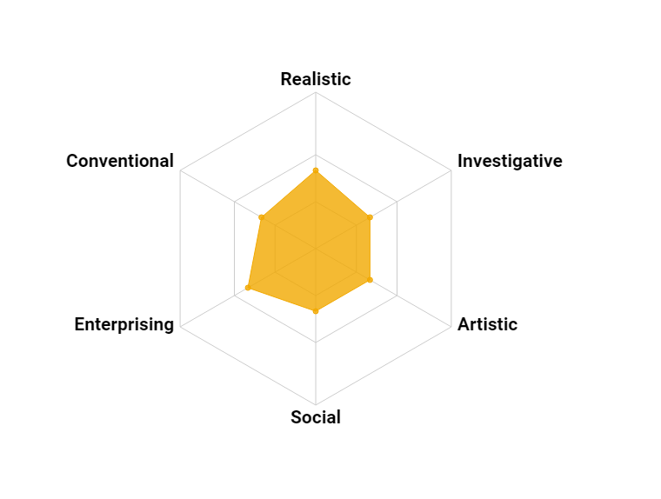
CAREER INTEREST AREAS
Realistic: The “Doers”
Investigative: The “Thinkers”
Artistic: The “Creators”
Social: The “Helpers”
Enterprising: The “Persuaders”
Conventional: The “Organizers”
Notes:
Introduction: [Use powerpoint] As you make your way through high school, you will learn more about yourself. You’ll identify things you enjoy, and those you don’t like doing as much. Understanding your interests can help you identify careers that might be a good fit for you. One way to find out how your interests might translate to a career is by taking an interest assessment. The Interest Profiler can match your interests to career options and help you explore the possibilities.
Interest Profiler: The interest profile activity uses Holland codes or career interest areas, which are a set of personality types developed by psychologist John L. Holland in the 1970s. There are six personality types in Holland’s Model: Realistic, Investigative, Artistic, Social, Enterprising, and Conventional. Dr. Holland reasoned that people work best in work environments that match their preferences. Most people are some combination of two or three of the Holland interest areas.

Slide 4
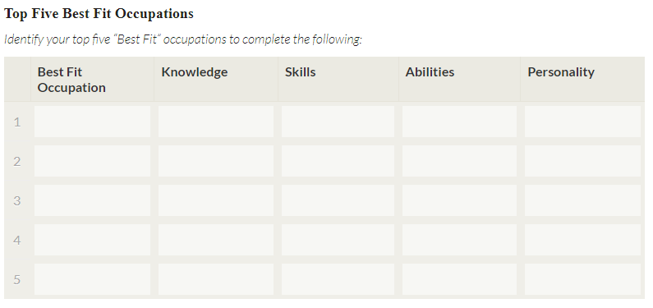
INTEREST PROFILER ACTIVITY
TAKE THE QUIZ
Go to https://nextsteps.idaho.gov/interest-profiler
Begin the quiz
COMPLETE THE ACTIVITY
Once you get your top 3 interest areas, scroll down and explore five occupations that feel like your “best fit”.
Notes:
Interest Profiler Activity: Give each student a copy of the handout_Interest Profiler to complete after they take the interest profiler quiz.You can have each student take it independently or have students take turns reading them aloud and rating them dislike, unsure, or like to keep everyone on the same pace.
Discover what your interests are and how they relate to the world of work. [ https://nextsteps.idaho.gov/interest-profiler ]
In this quiz, you will answer 60 questions about work activities that some people perform in their jobs. Read each activity. Then choose the response that best describes how you feel about the activity. There are no right or wrong answers.
When you finish the quiz, you will receive a report on your top career interests. Once you complete the assessment, review the results page and then complete the handout to reflect on your top three interest areas.
Closing: You now have a better understanding of your career interest areas or personality types that match your preference in the work environment. As you explored the different careers that are related, hopefully you found some that seemed like they would be a rewarding career that you may want to pursue in your future.

