Slide 1
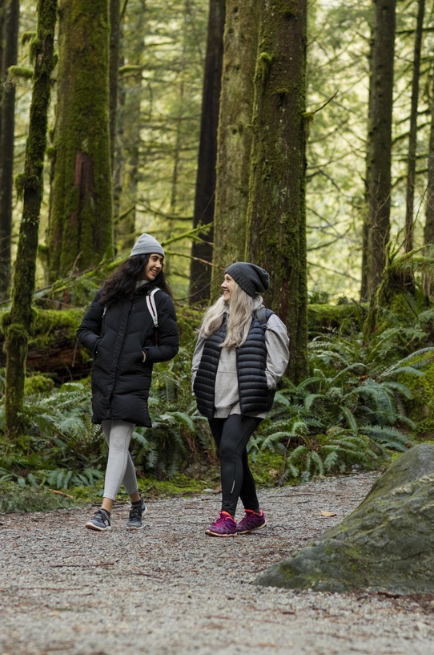
ESTABLISHING A STRONG SUPPORT SYSTEM
Date here
WHAT SUPPORT SYSTEMS ARE OUT THERE?
Notes:
Career Activity: Establishing a Strong Support System
Activity Summary: This lesson will help students identify, and recognize their current support systems, and how to develop a reliable support system that cares about you and wants to help you succeed.
Estimated Time: 45-60 minutes
Learning Plan Activity: 12th Grade Additional Activities:
Learning Outcomes: Students will explore their current support system, and how to develop your support system, and how to create a support system post-secondary. Students will be able to navigate different College websites to locate the Student Engagement/club sections.
Materials Needed: Powerpoint, Handout, Pen, Paper, Computer

Slide 2
“THE FUTURE BELONGS TO THOSE WHO BELIEVE IN THE BEAUTY OF THEIR DREAMS.”
ELEANOR ROOSEVELT
Notes:
Academic Vocabulary
Reliable: able to be trusted
Support System: is a network of people you trust and look to for guidance
Student Engagement: strong relationships between the student and their college campus, i.e. professors, peers, course content

Slide 3

SUPPORT SYSTEM SELF-REFLECTION
ASK YOURSELF THESE QUESTIONS
Who is part of your support system?
    Family, friends, co-workers, teachers, mentors, siblings?
What type of support do they offer you?
    Social, physical, intellectual, emotional, spiritual?
Who are you a support to? How do you support them?
How can I expand my support network?
    Volunteer, join a gym, join/start a book club, neighbors, professional organizations...
Notes:
Introduction: [Use powerpoint] Today we are going to look at what a support system is, how to develop one as you begin the next step in your journey, and why they are important.
Handout for Self-Reflection on Support System: Give each student a copy of the handout_Support System. Have each student complete each section of the handout as you review with the powerpoint. Research has shown that having a strong support system has many positive benefits, such as higher levels of well-being, better coping skills, and a longer and healthier life. Studies have also shown that social support can reduce depression and anxiety. We are going to fill in this handout together as we self-reflect on our current support systems and what needs we might have to develop more.

Slide 4
ACTIVITY: RESEARCH SUPPORT SYSTEMS
ATTENDING A 2- OR 4- YEAR COLLEGE/UNIVERSITY?
Search your college/university student services, clubs/organizations, etc.
  QUESTIONS TO ANSWER:
    What student services exist at my school and what is the contact information?
    How might I get involved on campus?
ENLISTING IN THE MILITARY?
Search which branch of service you are enlisting for and the ‘Services’ Morale, Welfare, and Recreation program’ (MWR)
  QUESTIONS TO ANSWER:
    What are three to five programs or services you’d like to learn more about?
ENROLLING IN AN APPRENTICESHIP? ENTERING THE WORKFORCE?
Search your apprenticeship or employer and see what services exist.
  QUESTIONS TO ANSWER:
    Does your employer offer and Employee Assistance Program (EAP)?
      What assistance does EAP offer?
Notes:
Activity: Research Support Systems: Whether you’re headed off to college, boot camp or your first day on a new job you may experience moments where you feel overwhelmed by change. Knowing the support systems that exist at your workplace or college as well as in your local community can help you develop a reliable support system that genuinely cares about you and wants to help you succeed. These resources are more important than you could possibly imagine.
For the first part, have students all locate the secio that corresponds with their plan after High School (Attending a college/university, enlisting in the military, enrolling in an apprenticeship, or entering the workforce.) Have them write down as they answer the coordinating questions to be able to complete the learning plan activity.

Slide 5

WHAT IS 211-IDAHO?
IDAHO’S FREE, STATEWIDE COMMUNITY INFORMATION AND REFERRAL SERVICE
Check out what is available in Idaho!
A comprehensive database includes programs that offer free or low-cost health and human services or social services, such as rental assistance, energy assistance, medical assistance, food and clothing, child care resources, emergency shelter, and more.
2-1-1 maintains a clearinghouse of information pamphlets and other related materials related to health and human services.
What three programs did you learn about from 211-Idaho?
Notes:
As students finish up, you can group them and have them review 211-Idaho and the services they offer to residents in Idaho. Each group needs to list three programs that they learned about from 211-Idaho. Once each group is completed, they will share with the rest of the class.

Slide 6
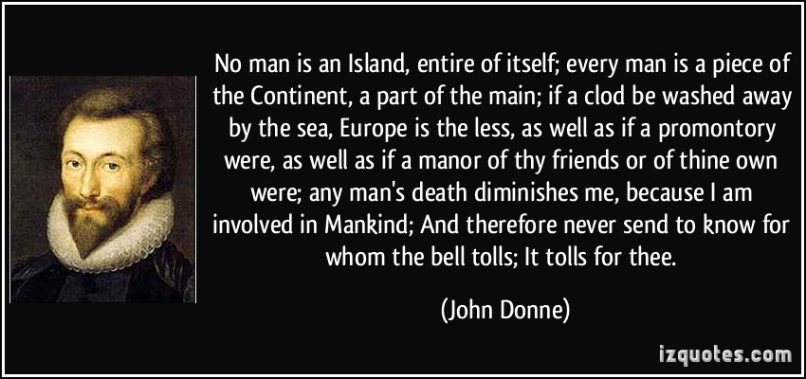

SUPPORT SYSTEMS
Support Systems are not a new idea, it has been around forever.
Find people to ‘Lean on’ and recognize that we are not an island.
Notes:
Closing: You have acknowledged the importance of a support system, and that it can look different for everyone. No matter what your plans after High School, continue to identify different opportunities for support, and how to engage.
Read ‘No Man is an island’ Poem – from the Poem by John Donne, he explores the idea of connectedness of people (our Support systems!) This was written during the 16th century.
'No Man is an Island'
No man is an island entire of itself; every man
is a piece of the continent, a part of the main;
if a clod be washed away by the sea, Europe
is the less, as well as if a promontory were, as
well as any manner of thy friends or of thine
own were; any man's death diminishes me,
because I am involved in mankind.
And therefore never send to know for whom
the bell tolls; it tolls for thee.
More recent artistic poem regarding our support systems – Lean On Me. Play Video: “Lean on Me” Performance by Bill Withers, Stevie Wonder, John Legend (~4.5 minutes)
Support Systems are not a new idea, it has been around forever. Find people to ‘Lean on’ and recognize that we are not an island.

