Slide 1

COLLEGE COST ESTIMATOR
Date here
WHAT WILL IT COST?
Notes:
Career Activity: College Cost Estimator
Activity Summary: This lesson will help students explore the cost of colleges/universities in Idaho to play for the amount of financial aid and scholarships they will need to help cover the cost of college.
Estimated Time: 30-45 minutes
Learning Plan Activity: 12th Grade
Learning Outcomes: Students will explore the cost of College, and the different ways to pay for both the college tuition, and the fees. Students will feel more empowered about how they can access scholarships, grants, etc to help pay for college.
Materials Needed: Powerpoint, Handout, Pen, Computer

Slide 2
“AN INVESTMENT IN KNOWLEDGE PAYS THE BEST INTEREST.”
BENJAMIN FRANKLIN
Notes:
Academic Vocabulary
N/A

Slide 3
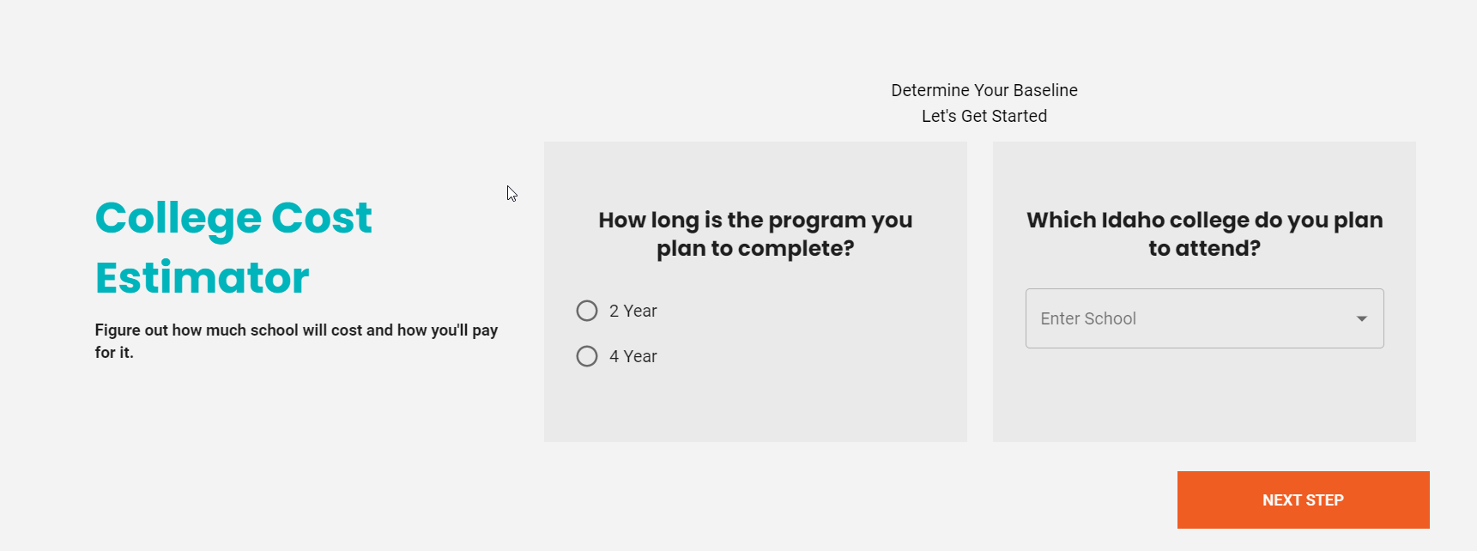
ACTIVITY: COLLEGE COST ESTIMATOR
Go to: https://nextsteps.idaho.gov/college-cost-estimator
Complete each section the best you can.
Use ? for more information on each section!
Notes:
Introduction: [Use powerpoint] One of the challenges you’re probably facing right now is figuring out how to pay for college. You’ve probably heard your counselor or other adults talk about THE FAFSA®. FAFSA stands for Free Application for Federal Student Aid, which is the form students complete to apply for federal grants, work-study, and loans to help pay for college and training. It’s also used by states and schools to determine your eligibility for scholarships. This important document will help you determine what your out-of-pocket expenses will be for completing your certificate or degree program. It is important to compare the estimated cost of your school choices to see what is reasonable to be able to attain your degree.
Activity: College Cost Estimator: Give students the Handout_College Cost Estimator to record what they find in the College Cost Estimator. Figure out how much school will cost and how much more income (Financial Aid/Scholarships) you will need to help you cover the expenses by completing the College Cost Estimator.
Review the Budget Breakdown on the College Cost estimator – emphasize the importance of scholarships and the FAFSA to help with the cost associated with college. Ask: What was an expense that you may have not thought of? Did the difference in additional income needed schock you? Did you pick your first choice school? If so, try your second choice school to compare costs.
Discussion Questions:
What was an expense that you may have not thought of?
Did the difference in additional income needed schock you?
Did you pick your first choice school? If so, try your second choice school to compare costs.

Slide 4

WHAT’S NEXT?
FINANCIAL AID AND SCHOLARSHIP TRACKING
Apply for Scholarships!
Complete the FAFSA (Opens October 1st)
Apply Idaho! (Opens October 1st)
Start saving! Talk with your parents about 529 Savings Plan
Notes:
What’s Next? Your choice of college and career are among the most important decisions you'll ever make. Take the time to do careful research and prepare to reduce your costs, so you can enter a career with minimal debt and make those investments and choices of your dreams!
Closing: Looking at estimated college costs help us understand the work we need to put in for scholarships and applying for financial aid. Comparing costs of schools that offer your same major will allow you to make the best choice for you and your future. The price tag may seem overwhelming, but remember that you are investing in your future to put you on a career path that can help you pay any loans back if needed.

