Slide 1
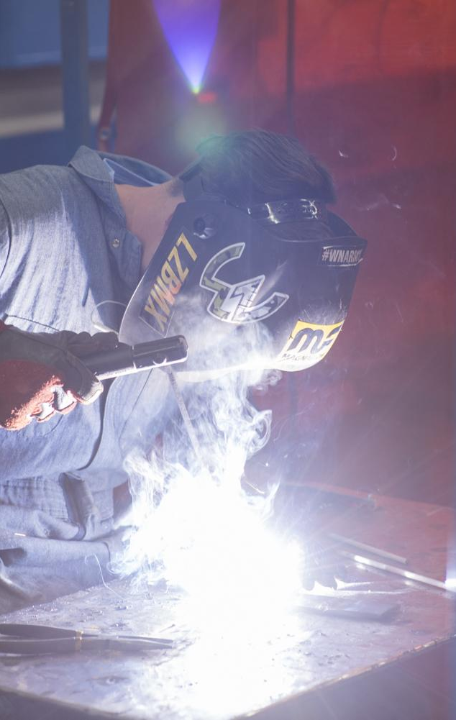
CAREER & TECHNICAL EDUCATION INTRO
Date here
WHAT IS CTE?
Notes:
Career Activity: CTE Intro
Activity Summary: This lesson will introduce students to Idaho Career & Technical Education (CTE), the six program areas in Idaho CTE, and the associated student organizations. The activities will provide students with a deeper understanding of the pathways and occupations within CTE.
Estimated Time: 55 minutes
Learning Plan Activity: 8th Grade
Learning Outcomes: Students will know where to find information about CTE programs in Idaho. They will know what student organizations are associated with CTE. They will also be able to describe CTE options and occupations that are most interesting to them.
Materials Needed: Powerpoint, Handout, Pen, Computer

Slide 2
“GO CONFIDENTLY IN THE DIRECTION OF YOUR DREAMS. LIVE THE LIFE YOU HAVE IMAGINED.”
HENRY DAVID THOREAU
Notes:
Academic Vocabulary
CTE- Career & Technical Education: educational programs that specialize in the skilled trades, applied sciences, modern technologies, and career preparation
Hands-on: experience or work involves actually doing a particular thing, rather than just talking about it or getting someone else to do it.

Slide 3

IDAHO CTE: CAREER & TECHNICAL EDUCATION
Notes:
Introduction: [Use powerpoint] You’ve got plenty of choices and time to explore post-high school opportunities. But the more you understand now, the easier it will be to make decisions (or at least have options) as you progress toward graduation. Life after high school might mean going to a four-year college or enrolling in a technical training program or figuring out a way to continue your education while you work. Today we are going to explore Career & Technical Education (CTE) programs here in Idaho.
Play video: Career & Technical Education by Idaho Public Television (~28 minutes)
[Alternative video if limited time: CTE 101 by CTEWorks (~2.5 minutes)]

Slide 4

ACTIVITY: EXPLORE IDAHO CTE CAREER AREAS
DO YOU LOVE:
Working with plants and or animals?
Dreaming up and starting new businesses?
Figuring out how things work or designing them to be better?
Making gourmet food, designing clothes, or helping children grow?
Helping people feel healthier
Building, fixing, or making things?
EXPLORE IDAHO CTE CAREER AREAS
Go to Idaho’s CTE website Career Areas
  https://cte.idaho.gov/programs-2/career-areas
Fill in your handout as you explore student organization and careers in each of the 6 different CTE areas.
Notes:
Activity: Explore Idaho CTE Career Areas :
Give students the Handout_Idaho Career & Technical Education Career Areas. Have students log into the Idaho CTE Website Career Areas: https://cte.idaho.gov/programs-2/career-areas/ to explore the 6 different CTE Career Areas.
Seventeen Idaho Career Technical Schools (CTS) and six technical colleges across the state provide robust career-focused instruction to students in grades 8-12. The curriculum is made available to students attending regular Idaho high schools as well, often via CTE Digital through Idaho Digital. When you enroll in a CTE program, you learn by doing and gain real-world skills that employers are seeking. Find out which CTE program and/or student organization is right for you, and ask your school counselor about the possibilities.

Slide 5
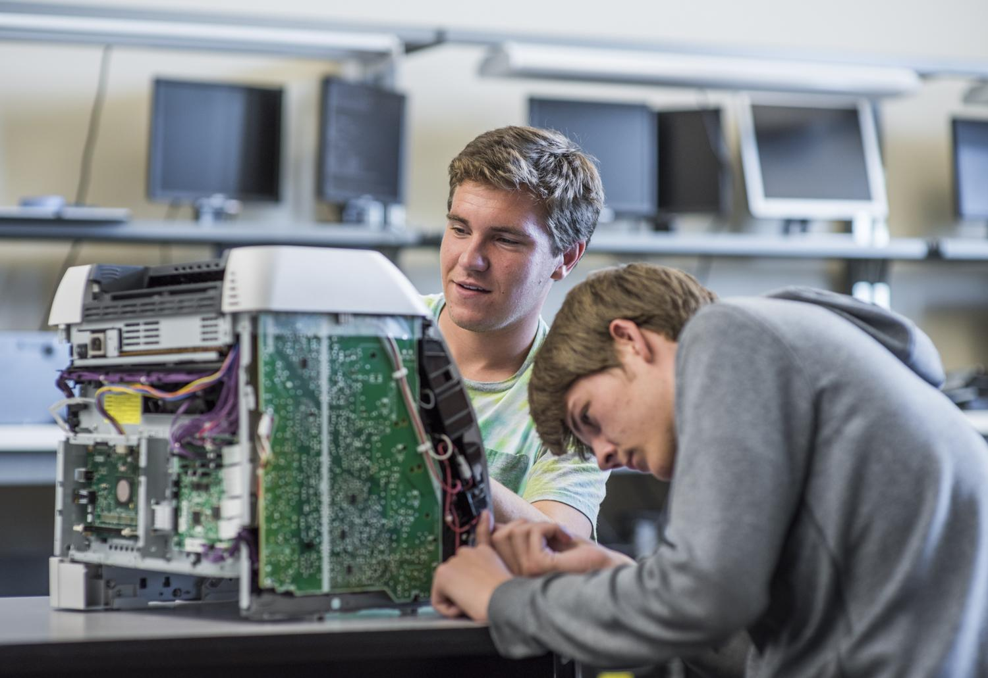

UNDERSTAND YOUR OPTIONS
SIX TECHNICAL COLLEGES IN IDAHO:
College of Southern Idaho, Twin Falls
College of Western Idaho, Nampa
College of Eastern Idaho, Idaho Falls
Idaho State University College of Technology, Pocatello
Lewis-Clark State State College, Lewiston
North Idaho College, Coeur d’Alene
If you want to find out more about getting into a technical college program, contact a transition coordinator, who can answer your questions and get you going in the right direction.
Notes:
Closing: If the program you are passionate about isn’t available at your high school there are 6 technical colleges in Idaho waiting for you when you graduate. Continue to explore an area that sounds interesting. If you would like to explore courses in High School, Idaho Digital Learning offers CTE digital courses for students at every high school in Idaho!

