Slide 1
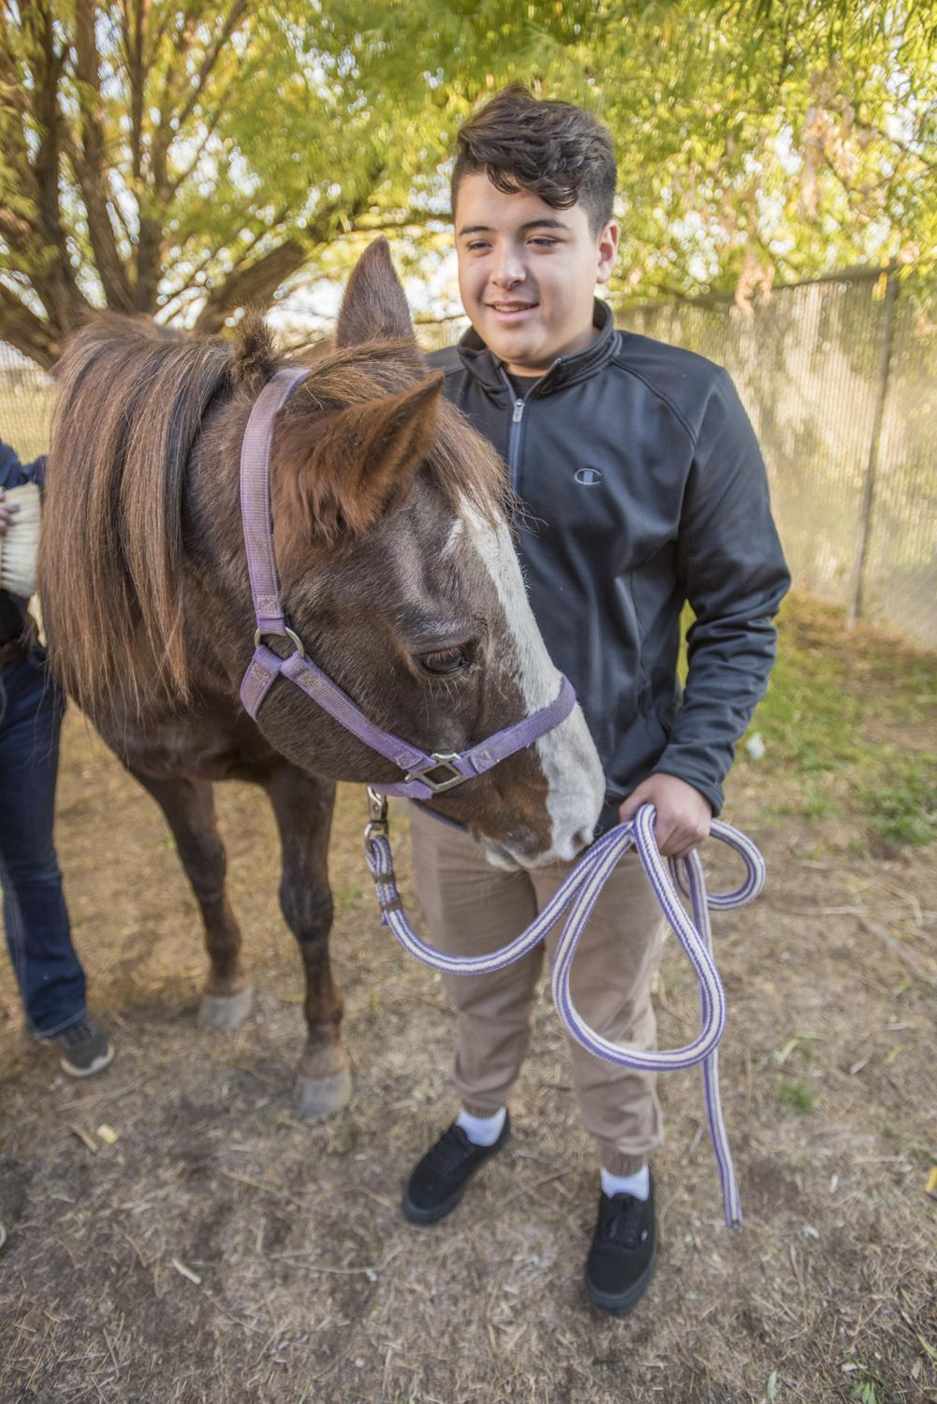
Breaking Barriers
Date here
HOW TO PERSIST-ON
Notes:
Career Activity: Breaking Barriers & Persist-On
Learning Plan Activity: None ; Additional Activities: 8, 9, 10, 11, 12
Estimated Time: 45-60 minutes (adjust as time is available)
Activity Summary: This lesson will help students identify their own barriers and strengths they hold. By exploring barriers students will be better able to discover them and ways to persist to help get to where they want to go after high school.
Learning Outcomes: Students will examine their own potential barriers and identify how they have broken through them in the past and explore how they might do so in the future.
Estimated Time: 45-60 minutes (adjust as time is available)
Materials Needed: Powerpoint, Handout, Pen

Slide 2
“HE THAT WOULD
HAVE THE FRUIT
MUST CLIMB THE
TREE.”
DR. THOMAS FULLER
Notes:
Academic Vocabulary
Life Barrier: An obstacle that could get in the way of where you want to go in your life if you let it.
Persistence: Not giving up and doing whatever it takes to get where you want to go in life.
Self-Advocate: Speaking up and asking for help on your own behalf to get the support and information you need to get to what you would like to see happen for yourself.

Slide 3

THE PURSUIT OF HAPPYNESS BASKETBALL AND DREAMS
Notes:
Introduction: [Use Powerpoint] Today we are going to examine barriers you have overcome and potential obstacles for your future plans for after high school. Those who persist are the ones that get what they want out of life. Attitude and drive are very important, as well as learning to self-advocate.
Inspirational Video Clips: Show as many of the motivational YouTube clips as you have time for. Each clip has a message of breaking through a variety of different life barriers and how each character persists.

Slide 4

MICHELLE OBAMA’S BEST ADVICE FOR STUDENTS | HOW TO SUCCEED IN LIFE
Notes:
Introduction: [Use Powerpoint] Today we are going to examine barriers you have overcome and potential obstacles for your future plans for after high school. Those who persist are the ones that get what they want out of life. Attitude and drive are very important, as well as learning to self-advocate.
Inspirational Video Clips: Show as many of the motivational YouTube clips as you have time for. Each clip has a message of breaking through a variety of different life barriers and how each character persists.

Slide 5

OCTOBER SKY
I WANT TO GO INTO SPACE
Notes:
Introduction: [Use Powerpoint] Today we are going to examine barriers you have overcome and potential obstacles for your future plans for after high school. Those who persist are the ones that get what they want out of life. Attitude and drive are very important, as well as learning to self-advocate.
Inspirational Video Clips: Show as many of the motivational YouTube clips as you have time for. Each clip has a message of breaking through a variety of different life barriers and how each character persists.

Slide 6

ROCKY BALBOA -
INSPIRATIONAL
SPEECH
Notes:
Introduction: [Use Powerpoint] Today we are going to examine barriers you have overcome and potential obstacles for your future plans for after high school. Those who persist are the ones that get what they want out of life. Attitude and drive are very important, as well as learning to self-advocate.
Inspirational Video Clips: Show as many of the motivational YouTube clips as you have time for. Each clip has a message of breaking through a variety of different life barriers and how each character persists.

Slide 7
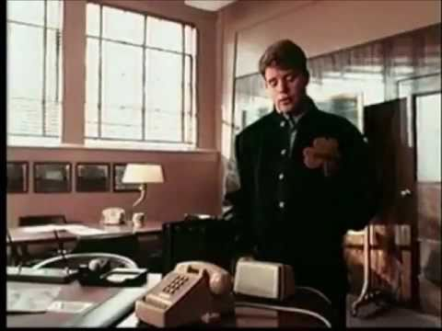
RUDY MOVIE TRAILER
Notes:
Introduction: [Use Powerpoint] Today we are going to examine barriers you have overcome and potential obstacles for your future plans for after high school. Those who persist are the ones that get what they want out of life. Attitude and drive are very important, as well as learning to self-advocate.
Inspirational Video Clips: Show as many of the motivational YouTube clips as you have time for. Each clip has a message of breaking through a variety of different life barriers and how each character persists.

Slide 8

MATTHEW MCCONAUGHEY | 5 MINUTES FOR THE NEXT 50 YEARS OF YOUR LIFE
Notes:
Introduction: [Use Powerpoint] Today we are going to examine barriers you have overcome and potential obstacles for your future plans for after high school. Those who persist are the ones that get what they want out of life. Attitude and drive are very important, as well as learning to self-advocate.
Inspirational Video Clips: Show as many of the motivational YouTube clips as you have time for. Each clip has a message of breaking through a variety of different life barriers and how each character persists.

Slide 9


FAMOUS PEOPLE WHO HAVE PERSISTED
Simon Cowell: had a record company that failed
Stephen King: his first novel was rejected 30 times
Jay-Z: couldn’t get signed to any record labels
Actress Charlize Theron: saw her mom killed by her dad
Oprah: was once fired from a newscaster job
President Franklin Roosevelt: became paralyzed at the age of 39
Stephen Hawking: developed AIs & became on of the most respected theoretical physicists in history
Notes:
Famous People who have persisted: Have students help read through the two slides of famous people who have persisted on in life despite life barriers.

Slide 10

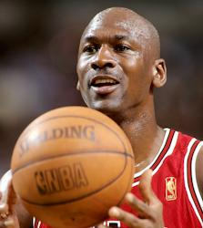
FAMOUS PEOPLE WHO HAVE PERSISTED
Walt Disney: was fired from a Missouri newspaper for not being creative enough
Michael Jordan: did not make the varsity team in his sophomore year in high school
Michael J. Fox: despite developing Parkinson’s disease has kept acting
Albert Einstein: had late speech development and did not talk until age 4
Vincent Van Gogh: only sold one painting while alive
Bethany Hamilton: a famous surfer had her arm bitten off by a shark at 13
Benjamin Franklin: his parents could only afford to keep him in school until 10th grade
Jim Carrey: was once homeless

Slide 11
POTENTIAL BARRIERS
WHAT ARE SOME POTENTIAL BARRIERS A STUDENT MAY FACE WHEN CHOOSING CAREER PATHS?
Desire to conform to Friends, Teachers, Family, Boss
Self-doubt, low self confidence
Financial issues
Stress
Procrastination
Lack of information
Anything else?
HOW MIGHT STUDENTS ADDRESS POTENTIAL BARRIERS?
Notes:
Potential Barriers: Discuss with students about potential barriers that they may be facing or have faced and ways that they have overcome them. Give students the handout_Breaking Barriers and have them fill in three barriers that they have had so far in their life.

Slide 12
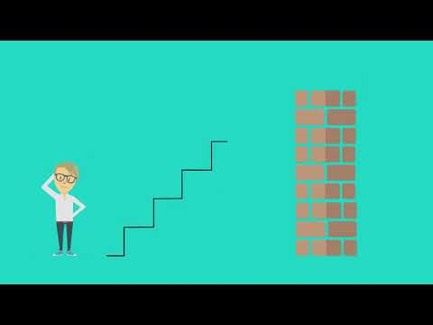
SELF-ADVOCATE
WHAT DOES SELF-ADVOCATE MEAN?
Speaking up and asking for help for yourself
Get the support and information you need (Search for it!).
Ask questions! Network with people! Talk!
Search for scholarships, tour the schools, do your research!
Anything else?
*Most important skill you can take with you from high school!*
HOW CAN YOU SELF-ADVOCATE?
Asking for help from research information online
Contact colleges, trade schools, etc. to get more information
Ask for mental health counseling if needed
Get organized and serious about a plan for your future (to end procrastination)
Ask! Teachers, Parents/Guardians, Relatives, Friends of the family, Employers, College and Career staff, Counselors
Notes:
Self- Advocacy: Play Self-Advocacy Introduction Video (~2 minutes) Have students discuss what self-advocate means and ways they can do it. After the discussion, have students complete the remainder of their handout by completing different ways to persist-on or self-advocate to overcome each barrier listed before.
Closing: Know that you are your own self-advocate. You are an agent of change and can make things happen for yourself. Today you have started to identify your potential obstacles. Choose to ask for help and take action steps to break down walls and create a great future for yourself. Build your own support team. Seek information you need, make plans, and break down barriers in your way. Persist-on! You’ve got this!

