Slide 1

Brag Sheets and References
Date here
Letters of Recommendation
Notes:
Career Activity: Brag Sheets and References
Activity Summary: This lesson will help students get organized, so that they will be able to obtain the best letters of recommendation.
Estimated Time: 30 minutes (plus At Home Tasks)
Learning Plan Activity: 11th Grade Additional Activities: 12
Learning Outcomes: Students will gain tools to help them get prepared to approach professionals for letters of recommendation to help increase chances of awards they are seeking (such as jobs, admittance to college, and scholarships).
Materials Needed: Powerpoint, Handout, Pen

Slide 2
“PROVIDE A BRAG SHEET WELL IN ADVANCE OF ANY LETTER DUE DATES.”
CASSIE TALBOT, CAREER COUNSELOR
Notes:
Academic Vocabulary:
Letter of Recommendation: A document written by a professional to help display a person’s talents, skills, and personality to obtain a scholarship, a job, internship, an honor, or admission to a college.
Reference: A professional who is willing to provide information about their experience working with a candidate for a variety of things, such as a job, scholarship, or admission to college.

Slide 3

LETTER OF RECOMMENDATION
WHAT MIGHT YOU US A LETTER OF RECOMMENDATION FOR?
Job
College Application
Scholarship
Honors Applications for College
Anything else?
Notes:
Introduction: Today we are going to talk about how to get the best letters of recommendation. You have two assignments you will be bringing back in (tell them when it is due). One of which is a brag form for your parents to fill out.
What might you use a letter of recommendation for?
Job, College Application, Scholarship, Honors Application for College, Anything else?

Slide 4

LETTER OF RECOMMENDATION REQUEST
WHO TO ASK?
Choose individuals who:
  know you well
  are familiar with your accomplishments
  able to make positive statements about your ability, character, and special talents
GIVE EXAMPLES OF WHO YOU COULD ASK?
WHO SHOULD YOU NOT ASK?
Notes:
Letter of Recommendation Request:
Who should you ask for a letter of recommendation? Counselor, Teacher, Employer, Coach, Administrator, Volunteer Work Supervisor, Club Supervisor, Extra-Curricular Supervisor
Who should you not ask for a letter of recommendation? Parents (Relatives in general)

Slide 5
GETTING THE BEST LETTER OF RECOMMENDATION
WHEN TO ASK?
The more time the better.
  2 weeks is best. 1 week Minimum.
  Do not wait until the deadline day!
    You will most likely be denied.
    It is disrespectful.
    You will not get the letter you need to get what you want.
WHAT TO PROVIDE?
Resume
Recommendation Form (Assignment)
Parent Brag Form (Assignment)
Deadline for when you need the letter completed
A description of a scholarship or job you are applying for can help the writer tailor the letter to be more specific in writing the letter
You may need to also provide a mailing address (or e-mail address) to the organization you want it sent to if it is requested it be sent directly and not given to the student.
Notes:
Getting the best Letter of Recommendation:
When to ask? The more time the better.
What to provide? Resume, Recommendation Form, Parent Brage Form, Deadline, A description of what you are apply for to help the writer tailor the letter, and also a mailing address or email address to the organization if it needs to be sent directly

Slide 6
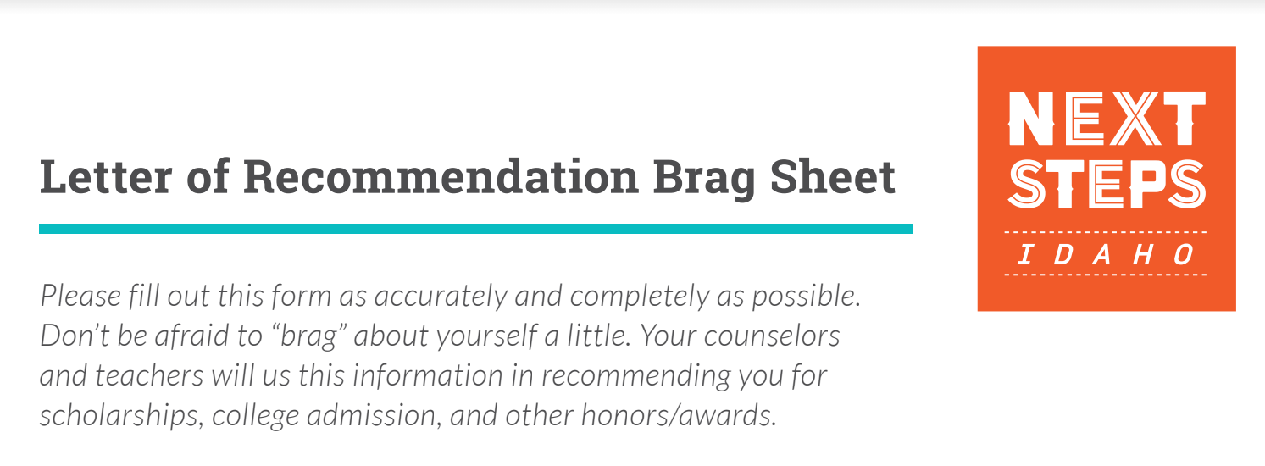
LETTER OF RECOMMENDATION BRAG SHEET
ACTIVITY
AREAS TO COMPLETE AS BEST AS YOU CAN
List ALL your activities and leadership roles beginning with 9th grade
  Clubs and Organizations
  Awards and Honors
  Athletics
  Church and Youth Group Activities
Plans after leaving high school
College Placement Exam Scores
Work Experience
Community Service
More about who you are
Notes:
Activity: Letter of Recommendation Brag Sheet Give each student a copy of the handout_Letter of Recommendation Brag Sheet. Collecting references from teachers that you’ve built relationships with is a great way to bolster your college or job application. To best help the letter writer help you stand out in writing a letter about you, provide as much information about yourself on this brag sheet.

Slide 7
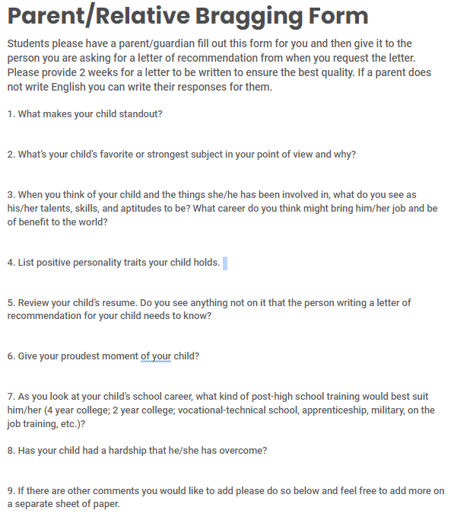
PARENT/RELATIVE BRAG SHEET
Notes:
Parent/Relative Brag Sheet: Give each student a copy of the handout_Parent/Relative Bragging form. Be clear about a due date. This next form, you will take home and have a parent/relative complete. This is another tool to use when asking other people to write a letter of recommendation for you.

Slide 8

GETTING THE BEST LETTER OF RECOMMENDATION
REMEMBER
Providing two weeks to write a letter is a good ballpark amount of time
The more information you provide, the better letter you will be able to obtain
Being organized will help you get a better letter
Save/file your Parent/Relative Brag Form and your Letter of Recommendation Brag Sheet!
  Continue to add new experiences as you complete them!
Notes:
Closing: After completing the assignments you will have those documents to use when you need to ask for letters of recommendation in the future. You will be able to make copies of the forms to provide to professionals writing you a letter to help you stand-out. Being organized will help you get a better letter. Put them in a file for easy access.
Remember that providing two weeks to write a letter is a good ballpark amount of time. Do not wait until the deadline to ask for letters or you may be denied. Also feel free to include extra paper with any other information you would like to share.
Remember the more information you provide the better letter you will be able to obtain. All students are standouts but a letter writer can’t let that be known without you providing enough information! Get organized, get thorough in the information you provide, and you will get the prize you are shooting for!

