Slide 1
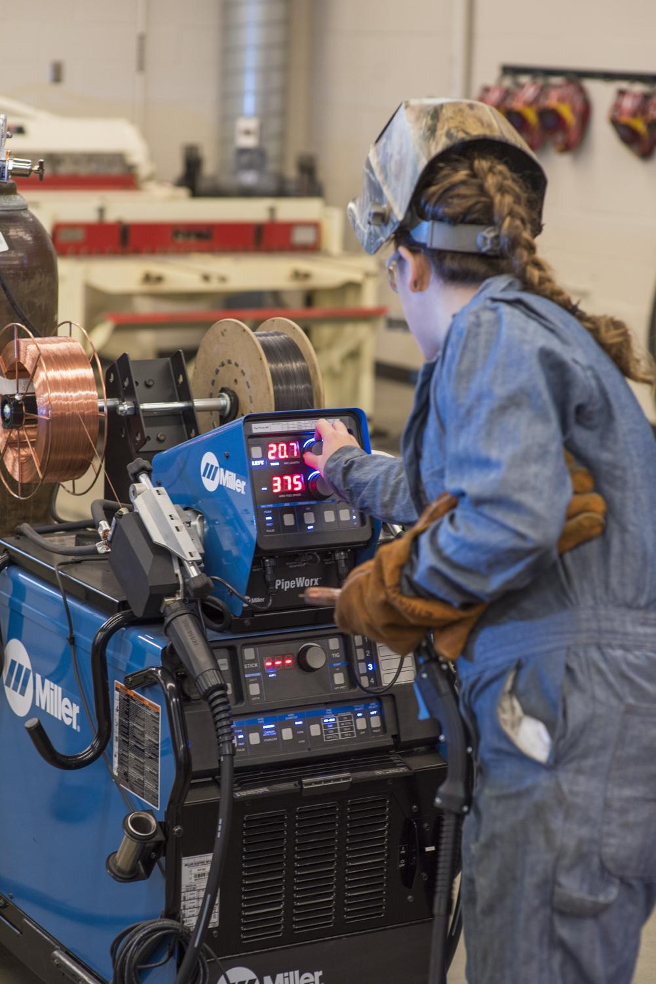
ARE YOU CAREER READY?
Date here
WHAT ROAD
ARE YOU ON?
Notes:
Career Activity: Are You Career Ready?
Activity Summary: This lesson will help students understand and self-assess six professional competencies to develop or practice between now and graduation to be career ready and experience workplace success.
Estimated Time: 45-60 minutes
Learning Plan Activity: 10th Grade Additional Activities:
Learning Outcomes: Students will gain understanding of six professional competencies to be career ready. Students will self-assess to see what professional competencies they need to develop and practice to be career ready and experience workplace success.
Materials Needed: Powerpoint, Handout, Pen

Slide 2
“THE SECRET OF GETTING AHEAD IS GETTING STARTED.”
SALLY BERGER
Notes:
Academic Vocabulary
Career Readiness: is the process of preparing students of any age with the essential skills they need to find, acquire, maintain, and grow within a job
Professional Competencies: are skills, knowledge, and attributes that are specifically valued to your future career

Slide 3
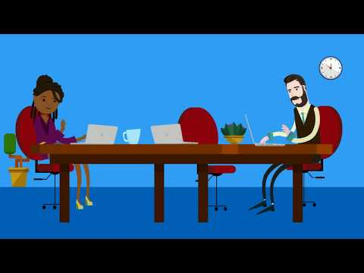
OVERVIEW OF CAREER READINESS COMPETENCIES
Notes:
Introduction: [Use powerpoint] At the end of the day, your teachers hope they’ve prepared you to be successful in the workforce and in life. Whether you are planning to make a short pit stop to complete a certificate or will spend 4-6 years in college, the skills you develop will determine the success you will have in your career. Play introduction video: Overview of Career Readiness Competencies (~7 minutes)
Give each student the Handout_Are you Career Ready? Use the powerpoint to review each competency and have students rate themselves as you go along. You can pause between each and have them work on the goal or have them complete each goal at the end.
Activity: Professional Competency -- Self-Assessment Tool: To be career ready, it is important to demonstrate skills that are valued in professions for success in the workplace. We are going to go through six professional competencies. As we review, use the handout to assess yourself in each area and set a goal on how you can develop or practice each competency.

Slide 4
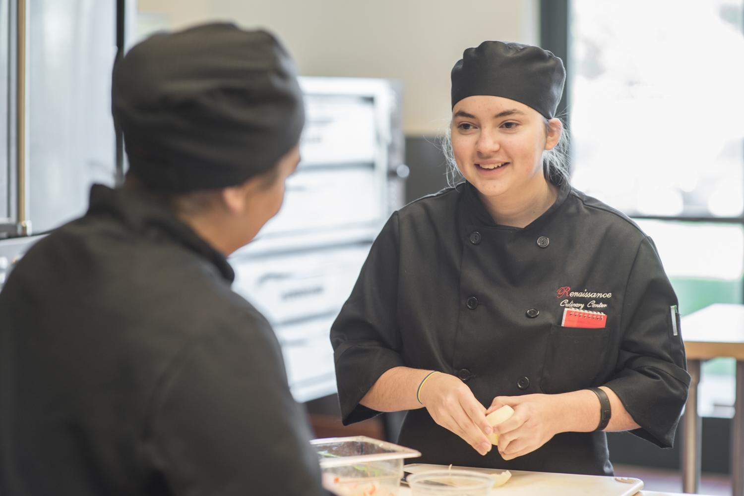
COMMUNICATION
SAMPLE BEHAVIORS
Understand the importance of and demonstrate verbal, written, and non-verbal/body language, abilities.
Employ active listening, persuasion, and influencing skills.
Communicate in a clear and organized manner so that others can effectively understand.
Frame communication with respect to diversity of learning styles, varied individual communication abilities, and cultural differences.
Ask appropriate questions for specific information from supervisors, specialists, and others.
Promptly inform relevant others when needing guidance with assigned tasks.
Clearly and effectively exchange information, ideas, facts, and perspectives with persons inside and outside of an organization.
Notes:
Communication: Articulate thoughts and express ideas effectively using oral, written and non-verbal communication skills (to instruct, inform and persuade), as well as listening for meaning to gain understanding. The ability to deliver information in person, in writing, and in a digital world.
Ways to develop this competency:
Develop and deliver a presentation for a class
Check for understanding by asking clarifying questions
Proofread online and written communication to avoid errors

Slide 5
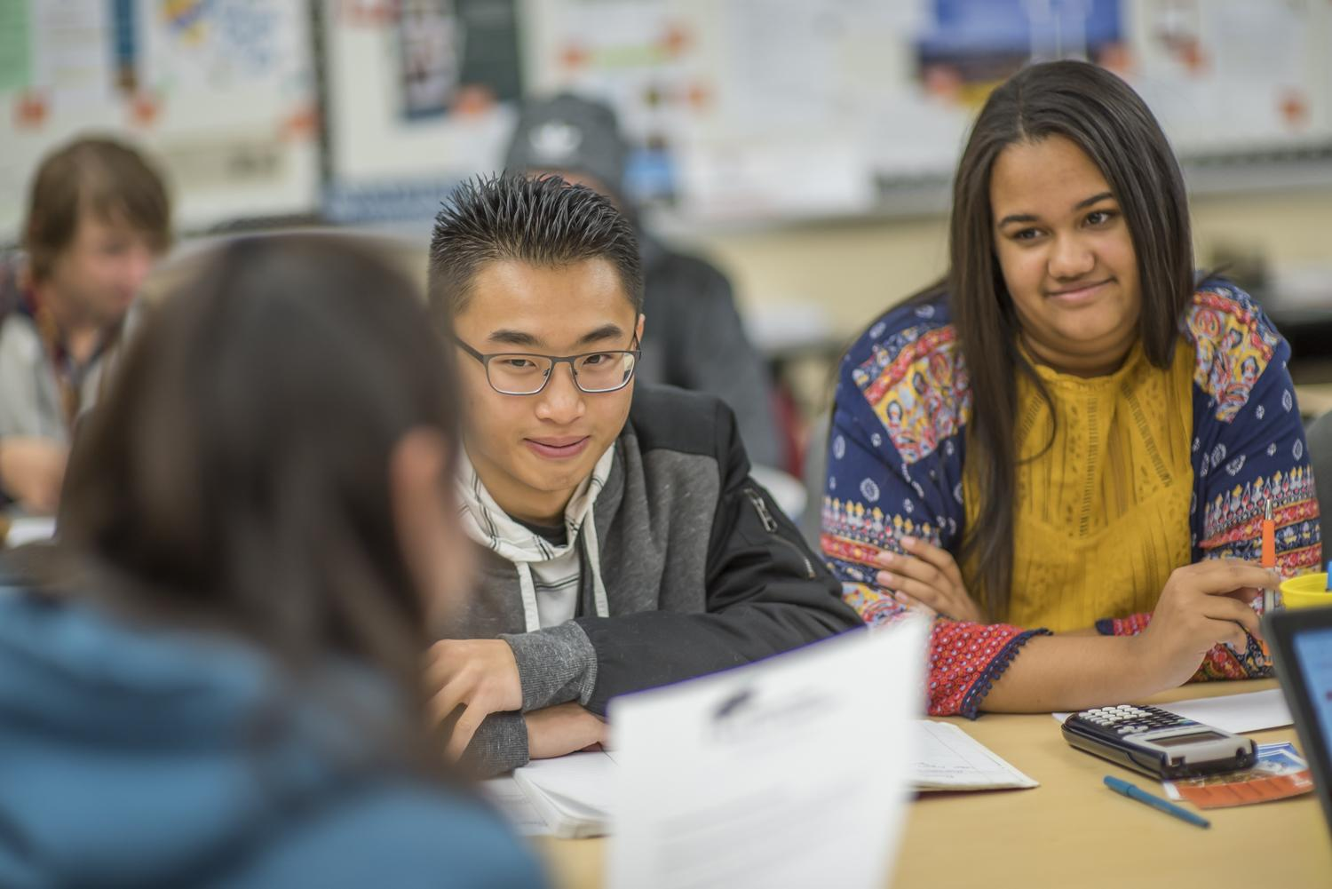
TEAMWORK AND INTERPERSONAL
SAMPLE BEHAVIORS
Listen carefully to others, taking time to understand and ask appropriate questions without interrupting.
Effectively manage conflict, interact with and respect diverse personalities, and meet ambiguity with resilience.
Be accountable for individual and team responsibilities and deliverables.
Employ personal strengths, knowledge, and talents to complement those of others.
Exercise the ability to compromise and be agile.
Collaborate with others to achieve common goals.
Build strong, positive working relationships with supervisor and team members/coworkers.
Build and maintain collaborative relationships to work effectively toward common goals, while appreciating diverse viewpoints and shared responsibilities.
Notes:
Teamwork and Interpersonal: Build and maintain collaborative relationships to work effectively with others in a team setting through shared responsibility, empathy and respect. The ability to manage one's emotions and conflict with others while contributing towards a common goal.
Ways to develop this competency:
Collaborate with others on a class project where responsibility is shared and not divided.
Handle difficult conversations in person with respect.
Consider others’ perspectives before making a decision

Slide 6
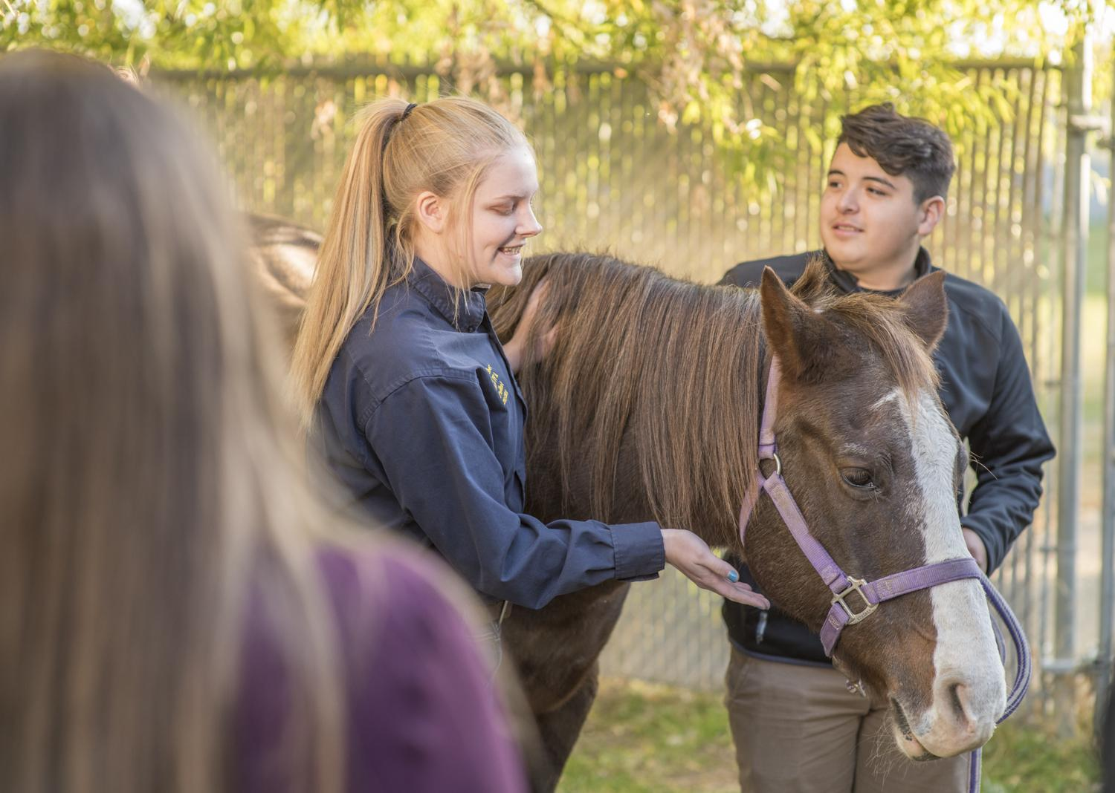
LEADERSHIP
SAMPLE BEHAVIORS
Inspire, persuade, and motivate self and others under a shared vision.
Seek out and leverage diverse resources and feedback from others to inform direction.
Use innovative thinking to go beyond traditional methods.
Serve as a role model to others by approaching tasks with confidence and a positive attitude.
Motivate and inspire others by encouraging them and by building mutual trust.
Plan, initiate, manage, complete and evaluate projects.
Recognize and capitalize on personal and team strengths to achieve organizational goals.
Notes:
Leadership: Motivate, organize, and delegate work by leveraging the strengths of individuals. The ability to use empathetic skills and a positive attitude to guide and influence others while reaching a shared goal through adaptability and effective decision-making.
Ways to develop this competency:
Take on a leadership role in a group or organization
Demonstrate initiative at your job/internship by taking on additional responsibilities

Slide 7
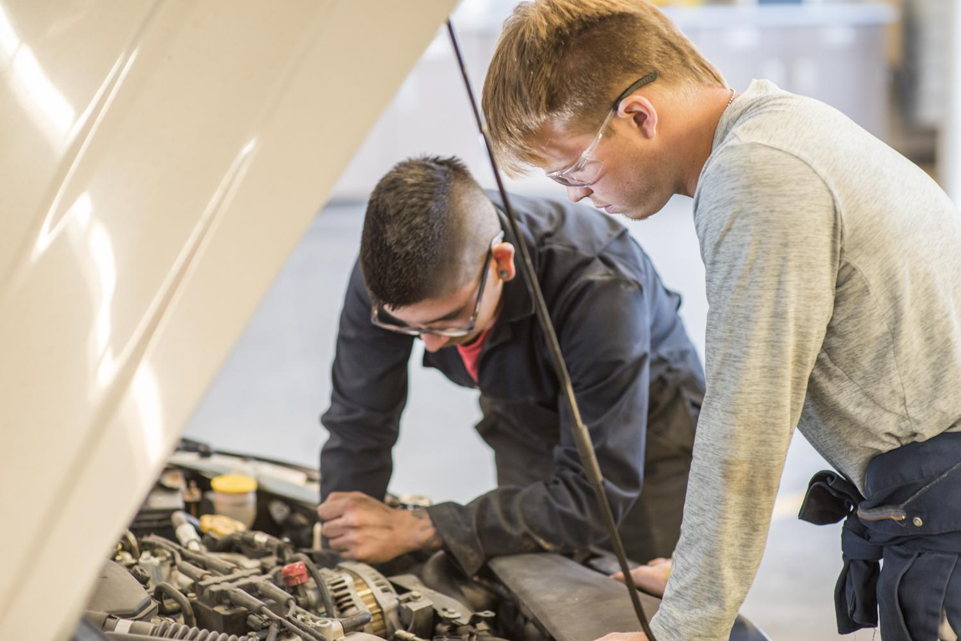
CREATIVITY AND PROBLEM-SOLVING
SAMPLE BEHAVIORS
Make decisions and solve problems using sound, inclusive reasoning and judgment.
Gather and analyze information from a diverse set of sources and individuals to fully understand a problem.
Proactively anticipate needs and prioritize action steps.
Accurately summarize and interpret data with an awareness of personal biases that may impact outcomes.
Effectively communicate actions and rationale, recognizing the diverse perspectives and lived experiences of stakeholders.
Multi-task well in a fast-paced environment.
Identify and respond to needs based upon an understanding of situational context and logical analysis of relevant information.
Notes:
Creativity and Problem-Solving: Exercise sound reasoning to analyze issues, synthesize information, make decisions and solve problems. The ability to think critically and strategically to develop original ideas and innovative solutions.
Ways to develop this competency:
Develop an action plan with specific steps to solve a problem
Brainstorm solutions to a problem before bringing it to a supervisor/professor
Activate your mind - read, do puzzles, write, etc.

Slide 8
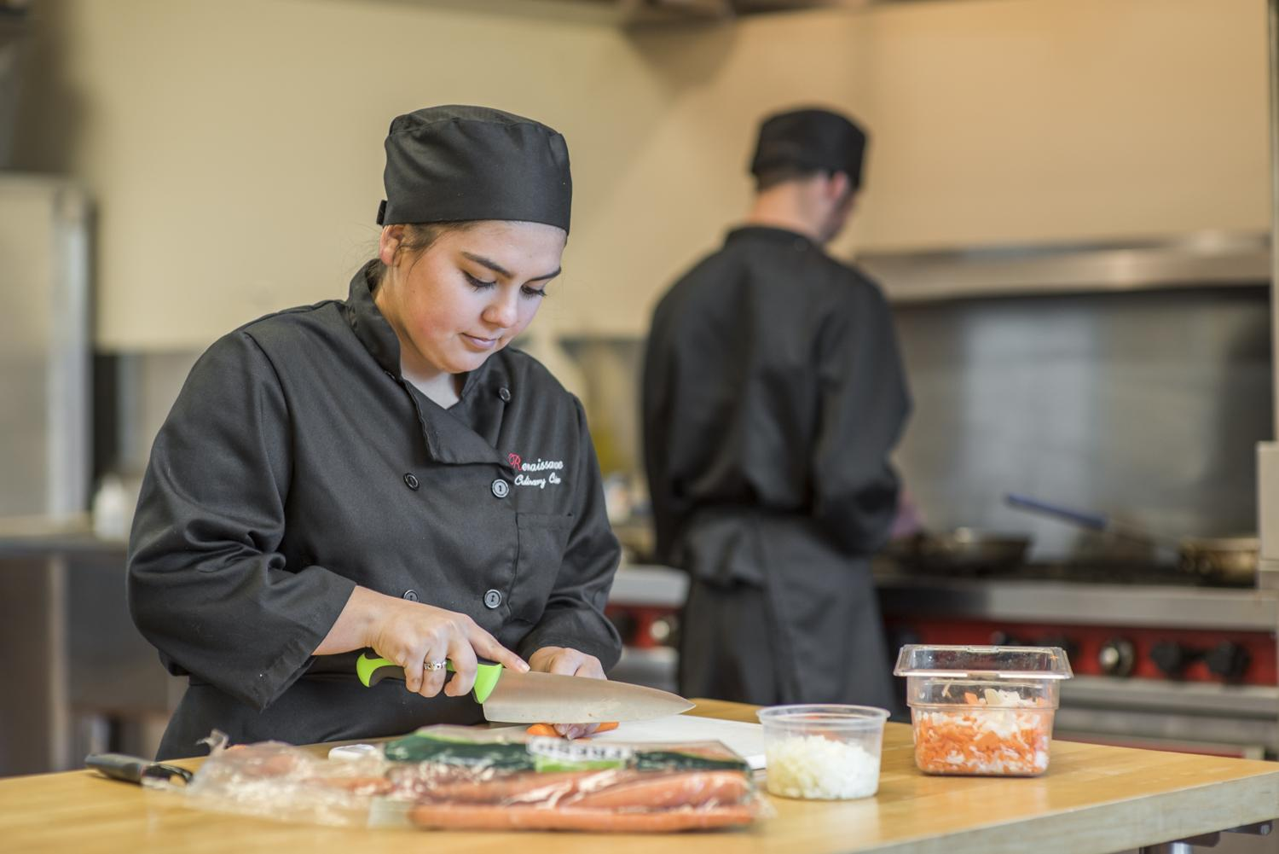
PROFESSIONALISM AND PRODUCTIVITY
SAMPLE BEHAVIORS
Act equitably with integrity and accountability to self, others, and the organization.
Maintain a positive personal brand in alignment with organization and personal career values.
Be present and prepared.
Demonstrate dependability (e.g., report consistently for work or meetings).
Prioritize and complete tasks to accomplish organizational goals.
Consistently meet or exceed goals and expectations.
Have an attention to detail, resulting in few if any errors in their work.
Show a high level of dedication toward doing a good job.
Knowing work environments differ greatly, understand and demonstrate effective work habits, and act in the interest of the larger community and workplace.
Notes:
Professionalism and Productivity: Demonstrate integrity, resilience, accountability and ethical behavior. The ability to take initiative, maintain effective work habits (prioritize, plan and manage work) to produce high quality results and project a professional presence.
Ways to develop this competency:
Use a planner or calendar to prioritize work/assignments and meet deadlines.
Reflect on a recent challenge and identify areas of growth and improvement for the future.
Review your social media through the eyes of a future employer and determine appropriateness

Slide 9

GLOBAL PERSPECTIVE
SAMPLE BEHAVIORS
Solicit and use feedback from multiple cultural perspectives to make inclusive and equity-minded decisions.
Actively contribute to inclusive and equitable practices that influence individual and systemic change.
Advocate for inclusion, equitable practices, justice, and empowerment for historically marginalized communities.
Seek global cross-cultural interactions and experiences that enhance one’s understanding of people from different demographic groups and that leads to personal growth.
Keep an open mind to diverse ideas and new ways of thinking.
Identify resources and eliminate barriers resulting from individual and systemic racism, inequities, and biases.
Demonstrate flexibility by adapting to diverse environments.
Address systems of privilege that limit opportunities for members of historically marginalized communities.
Demonstrate the awareness, attitude, knowledge, and skills required to equitably engage and include people from different local and global cultures. Engage in anti-racist practices that actively challenge the systems, structures, and policies of racism.
Notes:
Global Perspective: Respect the viewpoints of those from diverse cultures, races, ages, genders, religions and lifestyles to build collaborative relationships and communicate effectively. The ability to appreciate, value, and learn from other cultures and perspectives to move beyond tolerance.
Ways to develop this competency:
Attend an event on campus that encourages you to step outside your comfort zone.
Engage in conversation with individuals who have different perspectives than your own.
Participate in a study abroad of volunteer experience to broaden your horizons

Slide 10
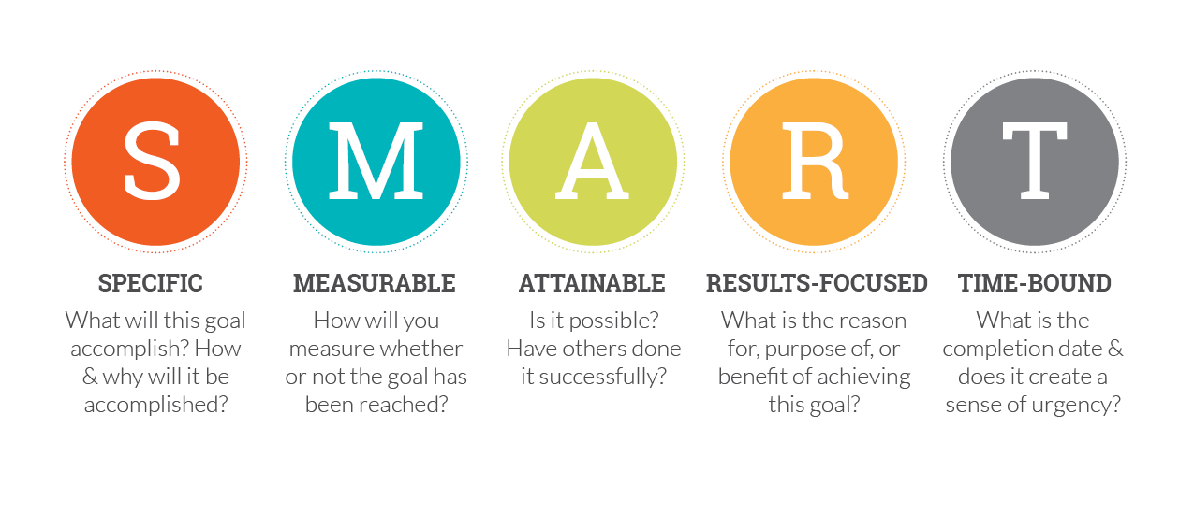
ACHIEVE YOUR GOALS
Notes:
Take a moment to turn your vision to improve into a SMART goal.
Closing: It is important to proactively develop oneself and one’s career through continual personal and professional learning. Be aware of your strengths and weaknesses and find ways to always practice improving. Set goals and be a lifelong learner.

