Slide 1

YOUR GPA
Date here
WHAT DOES IT MEAN?

Slide 2
“EDUCATION IS OUR PASSPORT TO THE FUTURE, FOR TOMORROW BELONGS TO THE PEOPLE WHO PREPARE FOR IT TODAY.”
MALCOLM X

Slide 3

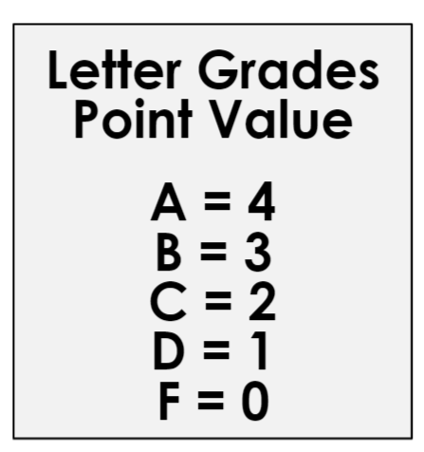
YOUR GPA - WHAT DOES IT MEAN?
A, B, C, & D are passing grades
F = zero credit & possible course retake
Every year counts!
  Don’t spend the next three years trying to “fix” your GPA!
Notes:
Introduction: [Use powerpoint] Depending on whether your high school runs on a trimester or semester schedule you will receive letter grades at the end of each session. High school is when your grades really start to impact your future.
Grade Point Averages (GPA) are one major criterion that colleges and employers will look at to evaluate your potential. Most schools across the country follow a four-point system. The closer you are to a ‘4’ (or an A in the letter grading system) at the end of the trimester/semester and school year the better. Those pluses and minuses on your letter grades in each class also count and can be important in boosting your cumulative GPA, which represents the total of all grade points you earn throughout your high school career.
Play Video: GPA by College Mappers (~2 minutes)

Slide 4
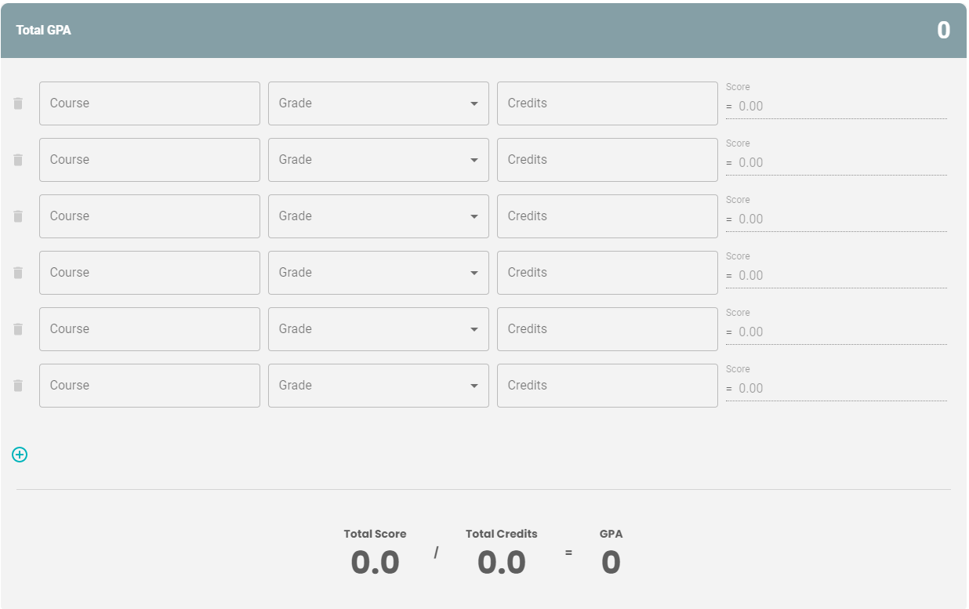
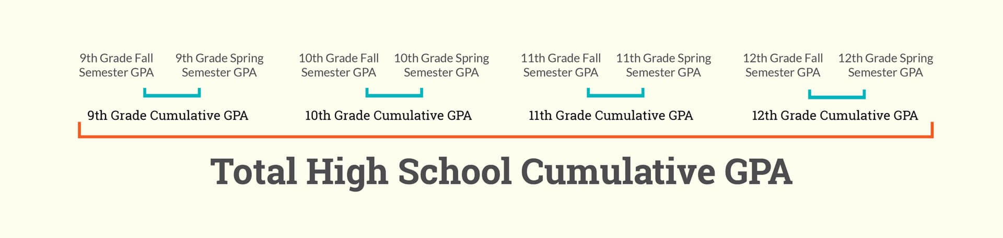
GPA CALCULATOR ACTIVITY
PRACTICE CALCULATING GPA
Go to:
  https://nextsteps.idaho.gov/gpa-calculator/calculator
Enter the Course, Grade, Credits from the transcript
  The GPA will auto calculate as you enter each.
CALCULATING CUMULATIVE GPA
Add up each years’ GPA and divide by how many years you added up
  Example: 9th + 10th / 2 = Cumulative GPA
Notes:
Activity: GPA Calculator: Give each student a copy of the Handout_Sample Transcript to complete this activity. If students have their own transcripts, use those instead.
You are going to use the two sample transcripts or your own transcript today to practice calculating a GPA to understand how much each grade is worth as it averages each year. Use this handy tool to calculate your grade point average and see where you’re at.
Go to Next Steps GPA Calculator: https://nextsteps.idaho.gov/gpa-calculator/calculator
After you have calculated the GPA for each year, find the student’s cumulative GPA.

Slide 5

WHY IS YOUR GPA IMPORTANT?
Notes:
Play Video: GPA by College Mappers (~2 minutes)
Even if you aren’t planning to attend college, you may change your mind later on in high school or even after. Some people are able to get a better job when they can prove they were a better student with their GPA. Scholarships play a large part in GPA, so if you want help paying for college with financial aid, keeping your GPA high will provide a lot of opportunities for you. No matter what next steps you have planned for your future, it is important to focus on your grades starting your freshman year. Your education is free right now, soak it all in.

Slide 6

GPA STRATEGIES
10 TIPS TO IMPROVE YOUR GPA
Take your education serious
Build good habits for learning
Get organized with homework deadlines
Retake classes if needed
Don’t miss classes
Participate consistently
Make time for extra studying
Get a tutor
Get extra help from teachers after school
Take the right classes
Notes:
Here are some tips you can use to help you improve or keep your GPA high throughout your high school years.
Closing: Your GPA is a key indicator of effort, not intelligence. Your GPA can also be a major factor in which colleges, educational and certificate programs, scholarships, and internships you will be eligible for after graduation. Keeping your grades up will give you the widest array of opportunities for taking the next step in your education and career after high school.

