Slide 1
APPLY IDAHO
One Application: 10 Schools

Slide 2
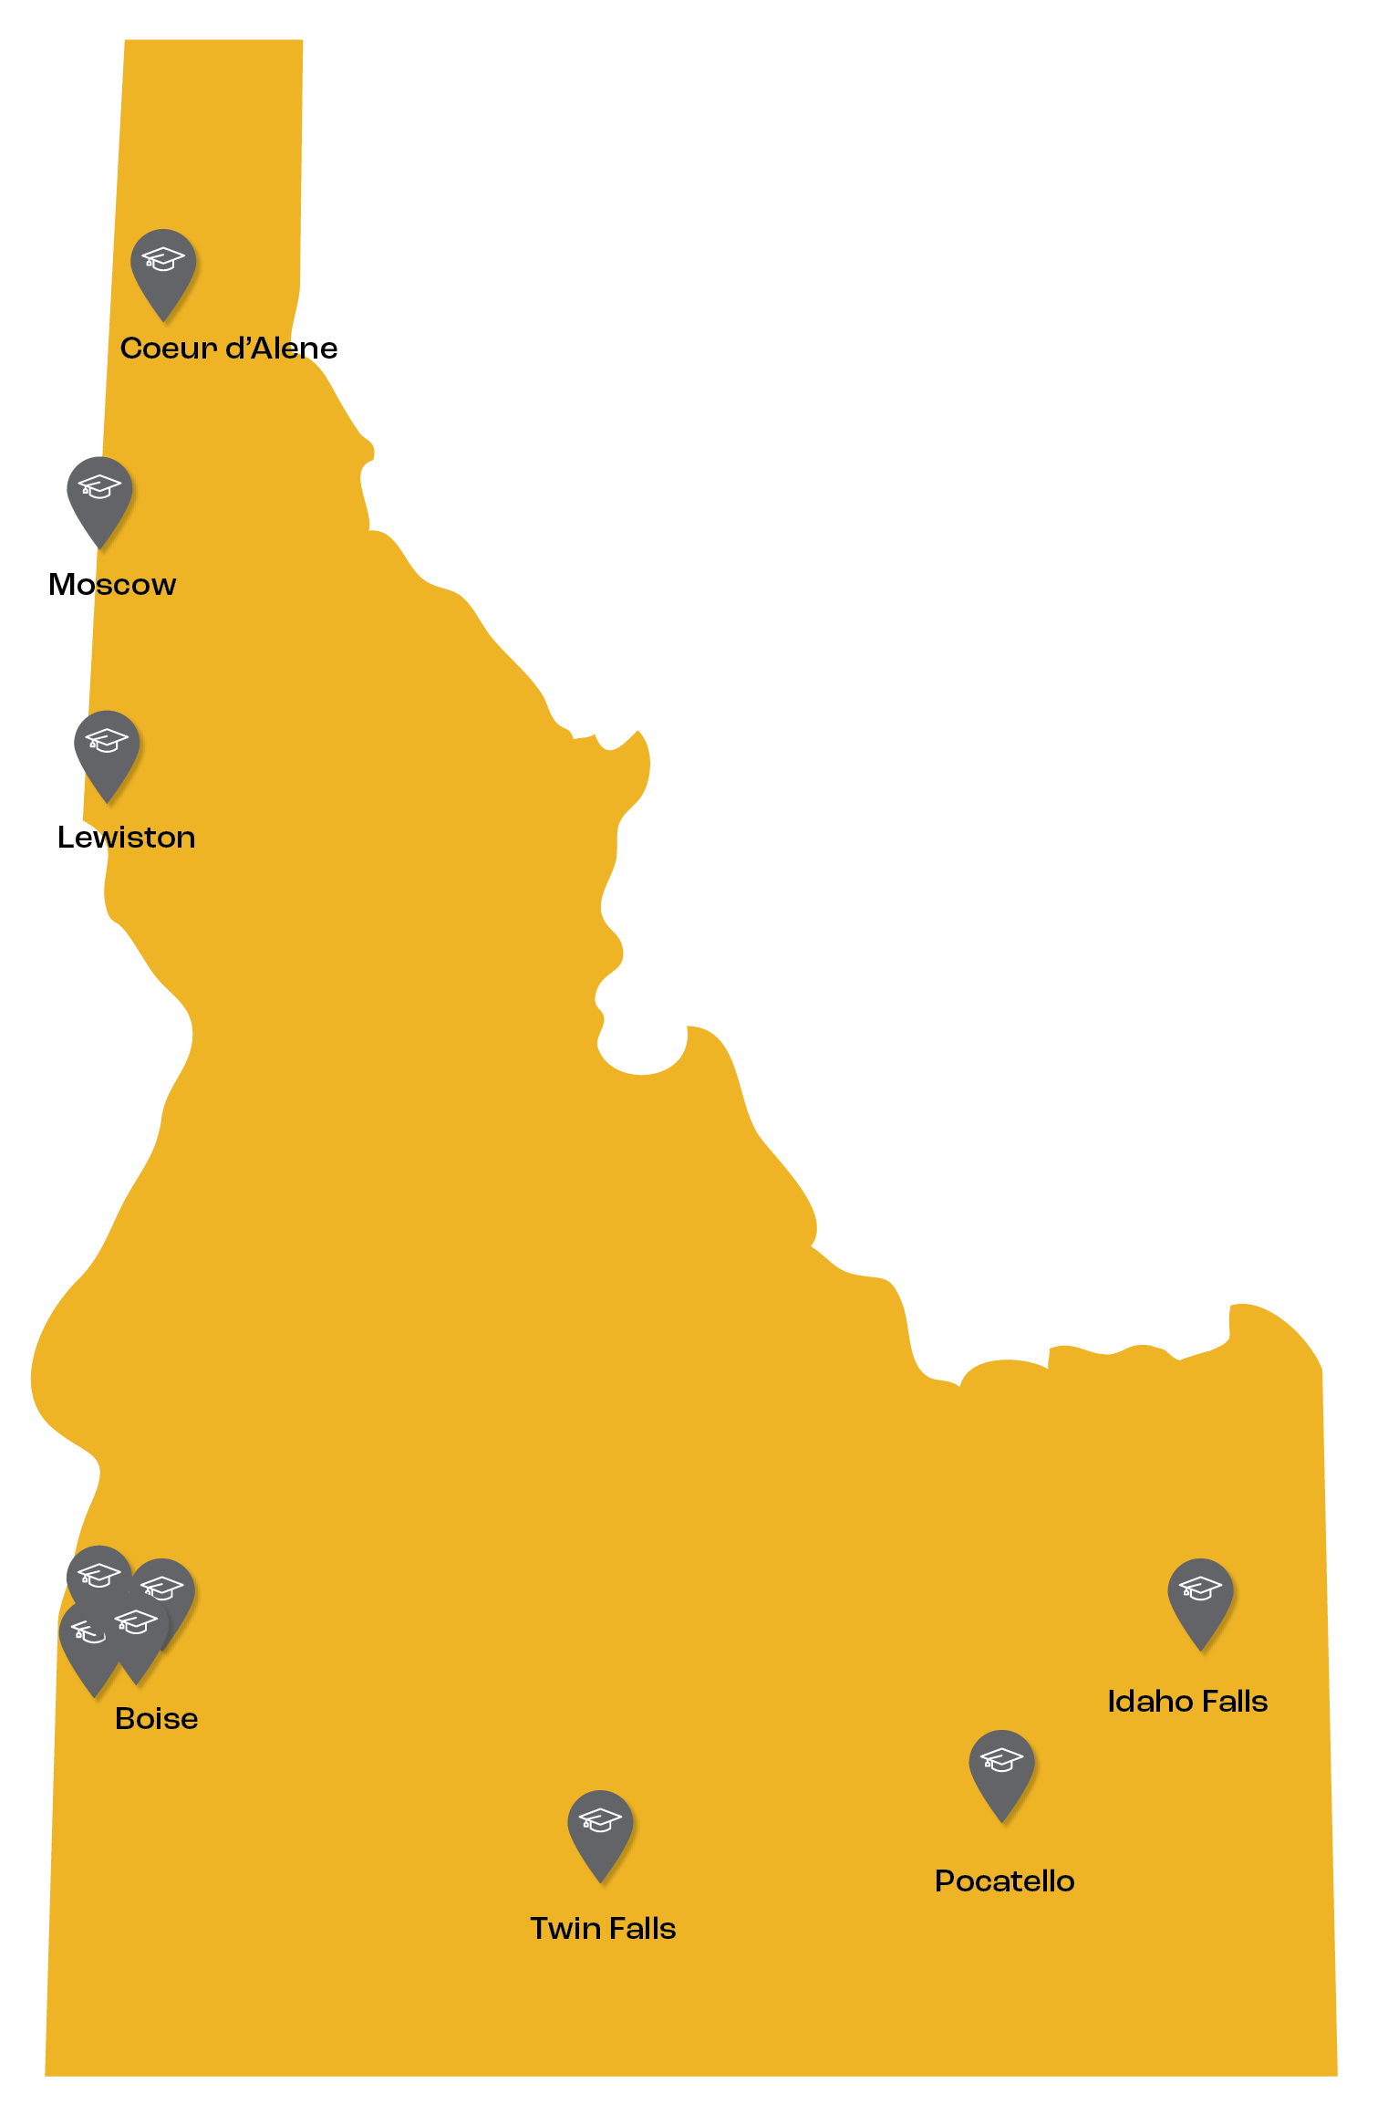
APPLY IDAHO BASICS
Apply Idaho is the state’s free, common application for in-state colleges. You can use the online form to apply for up 10 schools, at once!
The application can take just a few minutes to complete, if you come prepared.

Slide 3
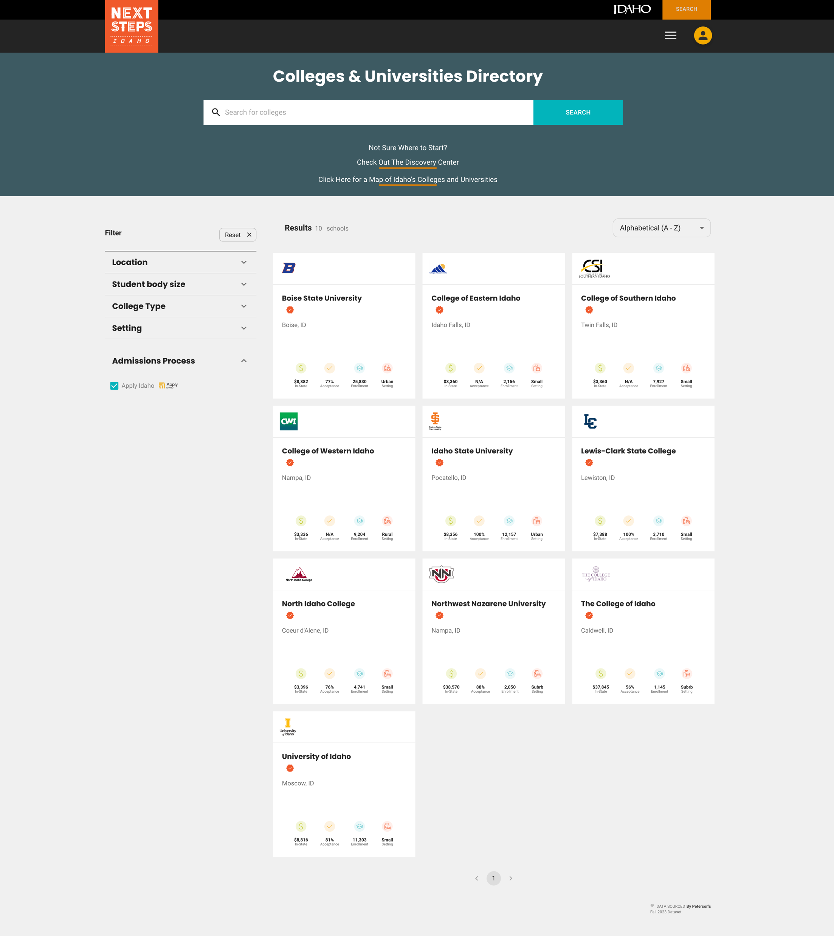
BEFORE STARTING AN APPLICATION
Think about where you want to apply to college. You can apply to up to 10 schools using Apply Idaho, but it makes the most sense to narrow your list to those you would want to attend.
Use the Next Steps Idaho Colleges & Universities Directory to research the options.

Slide 4
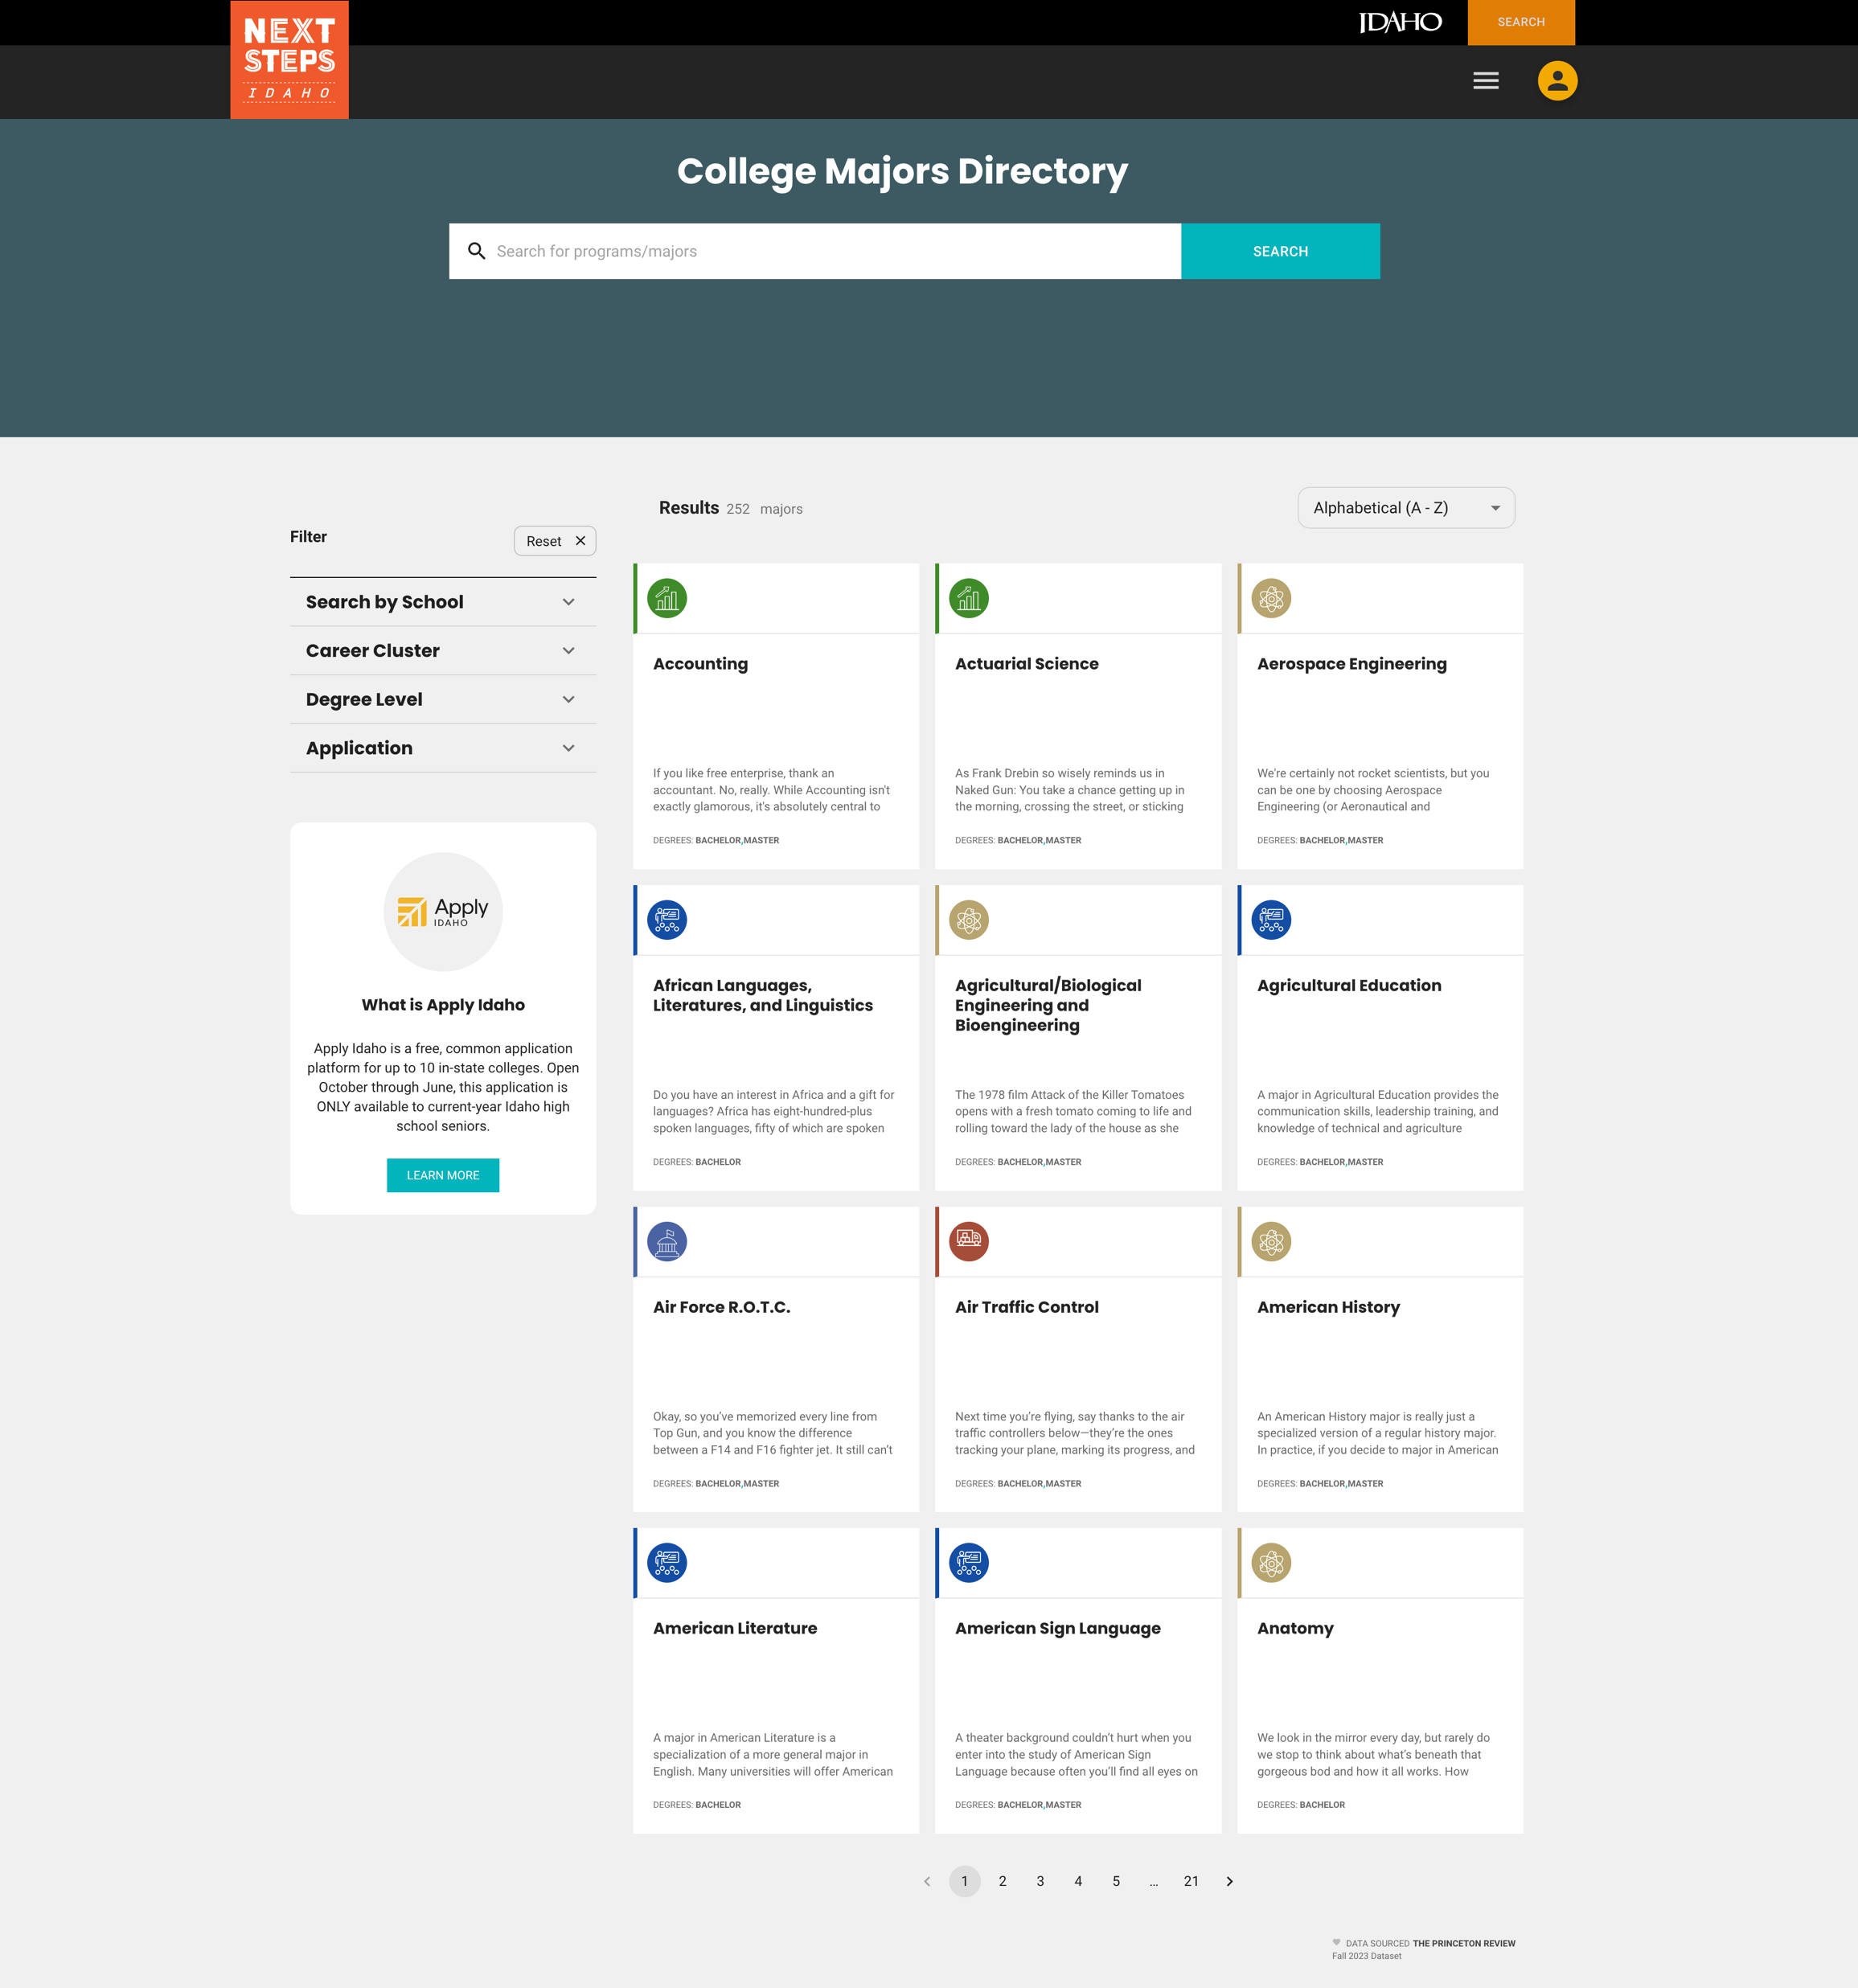
BEFORE STARTING AN APPLICATION
Consider what you want to study and research the majors the schools you are applying to offer.
Use the Next Steps Idaho Major Directory to search for degree options.

Slide 5
GATHERING ADDITIONAL INFORMATION
To start an application, you’ll need to have these things:
Your EDUID number: Ask your counselor if you don’t know this – it’s not necessarily the same as your school student ID.
A Personal email address: Not one that is issued by your school, because you may lose access to this when you graduate.
Social Security Number: Not required, but strongly encouraged for financial aid purposes.
High school graduation month and year
Permanent and mailing address: May be the same, but may not be if your family uses a P.O. Box to receive mail, for example.
Planned college start date: Most students will start in the fall after high school graduation.

Slide 6
CREATING AN ACCOUNT
STEPS
Enter basic student information
Enter your PERSONAL email address
Agree to the terms and conditions
Verify your email address
Login to the email you used to create your account and look for an email from applyidaho@edu.idaho.gov
Click on the verification link in that email.
When you are ready to apply, you’ll start an account, which is where you will be asked to provide most of the things previously mentioned.
Be sure to use your legal name, as it appears on your school documents and SAT/ACT score transcripts, as this will make it easier to get your records connected.

Slide 7
There are six sections of the application:
PROFILE
More student information
EDUCATION
Questions about your high school and your GPA & ACT/SAT Test scores
FAMILY
Questions about your parent/guardian and their educational history
INSTITUTIONS/MAJORS
This is where you select the colleges and programs you want to apply to.
SUPPLEMENTAL QUESTIONS
Some institutions need to get additional details to process your application. Most of these questions are not required but you are highly encouraged to fill it out.
APPLICATION SUMMARY
Check all your answers to make sure you have completed everything.
YOU ARE READY TO APPLY!

Slide 8
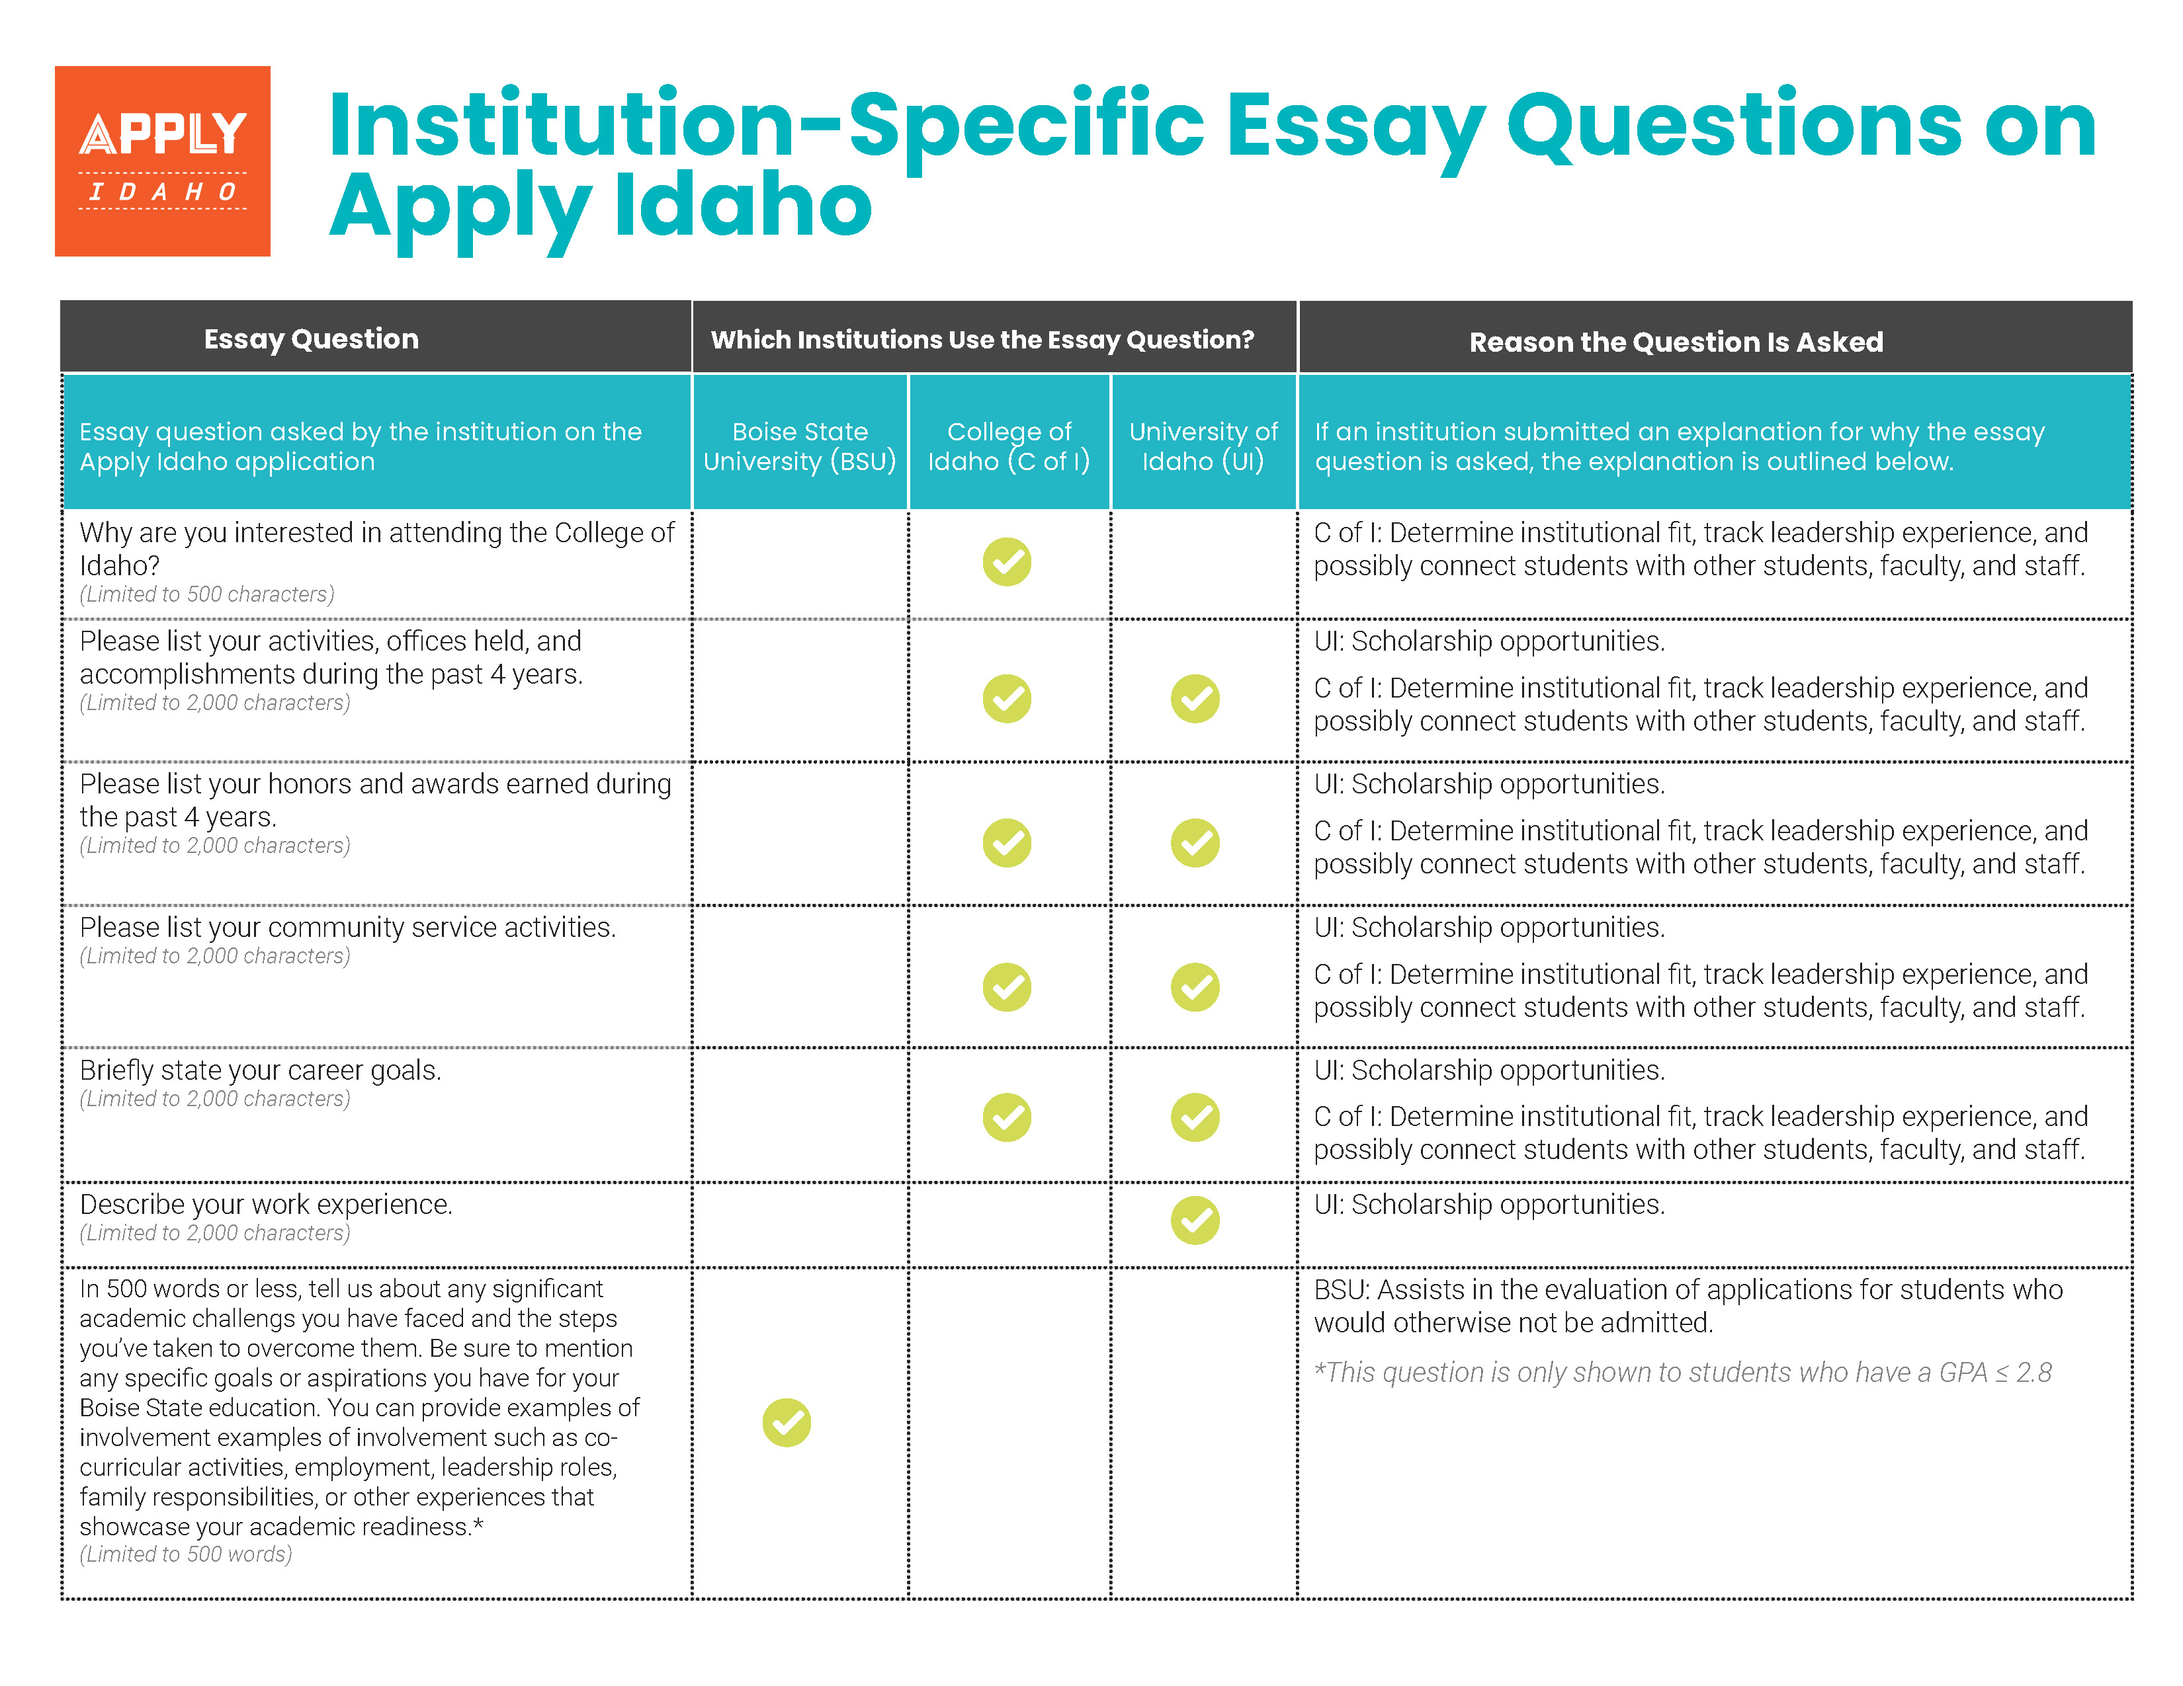
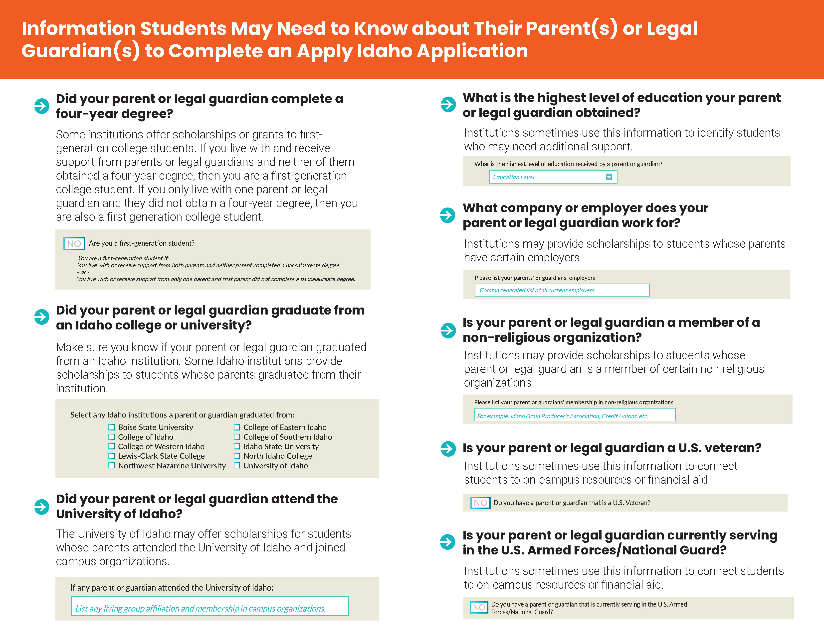
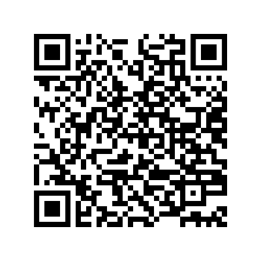
To prepare to answer these questions, download the Apply Idaho Flyer for supplemental questions, so you can see all of them in advance.
INSTITUTION-SPECIFIC SUPPLEMENTAL QUESTIONS
While most of these questions are optional, students are encouraged to answer them, as schools use answers to match you with resources like housing and scholarships.
Depending on your GPA and the institutions you are applying to, there may be some questions you must answer before you can submit your application.
https://nextsteps.idaho.gov/assets/uploads/2023/09/ApplyIdahoEssayQuestionFactSheet-2023.pdf

Slide 9
SUBMIT!
Once you’re reviewed your application summary page and are satisfied with your answers, click the submit button.
Note: you can return to your application to add additional colleges, even after it is submitted. Make sure to return to this page and click “Resubmit”

Slide 10
WHAT HAPPENS NEXT?
Keep checking your email! Colleges will email you within two weeks to either give you their decision, or they may need more information from you.
Make sure to fill out Scholarship Idaho and investigate other scholarship opportunities.
Create your FSA ID and start filling out your FAFSA to see what opportunities you are eligible for to help pay for school.
Check in with your school counselor to see if/when colleges are coming to visit so you can get more information and get your questions answered.

Slide 11
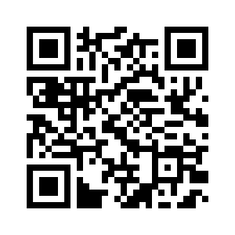
QUESTIONS?
For more information visit nextsteps.idaho.gov/apply-idaho

