Slide 1
HOW DOES HEALTH IMPACT MY WORK?
Date here
WHAT REALLY MATTERS TO ME?

Slide 2
LEARNING OUTCOMES
STUDENTS WILL BE ABLE TO (SWBAT):
Describe how health and wellness relate to school and work
Identify steps they plan to take to support their physical and mental health
FOCUS STANDARDS:
Domain 1: Self Evaluation (Who am I?)
3. Identify Values (What really matters to me?)
C. Relate the importance of health and wellness to school/work.
D. Document a reflection of the results

Slide 3
WHAT ARE HEALTH AND WELLNESS?
Health: “A state of complete physical, mental, and social well-being and not merely the absence of disease or infirmity (World Health Organization)
Wellness: “the pursuit of activities, choices, and lifestyles that lead to a state of holistic health; six categories: physical, mental, emotional, spiritual, social, environmental,” (Global Wellness Institute)
ON YOUR STICKY NOTE: What do you think health and wellness have to do with school and work??
Notes:
INSTRUCTOR: This is a great time to introduce the discussion of our topic. Students can pair and share or individually share their sticky notes. You could have them place all of their thoughts on a wall or whiteboard, or save the note to write an “ending reflection” on the back after the lesson!

Slide 4
Notes:
IMAGE: https://umwellness.wordpress.com/8-dimensions-of-wellness/

Slide 5
HOW DO HEALTH AND WELLNESS AFFECT SCHOOL AND WORK?
Life can be stressful!
There are things in our lives that we can control, and other things that are outside of our control.
Stressors, and how we manage them, play a large role in our performance.
WHAT ARE SOME STRESSORS IN YOUR LIFE?
DO YOU HAVE ANY STRESS MANAGEMENT TOOLS?
Notes:
INSTRUCTOR: Allow students to share current stressors they are facing (or ones they worry about in the future). Ask them about current management techniques. This could be a time to let students get ideas from each other and/or to offer suggestions and your own experiences to guide them.

Slide 6
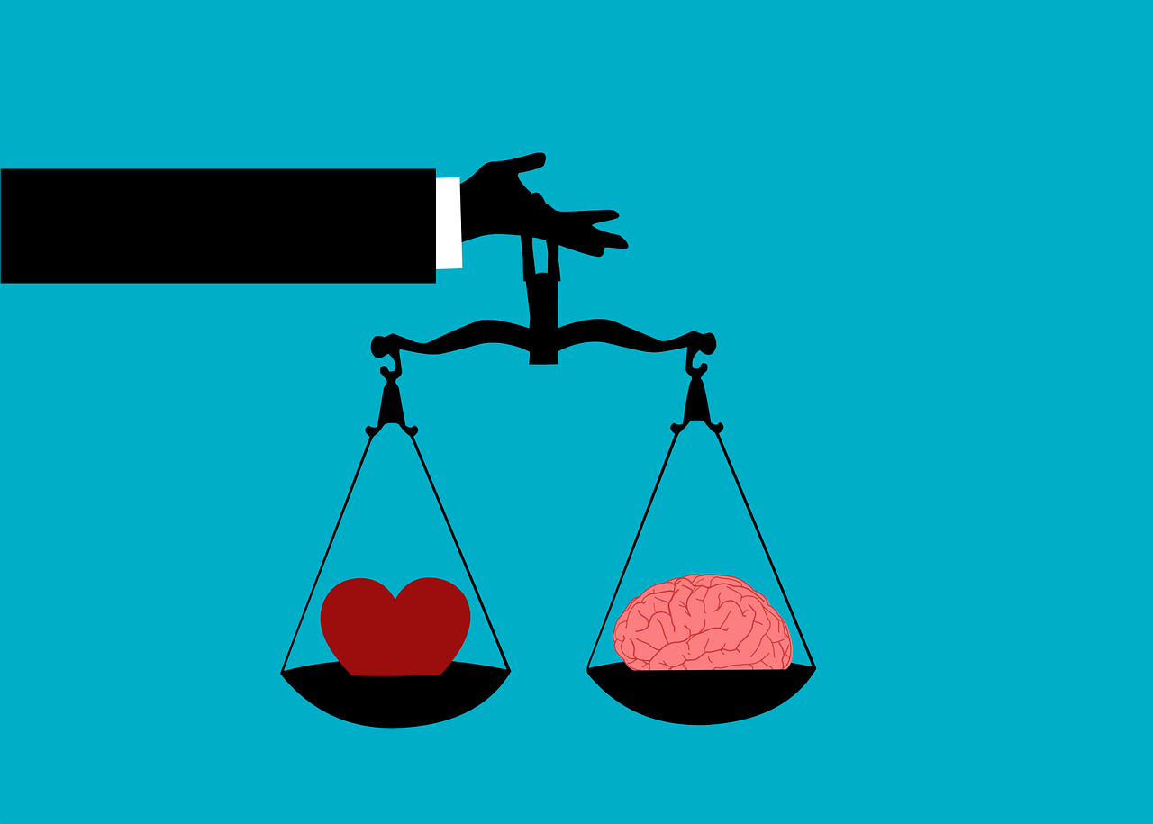
TWO DIMENSIONS OF WELLNESS
PHYSICAL WELLNESS
Physical Body: nourished through exercise, nutrition, and sleep
MENTAL/EMOTIONAL WELLNESS
Mind: engaging with the world through learning, problem-solving, and creativity
Heart: expressing our feelings and accepting the feelings of others
Notes:
INSTRUCTOR: Explain that while there are 8 identified components of wellness, we will be focusing on two.
Opportunity to have students share what they already know about these things and which one they believe is more important (if either).
IMAGE: https://www.kindpng.com/imgv/mobJRJ_work-life-balance-female-hd-png-download/

Slide 7
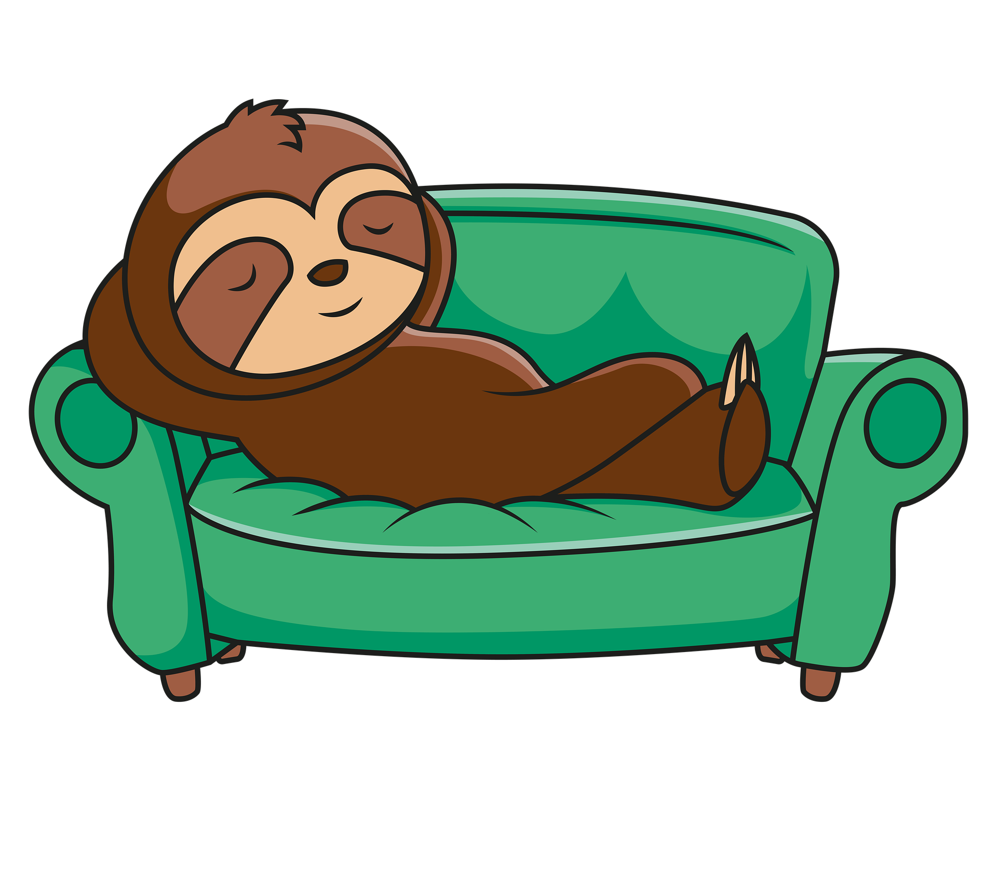
PHYSICAL WELLNESS
RATE YOURSELF ON A SCALE OF 1 (not doing at all) to 10 (doing consistently) FOR EACH OF THE FOLLOWING:
SLEEP
8-10 hours per night
NUTRITION
Regular meals consisting of fruits and vegetables, lean protein, whole grain, and water
PHYSICAL ACTIVITY
Exercise/Movement that you enjoy for approx. 30 minutes a day
HYGIENE
Showering, washing hands, brushing/flossing teeth, doctor check-ups, disease prevention
RELAXATION AND SELF-CARE
Schedule time for your favorite activities/relaxation time
Notes:
INSTRUCTOR: Consider elaborating on each of these items as you go through!
Emphasize that these things work together, it isn’t helpful to only focus on one without the others.
**If you want to add in fun facts:
Teens need more regular sleep than other populations (offer why if wanted)
30 minutes a day of walking can boost mood and reduce stress

Slide 8
MENTAL EMOTIONAL HEALTH
WHAT IS MENTAL HEALTH?
“Mental Health is a state of well-being in which an individual:
Realizes his or her own abilities
Can cope with the normal stresses of life
Can work productively
Is able to make a contribution to his or her community” (World Health Organization)
Notes:
INSTRUCTOR: This could be a productive time to open up the conversation about what kinds of things cause changes in mental health or why some people struggle more than others, etc.

Slide 9
MENTAL WELLNESS: POSITIVE MINDSET
HAVING A POSITIVE MINDSET
A positive mindset can have a big impact on how we handle life’s ups and downs.
POSITIVE THOUGHTS→ POSITIVE FEELINGS→ POSITIVE BEHAVIOR→
RATE YOURSELF ON A SCALE OF 1 (not doing at all) to 10 (doing consistently) FOR EACH OF THE FOLLOWING:
Focus on the positive instead of negative
Turn negative self-talk into positive self-talk
Acknowledge good things you have done
Forgive yourself
Practice gratitude everyday
Spend time with positive friends and family
Notes:
INSTRUCTOR: Consider elaborating on each of these items as you go through!
Emphasize that these things work together, it isn’t helpful to only focus on one without the others.
You may need to define terms like “self-talk” and “gratitude” especially for younger students. Provide examples and encourage students to think for themselves without sharing with partners while they rate themselves.

Slide 10
MENTAL WELLNESS: MANAGE STRESS
HOW TO MANAGE STRESS
Create a to-do list
Set Priorities
Decide on the most important items on the “to-do” list
Don’t be afraid to say “no” to new tasks
Take care of your physical health
Reach out to family, friends, or other trusted adults
For help, love, and support
Practice Mindfulness
Pay attention to the current moment
Avoid dwelling on the past OR worrying about the future
Get off the “hamster wheel”
Notes:
INSTRUCTOR: Ask students to share out what they learned previously about “physical health” and how to manage it!
Consider defining “priorities” or completing a “fake” priorititzation of a “to-do” list for an average student. Try to find a place to say “no,” a place to ask for help, a place for physical health, and a place for mindfulness.

Slide 11
MINDFULNESS ACTIVITY
“3 MINUTE BODY SCAN MEDITATION”
Notes:
INSTRUCTOR: Encourage students to complete the activity with you, but allow them to complete it to their level of comfort/safety.

Slide 12
MINDFULNESS AND COPING SKILLS
Mindfulness: “Mindfulness is the basic human ability to be fully present, aware of where we are and what we’re doing, and not overly reactive or overwhelmed by what’s going on around us.”(Mindful Staff)
Coping Skills: “Coping skills help you tolerate, minimize, and deal with stressful situations in life.”(Morin)

Slide 13
MENTAL WELLNESS: COPING SKILLS
WHAT ARE COPING SKILLS FOR?
HELP YOU MANAGE YOUR FEELINGS
Especially when going through tough times
SOOTHE YOU
Examples: time with pet, taking a bath
TEMPORARILY DISTRACT YOU
Examples: watching/reading something funny, cleaning, calling a friend
HELP YOU TOLERATE YOUR ANXIETY
Examples: deep-breathing, using 5 senses (smell, taste, sound, etc.)
Notes:
INSTRUCTOR: You may need to offer definitions or further explanation for terms like “soothe” and “tolerate.” This could be an opportunity for a share out and have students discuss what they already do to “cope” – offer the chance to share about coping strategies that are NOT effective and discuss why.

Slide 14
COPING SKILLS
CREATE A “TOOLKIT”
Identify strategies that work for you when you feel stressed
Use the list provided to circle or highlight AT LEAST 5 coping strategies that you can use
If there are strategies you use that aren’t on this list, add them!
Notes:
INSTRUCTOR: Give students 5-10 minutes to look through the list and add items to their assignment. Consider making a list on the board of strategies that your students are most interested in or find the most helpful!

Slide 15
CONCLUSION
ON YOUR ASSIGNMENT SHEET:
Create TWO wellness/health-based goal for yourself based on your self-assessments above.
Create one goal based on your physical health, and one goal based on your mental health.
Identify TWO action steps you will take to help you achieve this goal.
REMEMBER:
There are many components of overall wellness that we haven’t covered
Physical and Mental health are two primary areas
Prioritizing these two things can lead to better balance and success in other areas of life

