Slide 1
Going on a job hunt!
Date here
WHAT’S OUT THERE FOR ME?

Slide 2
LEARNING OUTCOMES
STUDENTS WILL BE ABLE TO (SWBAT):
1. Utilize self-evaluation results to choose a career or career pathway to study
2. Analyze and present information about the chosen career by creating a brochure
FOCUS STANDARDS
Domain 2: Career Exploration (What’s out there for me?)
1. Apply self-evaluation to the world of work (Where do I fit in the world of work?)
E. Choose a cluster or occupation. Research the education or training required including program of study, labor market information, and wage compared to Idaho’s living wage.

Slide 3
DO NOW
REFLECT ON THE FOLLOWING
Why is it important to research a career at this point in your life?
Is the career you are interested in now going to be the career you end up with?
Why is it important to be open-minded about choosing a career?
Notes:
INSTRUCTOR: Help students build connections between career interest now vs career they end up with and open minded-ness. Encourage students to share their thoughts on these topics. How much do they value these experiences and lessons? What would happen if they didn’t do this kind of research?
Provide examples, if possible. (i.e. what career were you matched them? Have you ever had a career change? Etc).

Slide 4
WHAT QUESTIONS DO YOU HAVE?
QUESTIONS ABOUT YOUR FUTURE CAREER
What do you want to know from the EMPLOYER?
What do you want to know from other EMPLOYEES?
What aspects of a career are most important to YOU?
How do you want your future to look?
What resources do you have available to you?
Notes:
INSTRUCTOR: This slide was meant to be compatible with PearDeck. You can easily post this question for students to answer via device if you prefer!
Encourage students to think about the many different areas in which they might seek information about a career that they choose. Each of these avenues could provide different critical information to help make a choice suitable for any candidate.
You may want to provide examples. i.e. what is the average salary? Does this job require travel? Are you able to do this job from home? How much time is spent on a computer or at a desk? Will you be collaborating with others often or mostly working individually? Do you have to speak in front of people for this job? Will you have work odd/unusual hours? What is the highest level of education required? Do you need to complete an externship? Is there a way to grow within this career field?

Slide 5
REVIEW AND RESEARCH
USE YOUR RESULTS FROM YOUR SELF-EVALUATION
If you haven’t taken a self-evaluation yet:
Interest Profiler
Choose a career from your self-evaluation results to research
Review the qualities/skills required
Assess the questions that will be specific for that career path
Notes:
INSTRUCTOR: Make sure students have access to the self-evaluation or their past results from the eval. Give them a few minutes to get re-oriented with the information and choose the career they want to use for the project.

Slide 6
YOUR PROJECT
BECOME AN EXPERT
Choose a career that “fits” you
Answer the questions on the provided handout
You will use this information to create your final product (be thorough!)
USEFUL WEBSITES FOR RESEARCH
Next Steps Idaho
US Bureau of Labor Statistics
Career One Stop

Slide 7
HERE’S WHAT YOU NEED TO INCLUDE
CREATE A BROCHURE FOR YOUR CAREER
A description of the job (including daily tasks/requirements)
Describe some of the skills required to do this job
List the education/training required (including program of study)
If available, include the MINIMUM qualifications
If available, Include labor market information
List local college/business support or hire for this job
List the average national salary, and if possible, compare it to Idaho’s average salary for this job
Include your desire and reasoning for choosing this career

Slide 8
EXAMPLE: OUTSIDE OF BROCHURE
INSIDE FLAP
BACK
COVER

Slide 9
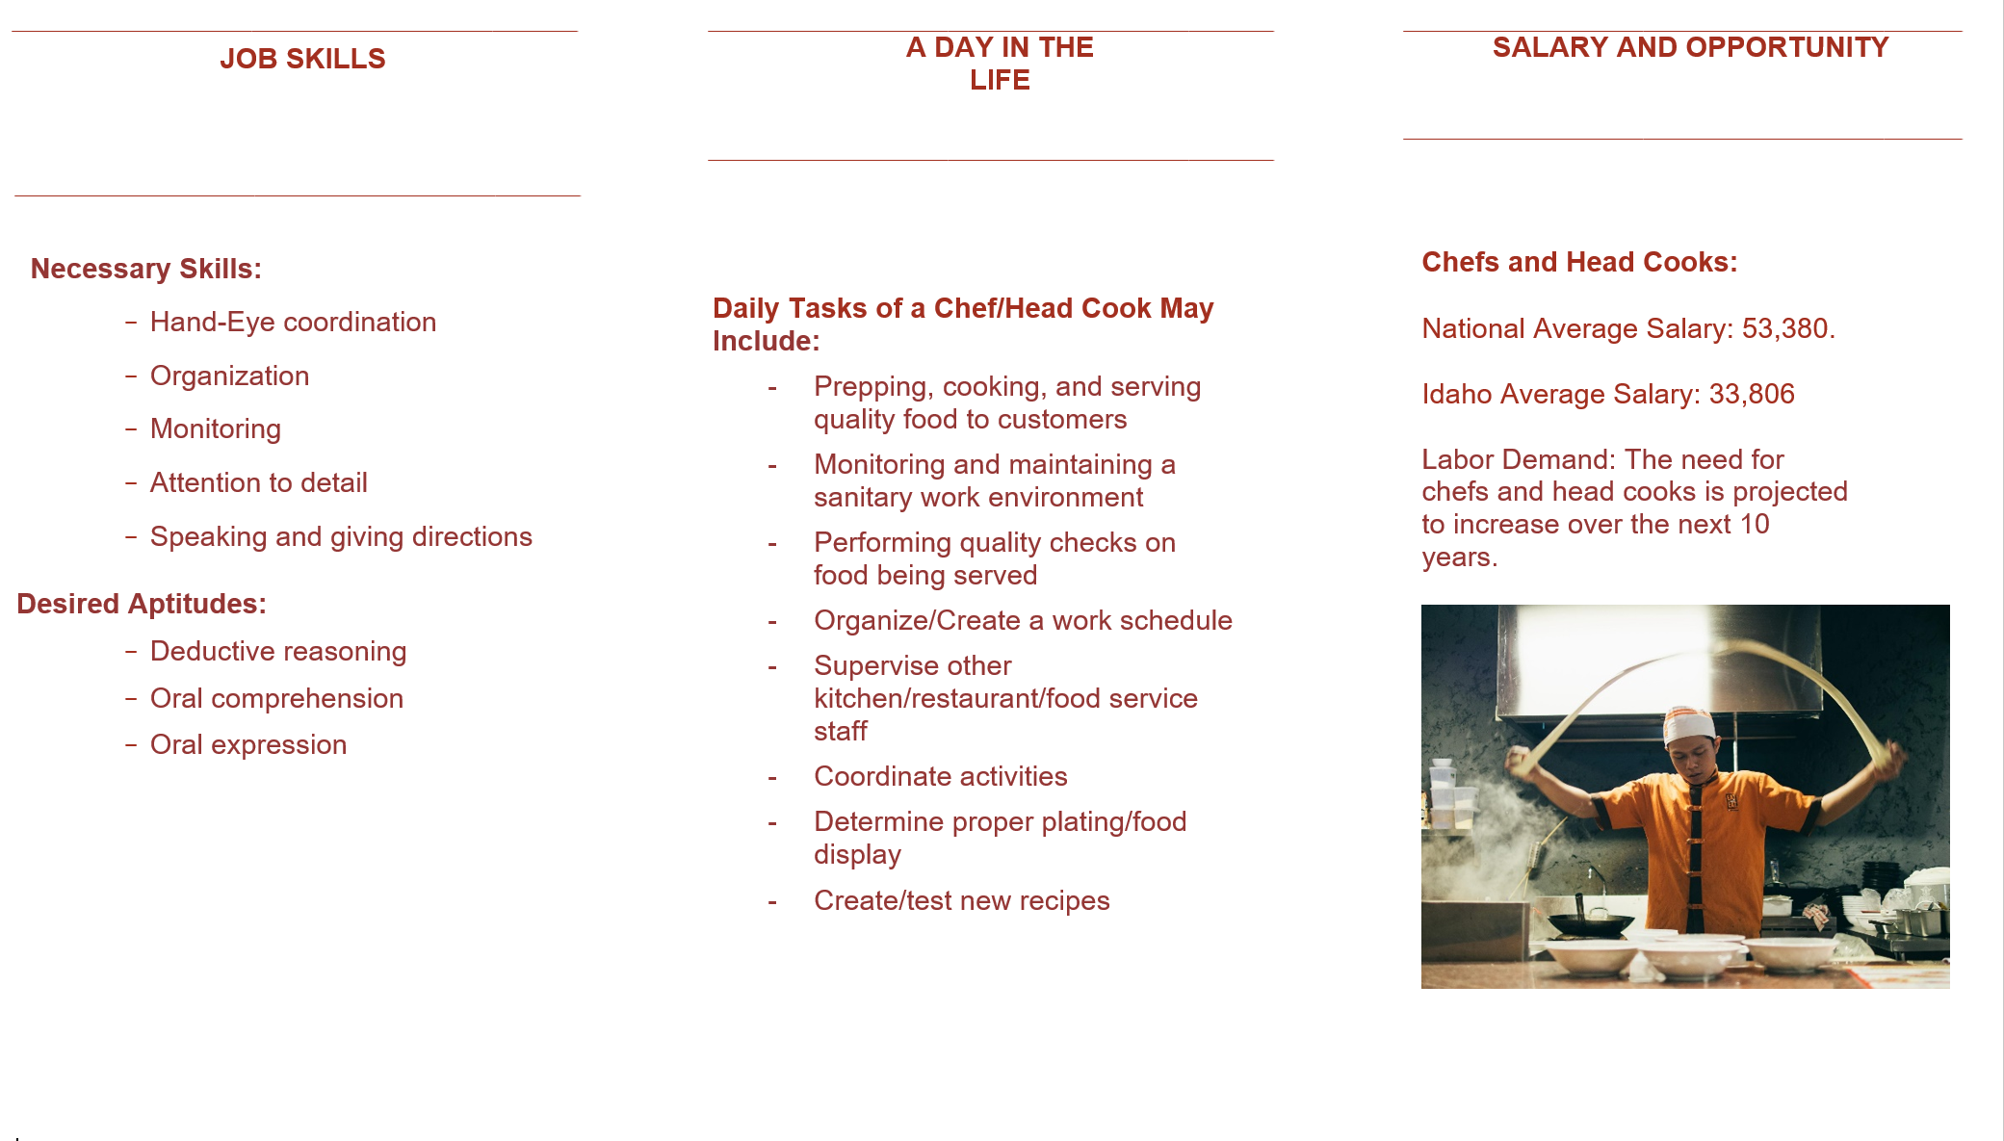
EXAMPLE: INSIDE OF BROCHURE
LEFT
CENTER
RIGHT

Slide 10
PREPARE TO SHARE
SHARE YOUR CAREER BROCHURE WITH THE CLASS
Summarize the information you found
Include 3-5 most important facts
Explain why you chose that career

