Slide 1
HOW IMPORTANT IS MY SOCIAL MEDIA?
Date here
WHAT AM I GOOD AT?

Slide 2
LEARNING OUTCOMES
STUDENTS WILL BE ABLE TO (SWBAT):
Evaluate their use of social media.
Evaluate and demonstrate understanding of the potential risks of using social media.
FOCUS STANDARDS
Domain 1: Self Evaluation (Who am I?)
4. Identify Skills (What am I good at?)
C. Information Security
Evaluate presence on social media
Evaluate the risk associated with presence on social media

Slide 3
“WE DON’T HAVE A CHOICE ON WHETHER WE DO SOCIAL MEDIA, THE QUESTION IS HOW WELL WE DO IT.”
Quote by: Erik Qualman
Notes:
Quote from: https://www.linkedin.com/pulse/social-media-advertising-10-quotes-from-marketing-genius-petrilli

Slide 4
BRAIN DUMP
WHAT ARE YOUR OPINIONS ABOUT SOCIAL MEDIA RIGHT NOW?
What are your likes vs. dislikes?
Can you identify pros and cons?
Do you have it?
What is it for?
How is it harmful vs. helpful?
Write as many as possible on your assignment sheet!
Notes:
INSTRUCTOR: Opportunity to use the whiteboard, posters, or an online platform to have students write down/submit some of their initial thoughts and ideas about social media. Use the thoughts that they contribute as discussion starters.

Slide 5
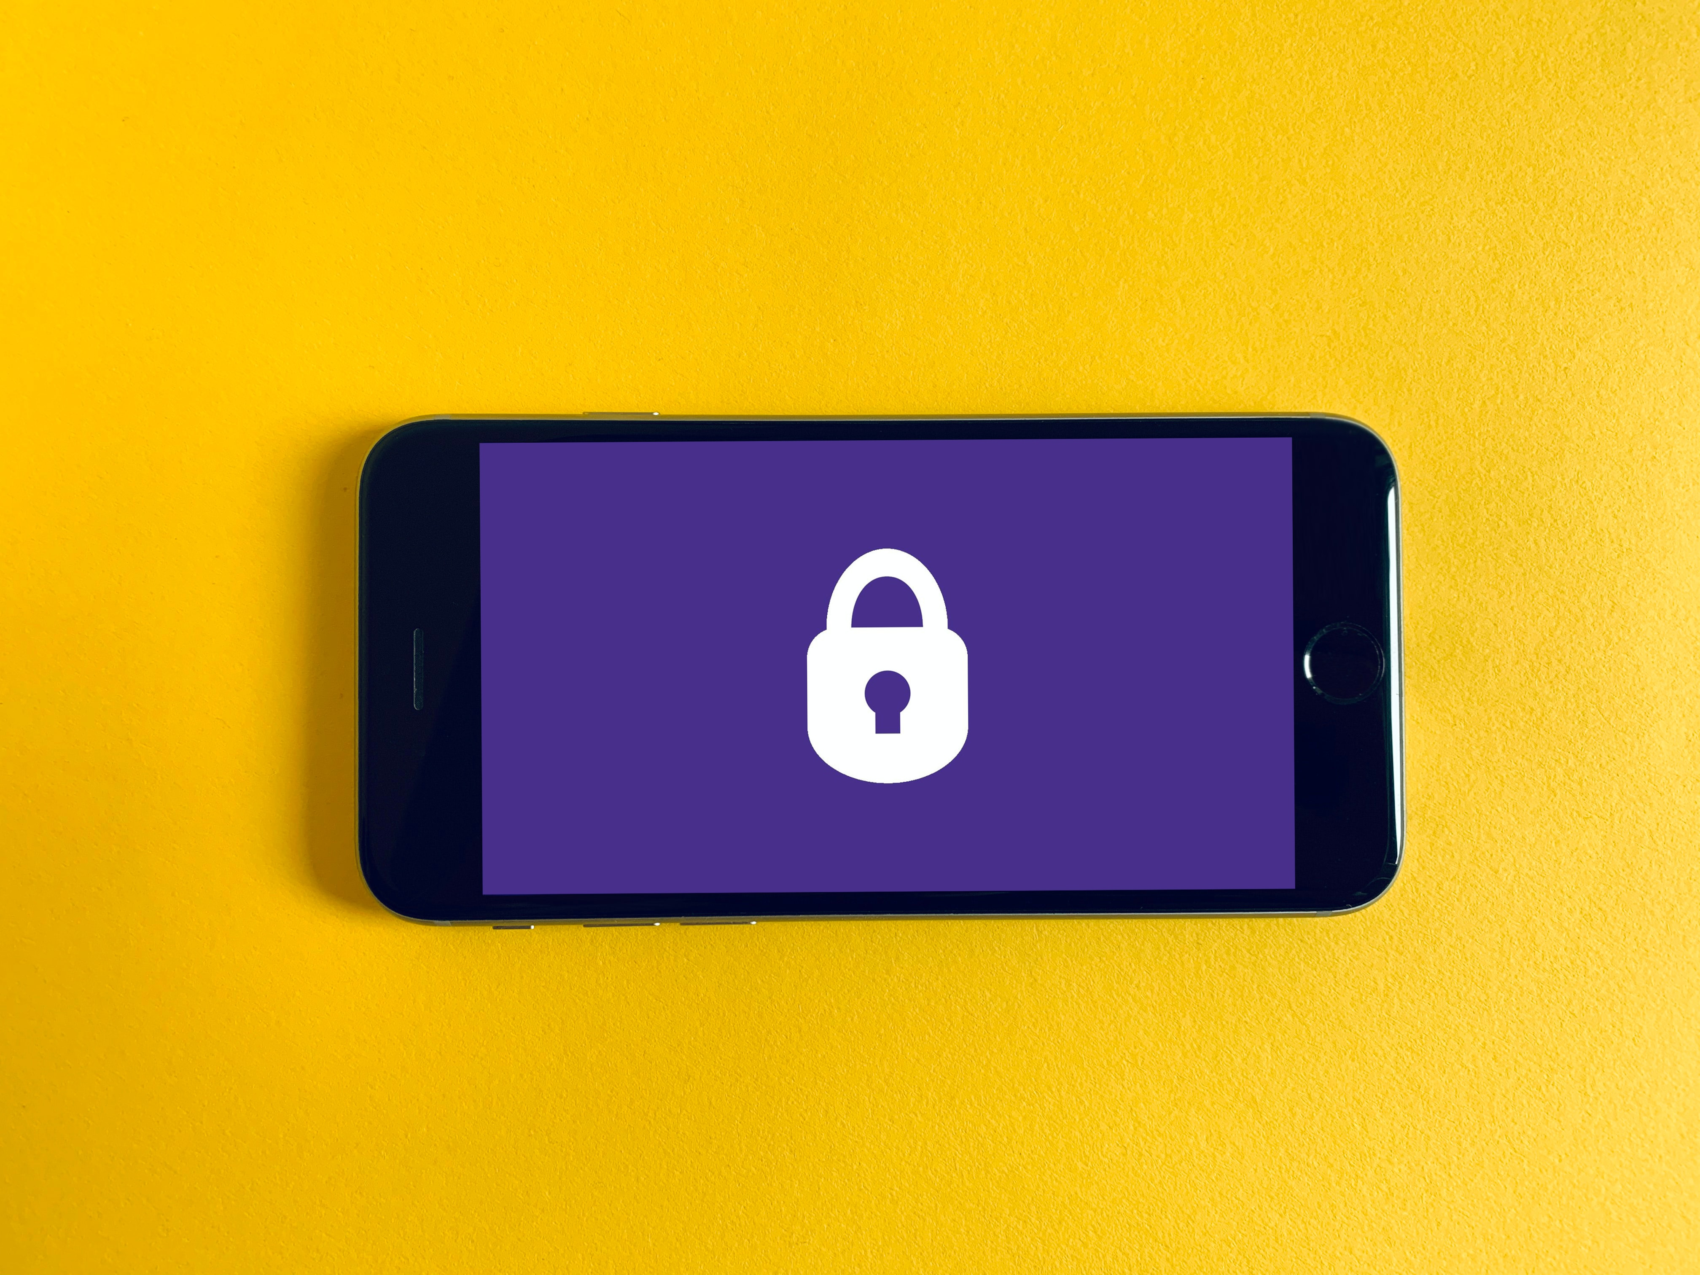
SOCIAL MEDIA: TERMS TO KNOW
INFORMATION SECURITY: protecting information and information systems from unauthorized access
PLATFORM: Technology which allows the sharing and interaction of users who form an online community.
PROFILE: An account created by an individual or business to share information about themselves and connect with others.
PRESENCE: refers to how a social media user posts and engages on their social media accounts.
Notes:
INSTRUCTOR:
Information security additional info: also protects from misuse, disclosure, disruption, modification, or destruction in order to provide integrity, confidentiality, and availability.
Consider having students discuss or evaluate how these things look or what they mean depending on the user’s age, job, lifestyle etc.
DEFINITIONS FROM: https://www.nist.gov/

Slide 6
SOCIAL MEDIA PLATFORMS
LIST ALL OF THE SOCIAL MEDIA PLATFORMS YOU CAN THINK OF.
FOR EACH ONE, TRY TO ADD:
Who uses this platform?
What is it primarily used for?
How secure do you think it is?
Notes:
INSTRUCTOR: It could be effective to have students work in partners or group to complete this brainstorming. Push them to think not only about the name of each platform, but what that platform specifically is doing, who is using it, etc.

Slide 7
HOW MANY SOCIAL MEDIA PLATFORMS ARE YOU ON?
# OF SOCIAL MEDIA PLATFORMs | # OF STUDENTS
0 -2
3-5
5+
Notes:
INSTRUCTOR: If times allows, this is a great opportunity for class participation and interaction. Tally up how many students fall into each category and write them on the board. If desired, have students from the different groups speak to their experience, reasoning, or ideas for the number of platforms they use.

Slide 8
SOCIAL MEDIA “FRIENDS”
PEOPLE LIKE SOCIAL MEDIA BECAUSE THEY BELIEVE IT HELPS THEM TO BUILD CONNECTIONS WITH OTHERS.
ANSWER THE FOLLOWING QUESTIONS FOR YOURSELF:
How many friends/followers do you have on your MOST USED social media platform?
How many of these friends/followers have you actually met in person?
How do you know the friends/followers you haven’t met in person?
Is this a concern or risk to you? Why or why not?
Notes:
INSTRUCTOR: You could allow for a discussion/debate of how “real” or “authentic” online relationships are. This is an important idea for people to consider in the world right now, and could lead to insight on both sides.

Slide 9
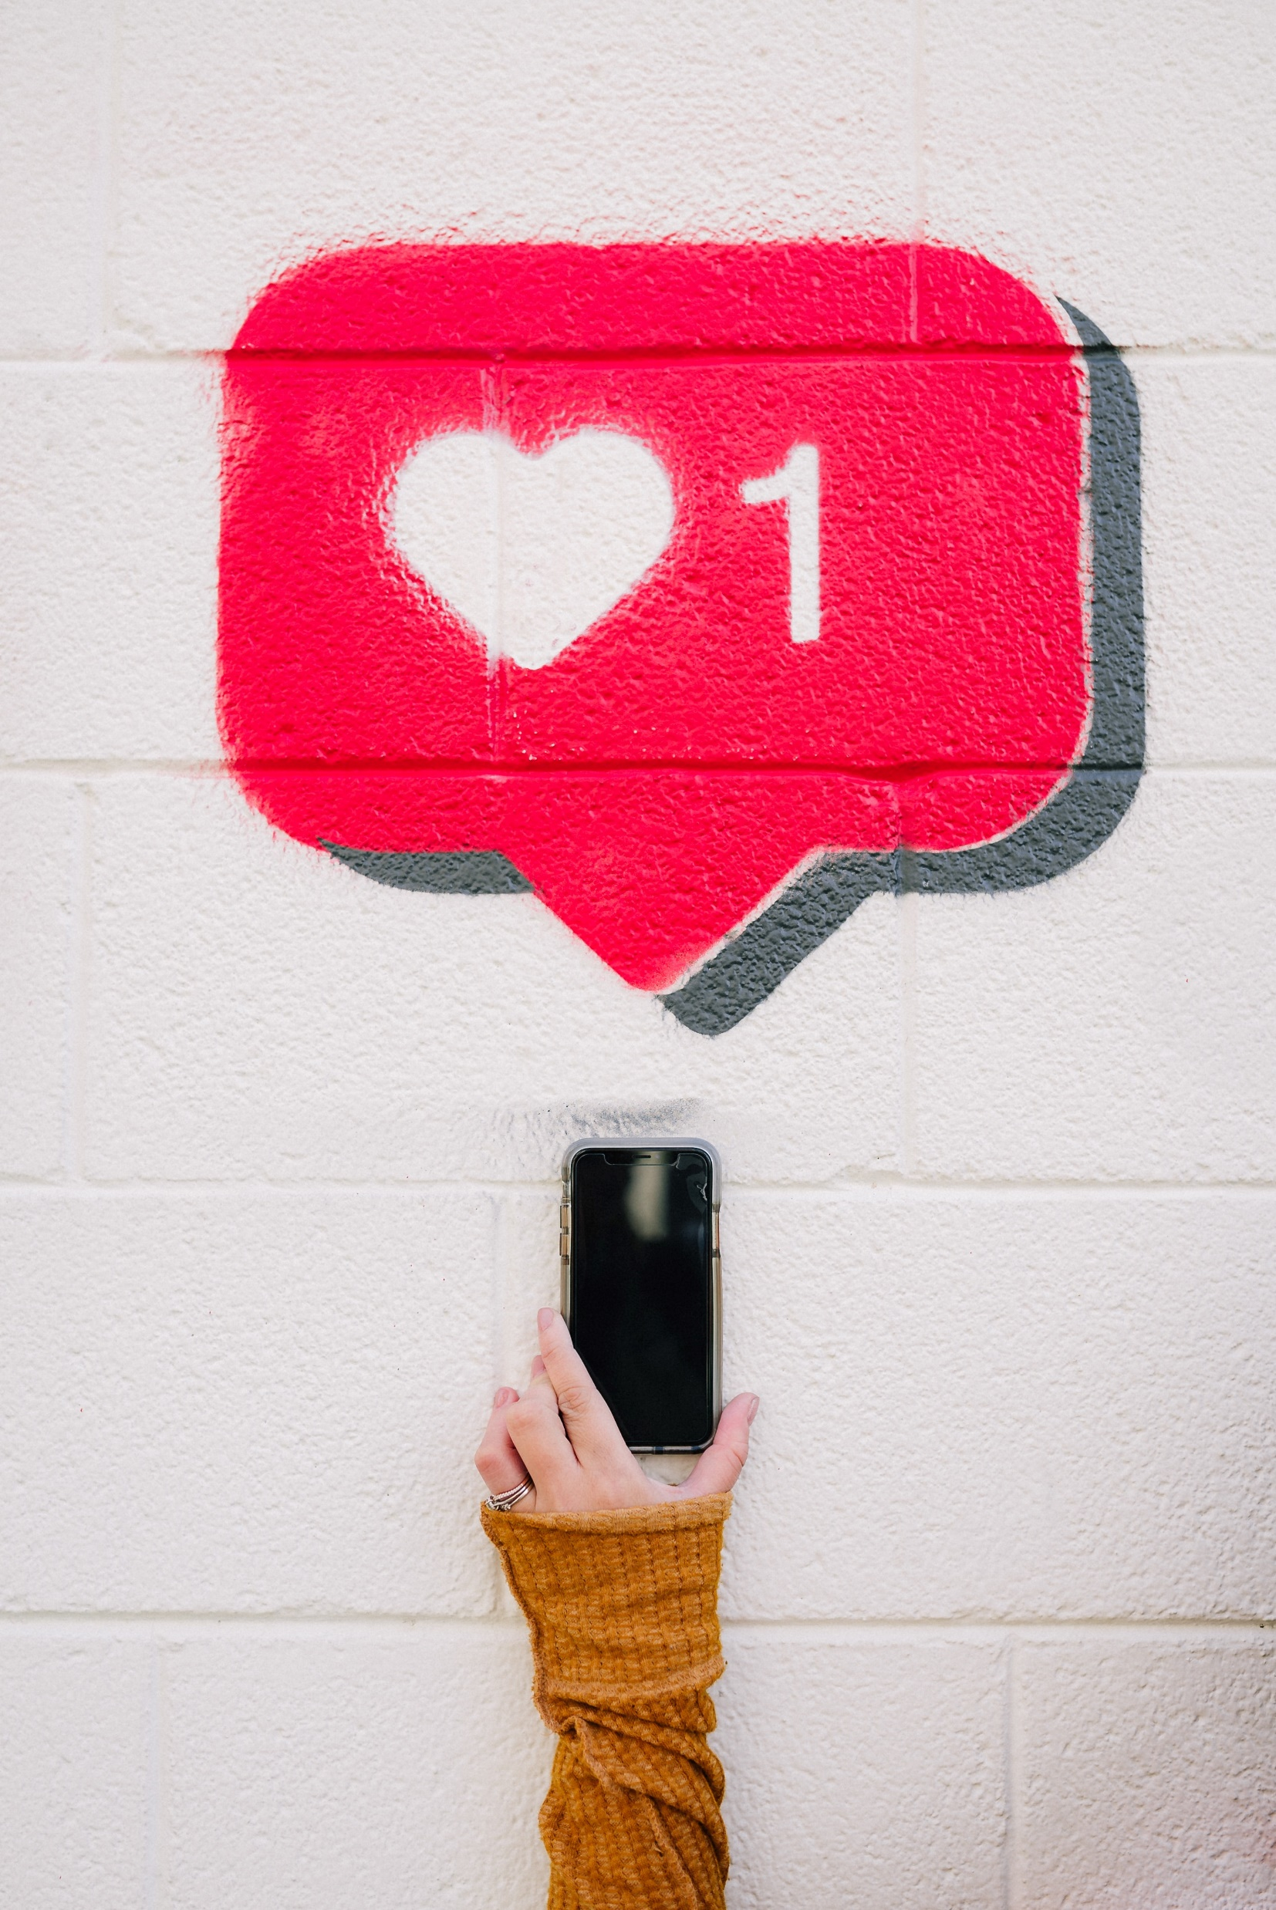
DEBATE/DISCUSS
IS IT POSSIBLE?
For a teen growing up in the world right now to have a social life/social circle/friends/etc. without having any presence on social media? Provide reasoning for your answer.
Notes:
INSTRUCTOR: You can choose to actually debate/discuss this question or just have students think about it. For an especially involved class, it may be fun to assign them a stance and have them practice arguing or debating with a partner. This activity can force them to see both sides, regardless of what they believe(d) initially.

Slide 10
POST REGRETS
THE INTERNET IS UNFORGIVING.
Once something is posted on the internet, there is no way to get rid of it.
Have you ever posted something you wish you didn’t?
Can you think of a time where this has happened on a larger scale (celebrities, politicians, public figures, etc.)?
What were the consequence or implications of these posts?

Slide 11
SOCIAL MEDIA AND EMPLOYMENT
HOW DO YOU THINK EMPLOYERS USE SOCIAL MEDIA?
Tomorrow, we will be reading an article on how employers use social media to hire and fire their employees.
EXIT TICKET: On your sticky note, complete the following:
ANSWER: Should employers be allowed to take an employee’s social media into consideration when they are hiring or firing them?
ASK: Create one question of your own based on today’s lesson/material.
Notes:
INSTRUCTOR: Exit Ticket is optional and could be completed on a sticky note, slip of paper, Pear Deck, or as a popcorn sharing activity at the end of class!

Slide 12
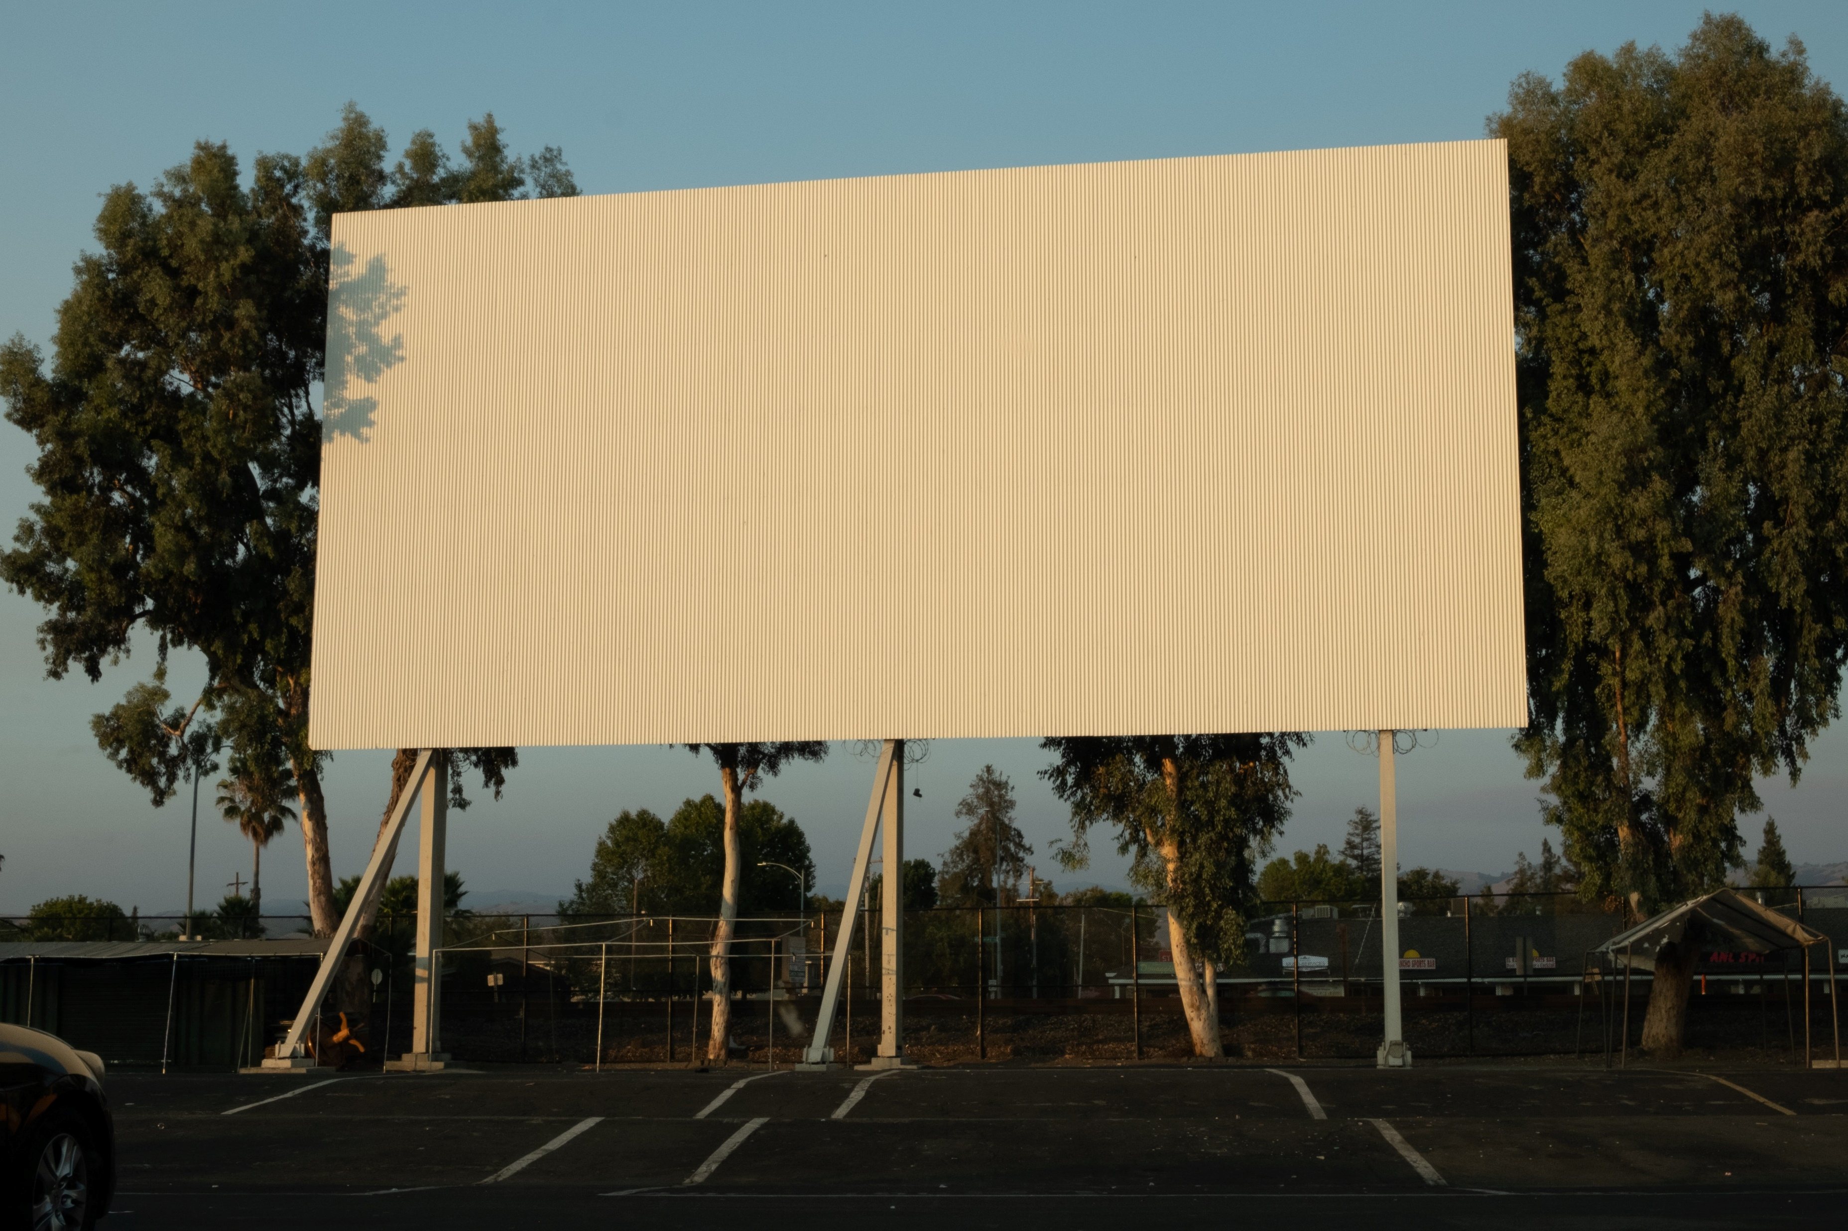
“DON’T SAY ANYTHING ONLINE THAT YOU WOULDN’T WANT PLASTERED ON A BILLBOARD WITH YOUR FACE ON IT.”
Quote by: Erin Bury
Notes:
Quote from: https://www.socialsamosa.com/2017/06/quotes-on-social-media/
INSTRUCTOR: Use this as the “Do Now” for day 2 of this lesson. Have students respond whether they agree or disagree and how this relates to the workplace. Give opportunity for discussion if desired.

Slide 13
KEEP IT CLEAN: SOCIAL MEDIA SCREENINGS GAIN IN POPULARITY
ANSWER THE FOLLOWING QUESTIONS AFTER READING THE ARTICLE:
What are some of the reasons that article lists for WHY employers will check a potential employee’s social media?
Why is it advised to NOT delete your social media while you are job searching?
What does the article encourage users to AVOID when it comes to their social media presence?
Is there anything on your social media right now that you wouldn’t feel comfortable sharing with a future employer (or college recruiter)?
Notes:
INSTRUCTOR: While/after reading allow for discussion including whether these screenings are an invasion of privacy, why they can be helpful OR hurtful for candidates, and whether they changed their initial opinion on them.

Slide 14
EXIT TICKET
REVIEW THE “SOCIAL MEDIA CHECK LIST”
What changes can/should you make to improve your own social media?
Notes:
INSTRUCTOR: Have students fill out the checklist on their assignment sheet for their own social media accounts. It might be effective to go through the list and recommendations together!

