Slide 1
WHAT IS WORK ETHIC?
Date here
WHAT AM I GOOD AT?

Slide 2
STUDENTS WILL BE ABLE TO (SWBAT):
Define Work Ethic
Describe the importance of work ethic in the workplace/classroom
LEARNING
OUTCOMES
FOCUS STANDARDS:
Domain 1: Self Evaluation (Who am I?)
4. Identify Skills (What am I good at?) B. Work Ethic
Define work ethic and its importance in the workplace

Slide 3
DEFINING TERMS
WHAT IS WORK ETHIC?
“Work ethic is a value based on hard work and diligence. It is also a belief in the moral benefit of work and its ability to enhance character.” (Educalingo)
Work ethic is about being reliable and self-driven.
Work ethic is important in the workplace (of course!), but is also applicable in school, sports, relationships, and personal growth.
EXAMPLES
Following through on assignments
Meeting deadlines
Being a good team player
Notes:
INSTRUCTOR: Encourage students to share ways in which they already do (or have had to) practice having Work Ethic. You could also ask them to consider people who they believe have a strong sense of work ethic and discuss what those people do/why they are successful/etc.

Slide 4
“WORK ETHIC IS A SELF-COMMITMENT TO HONOR YOUR JOB, TAKE PRIDE IN HARD WORK, AND DELIVER THE BEST RESULTS POSSIBLE — EVEN WHEN YOU DON’T FEEL LIKE IT.” Quote by: Kai Dickerson
Notes:
Source: (https://www.jobcase.com/articles/what-is-work-ethic-simple-definition-plus-examples)

Slide 5
THE IMPORTANCE OF A STRONG WORK ETHIC
Notes:
INSTRUCTOR: After watching the video, have students write down two examples/experiences. One time when they felt they showed a “STRONG” work ethic, and one time when they felt they showed a “WEAK” work ethic. If anyone wants to share, open the floor to the discussion of why and when these experiences happened the way they did.

Slide 6
WORK ETHIC SELF-ASSESSMENT
RATE YOURSELF ON A SCALE OF 1 (you are weak in this trait) to 10 (you are strong in this trait)
SELF-MOTIVATION
No prompt needed to get work done
INITIATIVE
Propose ideas and take matters into your own hands
PUNCTUALITY
Respect deadlines and finish tasks on time
COMMITMENT
Dedicated to the task at hand
Notes:
INSTRUCTOR: You may need to further clarify some of these concepts, especially for younger students. Provide relevant (school-related) examples for each of these concepts to help students connect.
i.e. A self-motivated student will research deeper or complete the assignments without pressure or asking from the teacher. A punctual student is on time to class and submits work on time.

Slide 7
WORK ETHIC IN THE WORKPLACE
LET’S LOOK AT A FEW SCENARIOS
On the next few slides, we will evaluate three possible scenarios in the workplace.
We will discuss which scenario would be more ideal to work with AND how it relates to work ethic.
Notes:
INSTRUCTOR: Instruct students to read through the entire scenario first, then form and opinion WITH REASONING. Consider making a collaborative list on the board to show which scenarios are most appealing or which traits of work ethic are shown in each.

Slide 8
SCENARIO #1
WHO WOULD YOU PREFER TO WORK WITH?
A person who works hard to contribute to group projects
A person who doesn’t meet deadlines or produce quality work.
Notes:
INSTRUCTOR:
Encourage students to share their opinions and thoughts. Make sure to push them to consider what aspects of work ethic are most important here. This could be an opportunity to have students reflect on their experience in completing group projects in school.

Slide 9
SCENARIO #2
WHO WOULD YOU PREFER TO WORK WITH?
A person who has a positive attitude and figures out how to get things done.
A person who complains and does the bare minimum to get by.
Notes:
INSTRUCTOR:
Encourage students to share their opinions and thoughts. Make sure to push them to consider what aspects of work ethic are most important here. Consider presenting to students who positive and negative influences/peers can impact our own mindset or work ethic.

Slide 10
SCENARIO #3
WHO WOULD YOU PREFER TO WORK WITH?
A person who stays focused and is always doing their best.
A person who is constantly goofing off while others are working.
Notes:
INSTRUCTOR:
Encourage students to share their opinions and thoughts. Make sure to push them to consider what aspects of work ethic are most important here. Have students weigh the pros of cons of being the “fun” guy and being the “hard” worker. Is there room for both?

Slide 11
WORK ETHIC SELF-REFLECTION
REFLECT ON YOUR OWN WORK ETHIC
You won’t have to share these results
Be honest and thoughtful in your responses
Notes:
INSTRUCTOR: Encourage to have students complete a 5-10 minute timed-write after the reflection. Have them discuss or provide reasoning for how they rated themselves on the various scales and explain what areas they wish to grow in. This will lead into the article they will be reading.

Slide 12
TIPS TO IMPROVE WORTH ETHIC By: Libby Rutky
IMPROVE YOUR WORK ETHIC
Traits can be developed over time
Self-awareness can lead to improvement in these areas
READ THE ARTICLE AND COMPLETE THE READING QUESTIONS ON YOUR ASSIGNMENT SHEET
Notes:
INSTRUCTOR: May be useful to have student annotate, highlight, underline, or group-read the article.

Slide 13
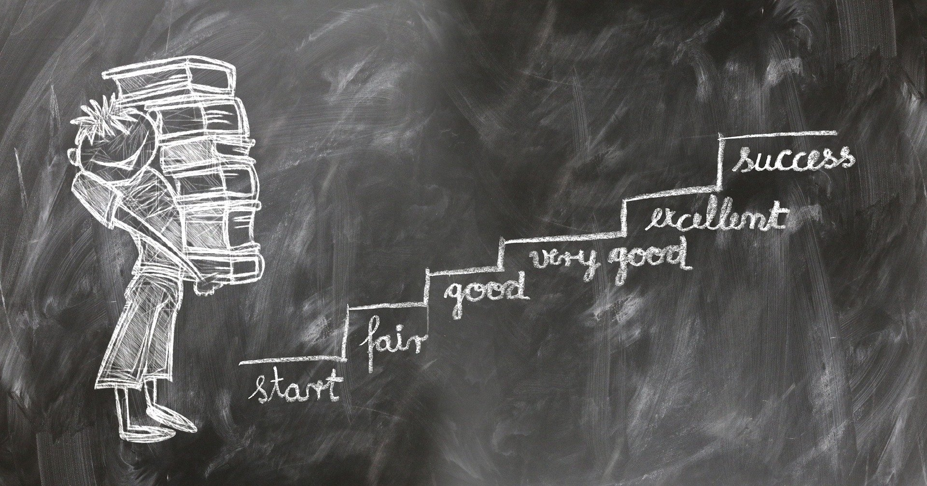
CONCLUSION
STUDENT BEHAVIOR → PROFESSIONAL BEHAVIOR
Develop skills now
Foster and improve skills as you grow
Work Ethic applies to everything you do in life
ON THE BACK OF YOUR ASSIGNMENT SHEET, ANSWER THE FOLLOWING QUESTIONS (complete sentences):
What is one area where you can improve your work ethic?
What specific step(s) can you take to improve in this area?
Notes:
INSTRUCTOR: Even though you’re a student now, you’re learning and developing the skills to be a future employee. You can see from this lesson that work ethic applies to everything you do in life, and now is the perfect time to be developing your work ethic.

