Slide 1
HOW DO I BALANCE IT ALL?
Date here
How Do I Get There?

Slide 2
LEARNING OUTCOMES
STUDENTS WILL BE ABLE TO (SWBAT):
Reflect by taking a self-inventory of time-management skills and identify how to improve.
Utilize the Priority Matrix to organize different tasks by levels of urgency.
FOCUS STANDARDS:
Domain 3: Future Planning (How do I get there?)
Efficiency and Productivity (How do I turn an interest into a plan?)
D. Manage time and resources and track progress throughout the term

Slide 3
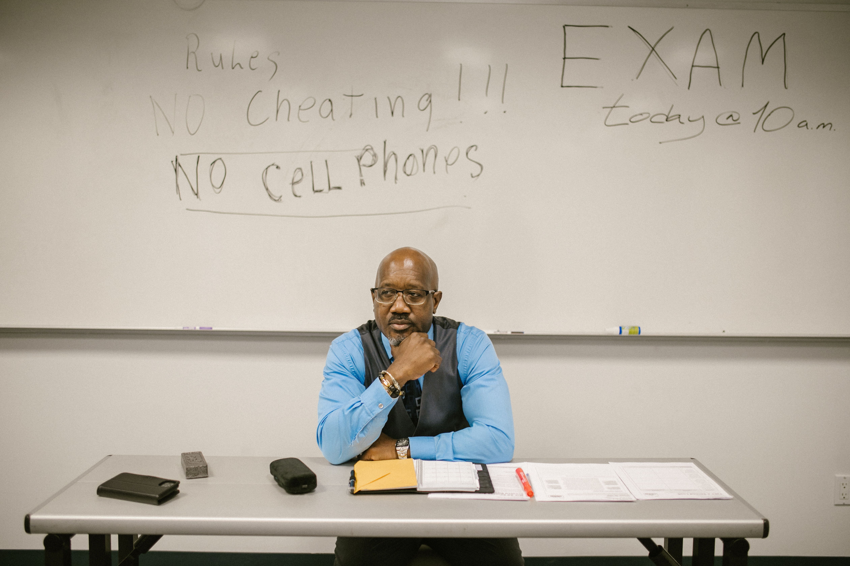
LEARNING THE VOCAB
TEST YOUR KNOWLEDGE
Efficiency and Productivity (Quizlet Review)
Notes:
INSTRUCTOR: Review these terms with students and encourage them to get involved in their own learning. There is no right or wrong for the initial activity.

Slide 4
PRODUCTIVITY VS. BUSY WORK
MISCONCEPTION: Being “busy” means being productive and accomplishing a lot
“Busy Work” often isn’t focused on the things that NEED to be done
Instead it places focus on things that can get done quickly or with little sustained-effort
Keeps you “busy” but is it productive?
Can you think of any examples of “busy work?”
Notes:
INSTRUCTOR: Consider having students brainstorm the different between basic work and over achievements Discuss common beliefs about what “busy” means. Ask your class if they have examples of “busy work”
https://www.puzzlemarketer.com/being-busy-is-not-being-productive/

Slide 5
THE “PRODUCTIVITY” CYCLE
People get into a mindset that these things have to be done.
They get consumed by the same tasks because they are seemingly endless.
The next day begins a new cycle of non-productivity.
Notes:
https://www.puzzlemarketer.com/being-busy-is-not-being-productive/

Slide 6
BUSY, NON-PRODUCTIVE TASKS
IN THE WORKPLACE
Checking emails
Making/returning phone calls
Holding Meetings
Reading the news and blogs
Reading/updating social media
AT SCHOOL/HOME
Brainstorm some of these tasks in your own world
HINT: Think of tasks that you do when you are procrastinating
Notes:
INSTRUCTOR: Take a few moments to explain why these things could be considered “busy” instead of productive. Make a clear distinction between tasks that are in one category vs another. Make sure that students are hearing the intention behind work as well as the actual task accomplishment.
This could be an easy discussion for a word wall, share out, or partner activity.

Slide 7
ONLY TIME WILL TELL
HOW WELL DO YOU MANAGE YOUR TIME?
Time Management Quiz
How Good is Your Time Management?
WHEN FINISHED: SUMMARIZE YOUR “TIME MANAGEMENT” RESULTS!
Notes:
INSTRUCTOR: After the students take the survey, discuss:
How did it go? Are there areas you can improve? Do you feel like your results were accurate? Why or why not?

Slide 8
Priority Matrix Activity
Recognize the difference between urgent tasks and important tasks
Prioritize tasks on your to-do list in accordance
This will make the difference between getting the job done or not finishing.
Notes:
INSTRUCTOR: Prepare students for the priority matrix. There are many ways this task/activity can be accomplished, give students time to make groups or partner sets if that’s the goal. Give them time to read process and organize if working individually. Or divide up the tasks by student if you want ALL class participation.

Slide 9
Define each quadrant
Quadrant 1: DO
Urgent AND Important- Do these first.
Quadrant 2: SCHEDULE
NOT Urgent BUT Important- Do these next.
Quadrant 3: DELEGATE
Not Important but Urgent- Do these later.
Quadrant 4: DELETE
Not Urgent or Important- Do not bother to do these tasks unless all of your other Quadrant 1-3 tasks are completed and you have the time.
Notes:
INSTRUCTOR: Walk around and help students make distinctions between these things. Some tasks may seem like they could be in more than one category. Have students walk through the decision process with you (perhaps do an example or two together)

Slide 10
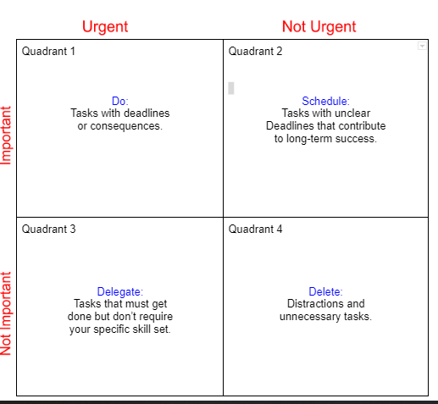
THE PRIORITY MATRIX Priority Matrix and Task List
Notes:
INSTRUCTOR: You may need to provide some assistance in defining concepts/ideas here. Make sure students are clear on “delegate” “urgent” and “contribute” so that this process makes sense. When all groups (or partner/individuals) are finished, invite the entire class together to place each item on the matrix as a class. Allow for discussion/debate/conversation between students.
This activity should take about 30 minutes to complete.
Draw the matrix on your whiteboard or click Priority Matrix and Task List (pg 23-25)
INSTRUCTOR: If completing the activity in groups, use these guidelines. OTHERWISE: Adjust guideless to fit the process that wokrs best for you. Activity:
Divide your class into small groups. Explain that each group has a list of work tasks that they will need to prioritize into the quadrants. There is no absolute wrong or right answer. Each group should come to a consensus as to what they believe is appropriate for each quadrant when compared to all of the other tasks on the list.
Have each group cut the tasks list apart and put them in the appropriate quadrants as identified by the group.
Allow for groups to discuss for approximately 15 minutes.
Call the class back together. Read off each task and ask each group to identify the quadrant they put it in. The class majority rules: put each task in the quadrant most groups agreed with.
Display this quadrant and have student put their response directly on the white board with magnets or dry erase markers.

Slide 11
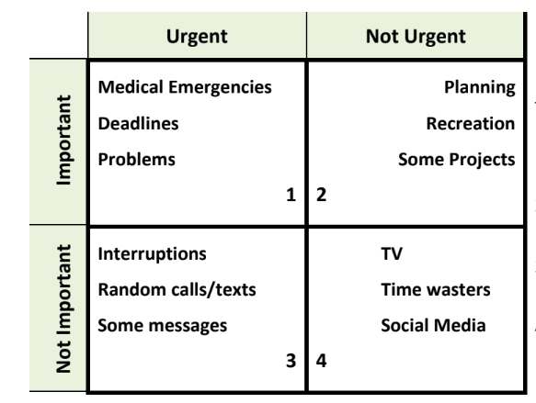
EXAMPLES:
HOW DID YOU ORGANIZE?
What questions did you ask?
What strategies were used?
Did you prioritize certain “types” of tasks?
Was your group in agreement most of the time?
Notes:
INSTRUCTOR: Take a moment to have students consider the questions for themselves and their group’s process. Allow for discussion or call-out if time allows.

Slide 12
Wrap Up and Reflection
REFLECTION:
Make a list of 5-10 items on your “to-do” list for today and organize them(priority matrix) based on these questions:
What is urgent and important?
What is important but not urgent?
What is urgent and not important?
What is not important and not urgent?
Notes:
INSTRUCTOR: Provide students examples of school, sport, home, friend, self-care tasks and give them time to work through their matrix. Offer to let students share if they want to.

