Slide 1
YOUR CHOICES ARE POWERFUL!
Date here
HOW DO I GET THERE?

Slide 2
LEARNING OUTCOMES
STUDENTS WILL BE ABLE TO (SWBAT):
1. Describe how their personal choices have an impact on their future.
2. Explain why future, and career-planning is important and why it should be subject to change.
FOCUS STANDARDS:
Domain 2: Career Exploration (What’s out there for me?)
2. Make Responsible Choices (How do my choices influence my future?)
A. Describe how personal, career, and educational choices impact major life decisions.
B. Describe how personal choices will affect workplace, school, and community.
C. Discuss the need for continuous career planning.

Slide 3
HOW DO THE CHOICES YOU MAKE TODAY, INFLUENCE YOUR FUTURE?
Notes:
INSTRUCTOR: If time allows, this is a good opportunity to get your students talking and sharing about what they value and how they feel about their own behavior and choices. If able, connect some of their discussion to how values are reflected in choices and therefore in our future.

Slide 4
DO NOW
WRITE ABOUT THE QUESTIONS BELOW (5 MINUTES)
Values are a person’s principles or standards of behavior; one’s judgment of what is important in life.
What are your THREE biggest values in your life at this moment?
Do you know how values and morals are different?
How do values affect the choices we make?
Notes:
INSTRUCTOR: Before students start writing encourage them to consider both, the values activities from Domain 1.3 (A-D), and the last lesson they completed for Domain 2. Help them build connections between the things they value most in their lives, and how that can shape their work/life/career/education/etc.

Slide 5
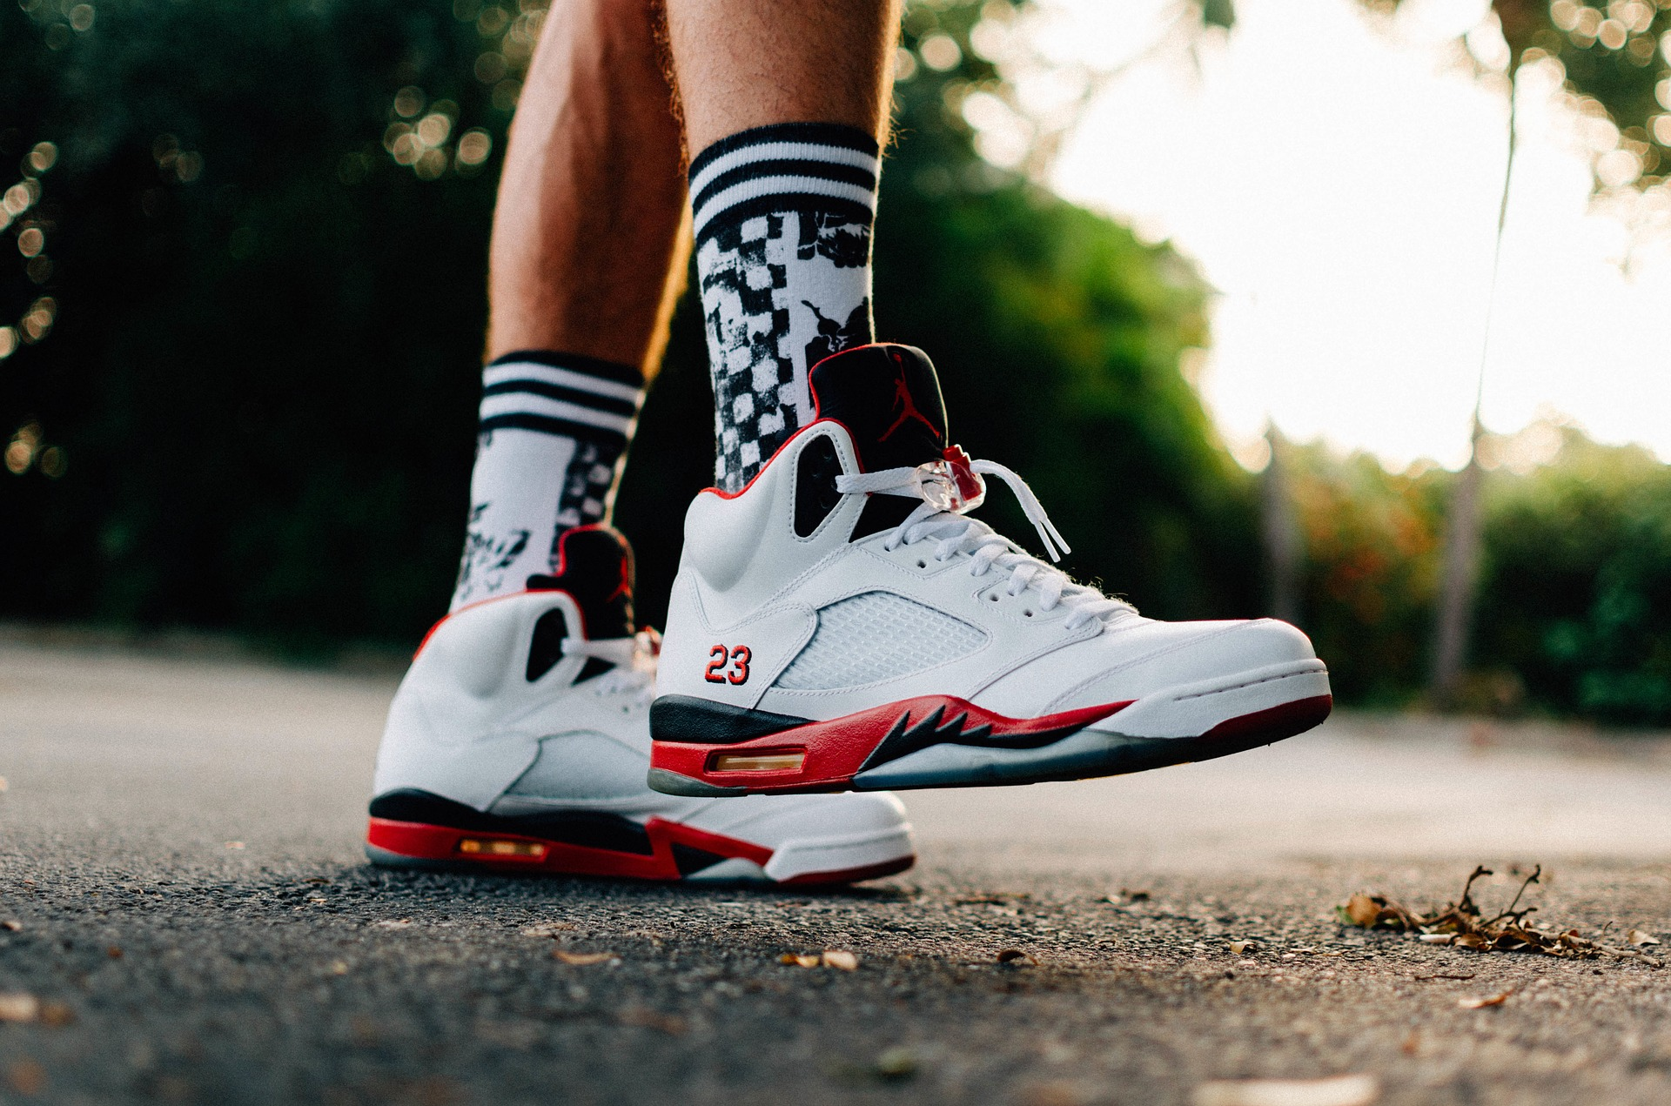
ARTICLE READ AND REFLECTION
AFTER READING, ANSWER THE FOLLOWING:
What thing(s) did the narrator in this story value the most? Did this change throughout the story?
Did the narrator make decisions (good or bad) based on that value?
How did the decisions made impact other areas of their life (social, career, education, etc.)?
Have you ever been in a similar situation? Explain how it impacted you!
Notes:
INSTRUCTOR: After discussing the character’s value/choices, encourage students to share or discuss a time when they were in similar positions. Ask them to consider the questions of how their values tend to shape the decisions they made, the things that drive them, the people they interact with etc. This is also an opportunity to allow students to consider what happens when we question our values or go against them.

Slide 6
VALUES ACTIVITY
16 PIECES
Split your blank sheet of paper into 16 pieces
They do not have to be exactly equal in size
Each needs to be big enough to write one or two words
ONE ITEM PER SQUARE
Three favorite activities
Five important people (must be separate – i.e. “mom”, “dad” not “parents”)
Three goals
Three favorite possessions
Two things you would like to own someday
Notes:
INSTRUCTOR: You may walk students through the process of folding and ripping so that all the pieces are equal, or just give them a few minutes for their papers.
Then have them write one word per paper and separate their squares into five piles based on the categories listed. Emphasize that they can’t group people, “family” “friends” “basketball team” and that they can include pets in people or objects. Other than that, they can put the things that matter most to them in each category.

Slide 7
ONCE UPON A TIME
LISTEN CAREFULLY
The story will give you directions
Make sure to listen and complete each step
Remember, this is an ACTIVITY not real life!
Notes:
INSTRUCTOR: Read the story “Once Upon a Time” to the class. Stop after each step and let students process the instructions. At the end, students should be left with ONE item. It can be helpful to stop and count periodically.
Resource: Clarifying-Values.pdf (overcomingobstacles.org)

Slide 8
ACTIVITY REFLECTION
ANSWER THE FOLLOWING
What item are you left with at the end of the activity?
Why was this the hardest thing for you to give up/part with? Why do you think you were left with this at the end?
How could this activity help us to understand what we value most in our lives?
What might your final item say about the things that you value most?
How might this value shape/impact the other areas of your life? (relationships, work, education, goals, hobbies, etc).

Slide 9
DO NOW
MAKE A LIST
Five things that you would like in your lifetime
Accomplishments, items, relationships, milestones, travel, etc
Underneath each one, write one step you will have to take to attain that thing
EXAMPLE
1) Get married
*Be open to relationships and meeting new people, even when it’s challenging
Notes:
INSTRUCTOR: After students make their lists, discuss what items they wrote down AND the steps required to get there. They can put any goals/wishes for the future on the list, but there must be steps that have to be taken to get there. Encourage them to think realistically about time, money, and sacrifice involved in our decisions.

Slide 10
WORKPLACE DECISION MAKING
CONSIDER YOUR VALUES AND HOW THEY IMPACT YOUR DECISIONS
These things show up regularly in our work/school/career
Our values impact the decisions we make
Those decisions do not only affect us
READ EACH SCENARIO AND MAKE AN APPROPRIATE DECISION
Notes:
INSTRUCTOR: You can split students into groups/partners for this or have each student complete on their own.

Slide 11
SCENARIO 1
You recently started a new job working in a popular clothing store in the mall. In the discussion prior to your hiring, you indicated that you would need certain evenings free to focus on schoolwork and college prep courses. You also stated that you would prefer not to work consecutive weekends. Despite that, every time the new work schedule is released, your boss assigns random shifts and disregards your requests.
HOW WILL YOU FOLLOW UP?
Notes:
INSTRUCTOR: Read the scenario and have the students decide what they would do in that situation. What impact does that decision have on your job or education?
Resource: Council for Economic Education

Slide 12
SCENARIO 2
You are on the starting line-up of your high school basketball team. You work hard to be on time to practice, do extra drills at home, and stay up on your schoolwork so you can play your best. On Wednesday night, you need to leave practice 30 minutes early to attend your little sister’s first dance performance. You know that the last 30 minutes will be free throw drills, which you are excelling at anyway. However, your teammate, Don, has also requested to leave practice early that day because he wants to attend a concert. Don has been benched for two weeks because of low grades and he has been struggling in practice because he hasn’t been sleeping or eating during the day.
HOW SHOULD THE COACH HANDLE THIS SCENARIO?
Notes:
INSTRUCTOR: Read the scenario and have the students decide what they would do in that situation. What impact does that decision have on the team? Family? Success?
Resource: Council for Economic Education

Slide 13
SCENARIO 3
Heather is a physician at a large urban hospital. Wednesdays at 4 PM she attends a one-hour, clinic administration meeting. If Heather leaves by 5 PM she arrives home in time to allow the nanny to get to her own children’s after-school program on time. At 5 PM, Heather stands up to leave. One of the clinic administrators asks if she can stay a few more minutes until they are done. Heather dreads saying she has to leave to relieve the nanny, because she is afraid that her colleagues may judge her as having a poor work ethic.
HOW SHOULD HEATHER PROCEED?
Notes:
INSTRUCTOR: Read the scenario and have the students decide what they would do in that situation. What impact does that decision have on family or workplace?
Resource: Harvard Business Review

Slide 14
SCENARIO 4
Ever since you were five years old, you have wanted to go to college to become an Architect. You have worked hard to get high scores on your college entrance exams and took all the courses available to you that would prepare you for your program. When applying for colleges, you know that Yale has the best program, but it is across the country from your family. Your dad really wants you to attend Cal Poly, his Alma Mater. While it is closer to home and a connection to family, Cal Poly doesn’t have an exceptional Architecture Degree Program.
When college acceptance letters start to arrive, you are accepted to both.
WHAT DECISION SHOULD YOU MAKE?
Notes:
INSTRUCTOR: Read the scenario and have the students decide what they would do in that situation. What impact does that decision have on family, education, finances, or career? Resource: Harvard Business Review

Slide 15
FINAL REFLECTION
WHAT DOES THIS MEAN?
How do your values and decision-making styles have an impact on your education/career experiences?
Based on these activities, why is it important to practice continuous career-planning?
What might happen if you don’t career-plan throughout your life?
Notes:
INSTRUCTOR: Could be an opportunity for virtual platform, sticky note, index card, etc.

