Slide 1
CREATING A PROFESSIONAL ONLINE PRESENCE
Date here
WHAT AM I GOOD AT?

Slide 2
LEARNING OUTCOMES
STUDENTS WILL BE ABLE TO (SWBAT):
Define digital citizenship. ​
Build connections between school/classroom rules to an online setting.​
Explain ways to keep their personal information safe.
Understand why it is important to protect one’s personal information.
FOCUS STANDARDS:
Domain 1: Self Evaluation (Who am I?)
4. Identify Skills (What am I good at?)
iii. Follow classroom/workplace protocols to maintain the security of information, computers, networks, and facilities.
vi. Demonstrate basic internet and email safety
v. Document a reflection about personal presence on social media, associated risks, and changes needed for personal safety

Slide 3
QUICK WRITE​
WRITE FOR THE FULL FIVE
What are ways you can practice being safe on the internet?
How would you define digital citizenship?
Notes:
INSTRUCTOR: Students will work for 5 minutes to answer the two questions. Pair students according to your classroom procedures and give them time to share.​ If desired, you could share out with the class after.
If students are struggling, allow them to think of these concepts on a larger scale (practicing safety in general or what does citizenship mean/look like in general).

Slide 4
DEFINING TERMS
DIGITAL CITIZENSHIP: “the continuously developing norms of appropriate, responsible, and empowered technology use.” (Digital Citizenship)
DIGITAL FOOTPRINT: “the trail of data you leave when using the internet. It includes websites you visit, emails you send, and information you submit online.” (Kapersky)
How do these concepts compare to “citizenship” and “carbon footprint” (or similar ideas)?
Notes:
INSTRUCTOR: This is a good opportunity to allow for discussion especially on the basis of comparing words/idea that they heard before (likely often) with these newer ideas/language. Consider asking students if they believe they have a “code” of digital citizenship and/or if they think there is or should be one.
Definitions from:
digitalcitizenship.net
kaspersky.com

Slide 5
“GOOD CITIZENSHIP IN PERSON, NEEDS TO FLOW INTO GOOD CITIZENSHIP ONLINE…”
Quote by: Jill Felty
Notes:
INSTRUCTOR:
Quote from: https://edtechmagazine.com/k12/article/2017/06/educators-offer-advice-about-teaching-good-digital-citizenship

Slide 6
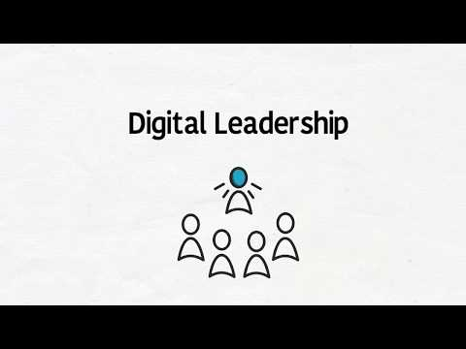
INTRODUCTION VIDEO: DIGITAL LEADERSHIP
Notes:
INSTRUCTOR: As students watch the video, they will fill in the second section of the handout. Review the terms from the video and direct students to complete the third section of the handout. ​
Missing terms on the handout: ​
Respect: Access, Etiquette, Law​
Educate: Communication, Literacy, Commerce​
Protect: Rights & Responsibilities, Safety & Security, Health & Wellness​
I’m inclusive​
I’m informed​
I’m engaged​
I’m balanced​
I’m alert​

Slide 7
DEFINE DIGITAL CITIZENSHIP
REVIEW THESE DEFINITIONS
→ CREATE YOUR OWN
“Digital Citizenship is more than just a teaching tool, it is a way to prepare students for a society full of technology.” ​Dr. Mark Ripple
“Being a digital citizen is a way of thinking, being, and acting online. It’s thinking critically, being safe, and acting responsibly.” ​Common Sense Media
“Digital citizenship is not so different from what we think of as traditional citizenship: Be kind, respectful, and responsible, and participate in activities that make the world a better place.” ​ISTE
Notes:
INSTRUCTOR: How did student’s definition of digital citizenship change? Allow students to share their updated definitions and their thoughts from the video. ​

Slide 8
COMPONENT 1:
WHAT DOES THIS LOOK/FEEL/SOUND LIKE?
Offline: in your community, classroom, and home​ | Online: in your online community​
Notes:
INSTRUCTOR: (This could be a good opportunity for group or partner work) Read each component and have students brainstorm ideas of what that component look/sound/feel like offline and online. Are there school rules or classroom procedures that connect with the 5 competencies? Why are these put in place? [Example answer: It’s the same online as offline: to create a welcoming, safe, positive environment for all participants.]​
Examples​
Offline: be kind to create a welcome environment people want to be around, invite others to participate in the activity​
Online: share and post positively and don’t support negative comments, remember that you’re talking with people, not just a user name​
https://www.iste.org/explore/digital-citizenship/infographic-im-digital-citizen​

Slide 9
COMPONENT 2:
WHAT DOES THIS LOOK/FEEL/SOUND LIKE?
Offline: in your community, classroom, and home​ | Online: in your online community​
Notes:
INSTRUCTOR: (This could be a good opportunity for group or partner work) Read each component and have students brainstorm ideas of what that component look/sound/feel like offline and online. Are there school rules or classroom procedures that connect with the 5 competencies? Why are these put in place? [Example answer: It’s the same online as offline: to create a welcoming, safe, positive environment for all participants.]​
Examples​
Offline: be kind to create a welcome environment people want to be around, invite others to participate in the activity​
Online: share and post positively and don’t support negative comments, remember that you’re talking with people, not just a user name​
https://www.iste.org/explore/digital-citizenship/infographic-im-digital-citizen​

Slide 10
COMPONENT 3:
WHAT DOES THIS LOOK/FEEL/SOUND LIKE?
Offline: in your community, classroom, and home​ | Online: in your online community​
Notes:
INSTRUCTOR: (This could be a good opportunity for group or partner work) Read each component and have students brainstorm ideas of what that component look/sound/feel like offline and online. Are there school rules or classroom procedures that connect with the 5 competencies? Why are these put in place? [Example answer: It’s the same online as offline: to create a welcoming, safe, positive environment for all participants.]​
Examples​
Offline: be kind to create a welcome environment people want to be around, invite others to participate in the activity​
Online: share and post positively and don’t support negative comments, remember that you’re talking with people, not just a user name​
https://www.iste.org/explore/digital-citizenship/infographic-im-digital-citizen​

Slide 11
COMPONENT 4:
WHAT DOES THIS LOOK/FEEL/SOUND LIKE?
Offline: in your community, classroom, and home​ | Online: in your online community​
Notes:
INSTRUCTOR: (This could be a good opportunity for group or partner work) Read each component and have students brainstorm ideas of what that component look/sound/feel like offline and online. Are there school rules or classroom procedures that connect with the 5 competencies? Why are these put in place? [Example answer: It’s the same online as offline: to create a welcoming, safe, positive environment for all participants.]​
Examples​
Offline: be kind to create a welcome environment people want to be around, invite others to participate in the activity​
Online: share and post positively and don’t support negative comments, remember that you’re talking with people, not just a user name​
https://www.iste.org/explore/digital-citizenship/infographic-im-digital-citizen​

Slide 12
COMPONENT 5:
WHAT DOES THIS LOOK/FEEL/SOUND LIKE?
Offline: in your community, classroom, and home​ | Online: in your online community​
Notes:
INSTRUCTOR: (This could be a good opportunity for group or partner work) Read each component and have students brainstorm ideas of what that component look/sound/feel like offline and online. Are there school rules or classroom procedures that connect with the 5 competencies? Why are these put in place? [Example answer: It’s the same online as offline: to create a welcoming, safe, positive environment for all participants.]​
Examples​
Offline: be kind to create a welcome environment people want to be around, invite others to participate in the activity​
Online: share and post positively and don’t support negative comments, remember that you’re talking with people, not just a user name​
https://www.iste.org/explore/digital-citizenship/infographic-im-digital-citizen​

Slide 13
ONLINE SAFETY: DIGITAL FOOTPRINT
DEFINITION: “the trail of data you leave when using the internet. It includes websites you visit, emails you send, and information you submit online.” ​(Kapersky)
Your digital footprint is relatively permanent
It forms your digital reputation.
Once information is online, it’s difficult to control who sees it and how it’s used. ​
Think before you post, determine which information to share, and check your privacy settings. ​
Notes:
INSTRUCTOR:
Definition from kaspersky.com

Slide 14
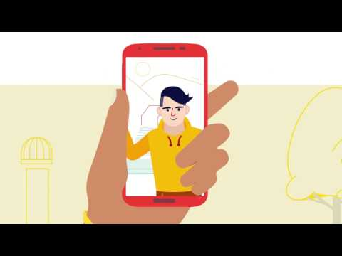
ONLINE REPUTATION
HOW TO MANAGE/MAINTAIN A POSITIVE ONLINE REPUTATION
Notes:
INSTRUCTOR: Before showing the video, ask students if they already know if ways/strategies they can use to manage their online reputation. Consider asking them how much their online reputation matters to them, the role that it plays in their daily/social life, etc.

Slide 15
WHAT IMPACTS YOUR ONLINE REPUTATION?
ACTIONS: build your online reputation | ACTIONS: tear down your online reputation​
Notes:
INSTRUCTOR: Have students consider this in their current AND future lives. How will their online reputation now potentially impact their future?
They can also reflect on ideas/actions that are mentioned or listed in the video!

Slide 16
PERSONAL INFORMATION
WHAT IS THE DIFFERENCE BETWEEN “PRIVATE” AND “PUBLIC”
It is important to know what can be considered public and what should stay private
Some information must be kept private to keep you safe
Some information must be kept private to protect yours (or your family’s) identity
CAN YOU THINK OF EXAMPLES FOR PRIVATE AND PUBLIC INFORMATION?
Notes:
INSTRUCTOR: What personal information would be considered private and what can be shared publicly?
Private: any identification number (school id, license, SSN), full name and birthday, address, specific locations, payment details, personal contact information: email, phone, username and passwords
Public: Favorites (movie, food, hobby), names of friends and pets, siblings, age, gender, memories, thoughts and opinions (while still being respectful)

Slide 17
CONCLUSION
ANSWER THE REFLECTION QUESTIONS
What have you learned from this lesson?
As a student, how can you practice online safety and good digital citizenship now?
What are you going to do today to become a better digital citizen?
Notes:
Conclusion: Digital citizenship isn’t just about internet safety. It’s also about being responsible and respectful as you navigate online. There are rules and competencies in place for you to know what is acceptable behavior to have a positive reputation, offline and online. You control what you post and how much you share online.

