Slide 1
PERSONALITY TYPE: WHAT MAKES ME UNIQUE?
Date here
WHAT MAKES ME UNIQUE?

Slide 2
LEARNING OUTCOMES
STUDENTS WILL BE ABLE TO (SWBAT):
Describe their personality type
Describe and understand the strengths and weaknesses of their personality type
FOCUS STANDARDS:
Domain 1: Self Evaluation (Who am I?)
Identify Personality (What makes me unique?)
Take a personality inventory
Document a reflection of the results
Notes:
IMAGE: https://venngage.com/templates/infographics/myers-briggs-personality-types-infographic-28cf03b7-7cb7-4d8f-9a36-725dbc9143e2

Slide 3
DEFINING TERMS
WHAT IS PERSONALITY?
Personality is a person's unique pattern of thoughts, feelings, and behaviors.
Personality is also shown in someone's strengths, weaknesses, and preferences.
It is believed that our personalities remain consistent throughout life and are not easily changed.
Notes:
INSTRUCTOR: This may be a good time to open to door for conversation or explain how having self-awareness and understanding can be important to finding a career/college pathway. Provide your own examples or ask students to share ideas about this concept.

Slide 4
PERSONALITY TRAITS ARE THE BUILDING BLOCKS OF YOUR PERSONALITY.
Notes:
Instructor should provide examples such as:
Adventurous
Creative
Dramatic
Organized
Shy
This would be a good opportunity to encourage students to discuss traits they have, like, dislike, inherit, etc.

Slide 5
PRE-ASSESSMENT SELF-REFLECTION
ON YOUR ASSIGNMENT SHEET, TAKE 10 MINUTES TO COMPLETE THE SELF-REFLECTION
(USE COMPLETE SENTENCES)
How would you describe yourself in 3 words?
Is your personality like either of your parents? Why or why not?
What qualities do you most admire in yourself?
What is your biggest weakness?
What is your greatest strength?
Notes:
INSTRUCTOR: Let’s see what you think about your own personality, before we take any personality assessments.
Inform students that they will have the opportunity to share some brainstorming if they want to, but won't be required to tell anyone!

Slide 6
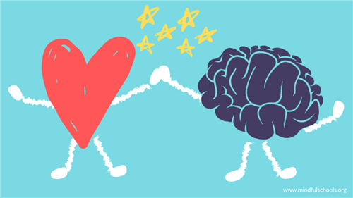
WHY BOTHER?
REASONS TO STUDY YOUR PERSONALITY
Learning about your personality will help you understand yourself better.
Why you think, feel, and behave the way you do.
Gain more self-awareness.
Self-awareness is being aware of your thoughts, feelings, and actions.
Improve interactions with others.
Decide on a career/future pathway that might be a good fit
AFTER: Complete the “Quick Check-In” on your assignment sheet!
Notes:
INSTRUCTOR: After reviewing this slide, have students complete the “Quick Check-in”
Open discussion to students about why having self-awareness could improve relationships! What aspects of your personality are you already aware of that either help to build successful relationships, or hinder you from doing so?

Slide 7
PERSONALITY ASSESSMENTs
RELIABILITY AND VALIDITY
There are many personality tests available, and some are more serious (and accurate!) than others!
These tests are simply meant to give you some level of insight into your personality.
No test is 100% accurate (people are subjective!)
Notes:
INSTRUCTOR: When you take a personality test, you’ll sometimes get results that don’t seem to match up with other assessments you’ve taken, but that’s okay!
It may be worth discussing what makes something "reliable" or "valid" and whether personality assessment can be either!

Slide 8
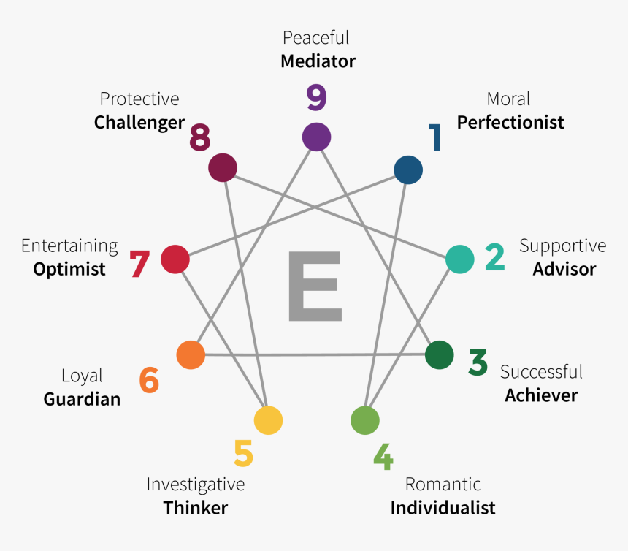
PERSONALITY ASSESSMENT EXAMPLE #1 THE ENNEAGRAM TEST

Slide 9
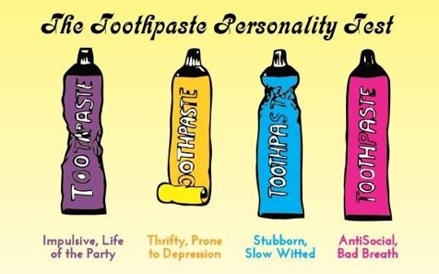
PERSONALITY ASSESSMENT EXAMPLE #2 THE TOOTHPASTE PERSONALITY TEST
Notes:
INSTRUCTOR: One of these tests is more "scientific" than the other, but both could cause someone to stop and think about their own results.
This could be an opportunity to discuss other personality tests students have taken, and their current beliefs about whether these are accurate or not.

Slide 10
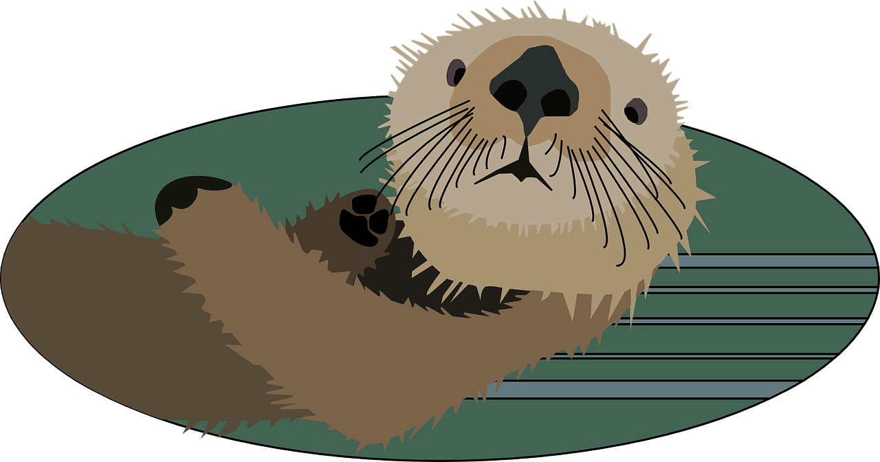
5-MINUTE PERSONALITY TEST Study by Gary Smalley and Dr. John Trent (1999).
WHAT TO DO
Today, we’re going to start with the 5-Minute Personality Test.
Follow the instructions at the top of the test.
Total your scores according to the directions at the bottom of the page.
Complete the “5-Minute Personality Test Reflection” on your assignment sheet.
Use pages 2-5 of the test for reference.
Notes:
INSTRUCTOR: This is a good starter test to help you get the hang of the process.
By the end of the test, your highest score will reveal your most dominant personality type.
Be diligent in reading through the questions thoroughly and take your time when calculating your personality type/answering the reflection questions.

Slide 11
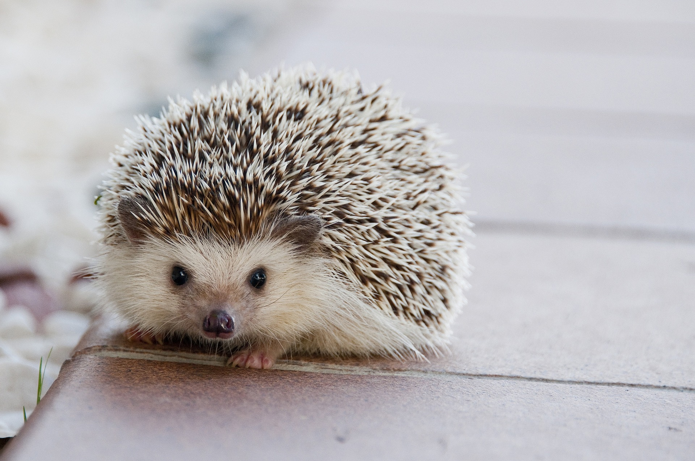
DAY 2: DO NOW
PROMPT
Based on yesterday’s “5 Minute Personality Test” you were matched with an animal that represents your personality type.
If you were to choose a DIFFERENT animal (not one of those four) that you feel represents you, what would you choose and why?

Slide 12
MYERS & BRIGGS 16 TYPES PERSONALITY ASSESSMENT Study by Isabel Briggs Myers and Katharine Briggs (1942-1962)
Notes:
INSTRUCTOR: Today we’re going to take a more detailed personality test based on the Myers and Briggs 16 Types. As you watch, look out for all descriptions that fit you!
This video will provide a bit of background about what the test is assessing and looking for. Once we have watched the video, we'll complete the test ourselves.

Slide 13
TAKE THE ASSESSMENT
SAMPLE QUESTIONS
*Most questions are answered based on a scale (“very accurate” to “inaccurate” or “strongly agree” to “strongly disagree”) You can take the assessment at the following website: https://www.truity.com/test/type-finder-personality-test-new
Notes:
INSTRUCTOR: Remind students to remain diligent and really answer/read each question in order to receive the MOST accurate results
You’ll answer 130 questions as honestly and authentically as possible.
**NOTE: Recommended to create a scannable QR code or distribute the link to students using a different platform so they don't have to type it in.

Slide 14
DETERMINE YOUR PERSONALITY TYPE
REFLECTION TIME
Begin working on the “Personality Assessment Reflection” on the assignment sheet.
Read more about your personality type (or others!):
Personality Descriptions
Personality Descriptions (Deep Dive)
CONSIDER
Do your results seem accurate (why)?
Does a different personality type fit you better(why)?
Between yesterday's test and today's, which one do you feel was more accurate?
Notes:
INSTRUCTOR: Guide students to start working on questions 1-3 as they finish their test, remind them not to close the website!
INSTRUCTOR: Encourage students to look further into their four-letter personality type and provide them with tools and time to do so
IF STUDENT POP/SCHOOL ALLOWS: students may now research their personality type using outside sources
DISCUSSION: What interesting things did you learn about your own personality type?

Slide 15
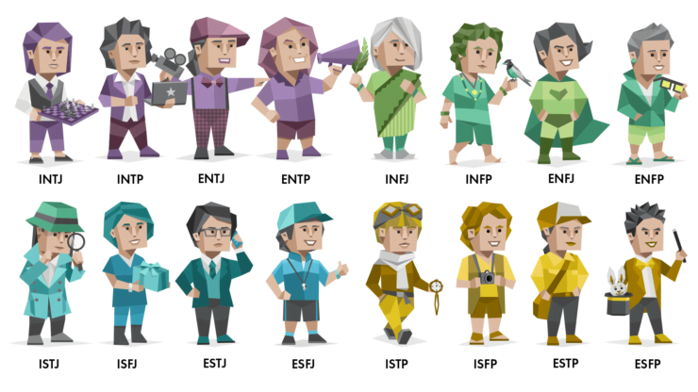
WHAT’S YOUR PERSONALITY TYPE?
Notes:
IMAGE: https://medium.com/@liangoldstein/how-to-assess-product-management-skills-here-are-the-top-4-mbti-types-391967e7772a

Slide 16
CONCLUSION
Understanding your personality can help you to figure out what might be a good career fit for you.
List three interesting things you learned about your personality type.
What are some ways that you can use the information about your personality type in your relationships with your friends, family, teacher, and classmates?
Notes:
Understanding your personality gives you greater insight into why you think, feel, and behave the way you do. This knowledge can help you develop self-awareness and have more positive interactions with others.

