Slide 1
STARTING A RESUME
Date here
PLAN AHEAD!
Notes:
Career Activity: Starting a Resume
Activity Summary: This activity will help students develop a vision for how to develop a strong resume that will be important to hold by the start of the senior year. Additionally students will learn how to create a cover letter to accompany their resume.
Estimated Time: 30-55 minutes (Part 1: Starting a Resume; Part 2: Creating a Cover Letter)
Learning Plan Activity: 11th: Starting a Resume; 12th Grade: Creating a resume and cover letter Additional Activities: 9, 10
Learning Outcomes: Students will learn what a solid resume and cover letter entails, build one, update it, and review it. Students will end with a vision as to what they can accomplish in high school to help create more opportunities for the best training and financial support for after high school. This will lead to the development of a topnotch resume upon entering the senior year.
Materials Needed: Powerpoint, Handouts, Pen, Computer

Slide 2
“DON’T WAIT FOR THE RIGHT OPPORTUNITY, CREATE IT.”
GEORGE BERNARD SHAW
Notes:
Academic Vocabulary
University: A school that offers courses leading to the following degrees.
Bachelor’s Degree: 4-Year Degree
Can focus more on the Arts (BA) or Sciences (BS)
Can take longer than 4 years to complete if the student takes less classes per semester
Master’s Degree: 2-3 years past a Bachelor’s Degree
Doctorate: 5-Year Degree (Typically)
Done usually after a Master’s Degree and highest degree that can be earned
Sometimes programs allow part of the Master’s Degree credits to count toward this degree shortening the length of time to get the degree
Community College: A school that offers courses leading to a 2-Year Associate's Degree, and also typically holds 1-2 year certificate programs which usually includes trade programs.
Some students start at a community college then transfer to a University to complete a 4-Year Degree.
Apprenticeship: Learning a trade or art under a skilled worker usually for pay (Example: Plumbing).
Trade School: A school that teaches skilled trades (Example: Automotive, Cosmetology).
Rigor: In regards to high school this term means a student challenges himself/herself in taking more classes than required and/or taking higher level courses (college level) such as Advanced Placement or Dual Credit Courses. It also may mean the student takes higher level courses in classes such as in the trades (Ex. Automotive, Cosmetology)

Slide 3
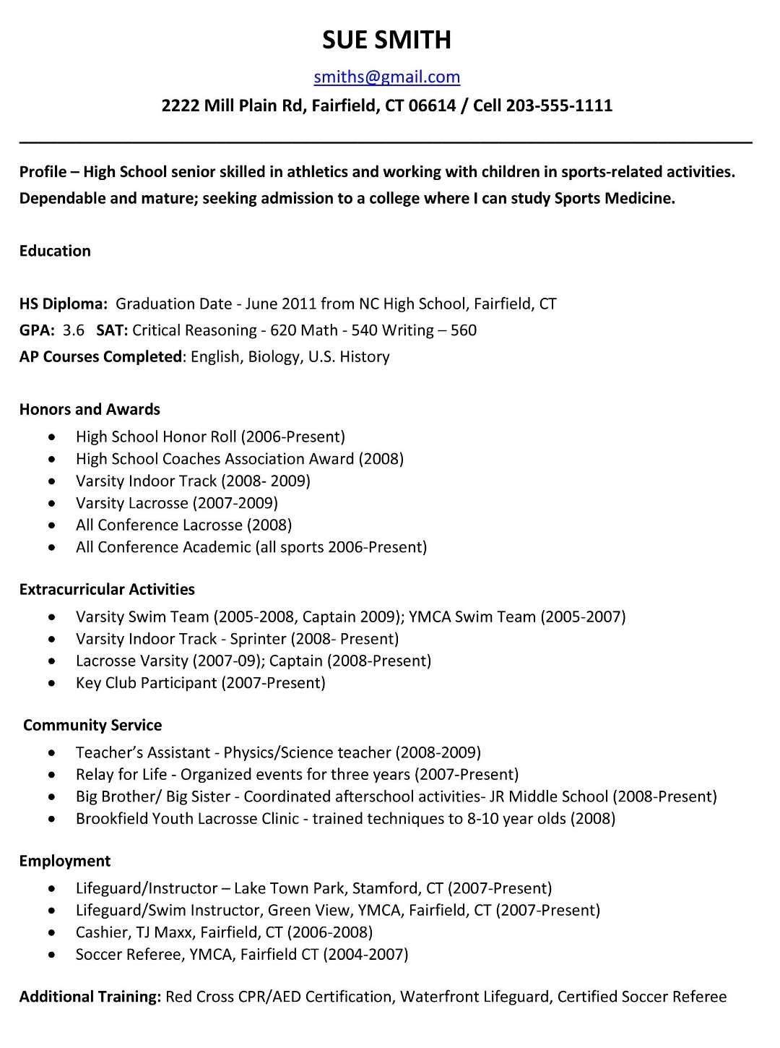
RESUME
WHY DO I NEED A RESUME?
A resume is a document used by a person to display their background and skills.
Can use it to:
Get a letter of recommendation
Apply to a college
Apply for a job
Go into the military
Get into a trade school
Get an apprenticeship
Notes:
Introduction: Having a resume that lists your skills and experience is crucial to being successful in the future. Though you may feel like you don’t have much to put on a resume yet, going through the process of creating one will put you in the mindset of thinking about how to stand out from the crowd.
Think of your resume as the written expression of a social media account. On your Instagram, Snapchat, or YouTube Channel you show people what you’ve done, where you have been, your interests, and the things that make you unique. You put the best version of yourself on those platforms, for presentation to the world.Resumes are not much different, though they pertain mostly to your professional accomplishments. A good resume shows a potential employer what you can do and why you are the best person to do that job by listing your skills and experience and accomplishments. Though you may feel like you don’t have much to put on a resume yet, going through the process of creating one will put you in the mindset of thinking about how to stand out from the crowd.Today we are going to have you look at what you have accomplished since last year, what you are working on now, and also consider what you will do this year, so you will enter your senior year with a strong resume. Keep your resume from here on out on your path into adulthood. It will be easy to update it over the years as your life training and jobs shift with you on your career journey.
Resume:
Letters of Recommendation: Producing a solid resume will give the best ammo to a letter writer to say the things they need to be able to say to get you what you want (scholarships, a job, admission to college, etc.)
Scholarships: Lots of scholarships ask for a resume
University and Community Colleges: Even if a University/Community College does not require an actual resume, what it took to build it will pay off and be used on an application when applying to college. Great grades, leadership, extra-curricular, work and volunteer experiences will lead to being admitted and receiving scholarships.
Jobs: Great resumes get you the interview, so you can sell yourself in person for a job
Military: What recruiter would not want to jump at having you who has a solid resume? She/he will be excited to help you keep building it.
Trade School: Trade schools will want to snatch you because of your great resume. Also because of your demonstrating a good use of your time in high school the school may be able to provide some scholarship opportunities to help you attend.

Slide 4
GETTING READY TO CREATE YOUR RESUME
 | 9th Grade | 10th Grade | 11th Grade | 12th Grade
Volunteer Work
Cumulative GPA
Leadership
Athletic Participation
Music, Drama, Dance, Other Performing Activities
Honors/Awards
Club Activities
Employment
# of Ap/Dual Credit/Honor Classes
Complete the Handout
My Plan: Building a Solid Resume
Before you begin, you may want to collect your school and work history and information on any awards you've earned.
Save this information and add to it each year to update your resume!
Notes:
Getting Ready to Create your Resume: If you do not have a resume started, use this template to help you get started. As you plan ahead, think of other ways you can add more to your resume in these areas in the future! Give students a copy of the handout_My Plan: Building a Solid Resume. Have students complete as much information as they can remember to help with entering the information in the Resume Builder Activity next.

Slide 5
CREATING YOUR RESUME ACTIVITY
CREATE YOUR RESUME
GO TO https://myfuture.com/career/resume-builder
Follow this user-friendly Resume Builder app and make sure to save a copy of this document on your Google Drive or another safe place you can access when you need it.
Fill in each section the best you can!
To protect your privacy, the Résumé Builder stores your information only while you work. If you close the browser, or the session times out, your information will not be saved.
You can save your résumé by either downloading the file to your computer or printing it out.
If you would rather create it in a different format to be able to edit easier, please do so!
Notes:
Creating a Resume Activity: (11th Grade - End at this slide) If resumes and plans are saved in a career file, on a student computer, etc. have students pull them up.
Follow this user-friendly Resume Builder app: https://myfuture.com/career/resume-builder and make sure to save a copy of this document on your Google Drive or another safe place you can access when you need it.
Closing: Remember a resume is a living document that is always changing and the need to plan ahead is important. In order to get where you want to go in a career don’t forget to look at your plan often, and think about ways you can make yourself standout. The resume that catches the reader’s eye is the one that will get the prize on the other side.

Slide 6
CREATING A COVER LETTER
Date here
Date here
GET WHAT YOU WANT!
Notes:
Part 2: 12th Grade
Career Activity: Creating a Cover Letter
Introduction: [Use powerpoint] Every time you send out a résumé, you'll need to have a great cover letter to send along with it. It's a good idea to customize your cover letter for each job you're applying for. The cover letter is another way of introducing yourself to a potential employer. What it says about you can be the difference between getting in the door and missing your chance.

Slide 7
CREATING A COVER LETTER
CREATE YOUR COVER LETTER
GO TO https://myfuture.com/career/creating-your-cover-letter
Before you Write
Think about yourself and your experiences
How did you hear about this opportunity?
What do you know about the organization you’re writing to?
To whom are you writing?
Writing the Letter
Maximum of one page
Proofread Carefully
Write individual letters
Forget photos
Sume simple, clear sentences
Save your resume and cover letter in a place where you can find them easily and edit them!
Notes:
Creating a Cover Letter Activity: After students have updated their resume, have them start working on a draft cover letter that they can edit or personalize as needed. Have each student go to the My Future Create your Cover Letter website and open a new Google Doc/Microsoft Word/Paper. Give each student a copy of the handout_ Sample Cover Letter for reference.

Slide 8
COMPOSING THE COVER LETTER
COMPOSE THE LETTER
Be yourself! Write in the active tense.
Paragraph One: Start with how you heard about the job—friend, employee, newsletter, advertisement, etc.
Paragraph Two: Here you should describe your qualifications for the job—skills, talents, accomplishments and personality traits.
Paragraph Three: Describe why you'd be a good fit for the company.
Paragraph Four: Mention the enclosed résumé, give them a reason to read it in-depth (e.g., "For my complete employment history and applicable computer skills, please see the included résumé") and ask for an interview.
Notes:
Composing the Cover Letter: Students should use their resume as they think about their talents, strengths, etc. Some parts will not be able to complete unless they have a specific audience they are writing to.
Paragraph 1: This is especially important if you've been referred by a mutual friend or acquaintance. If this is the case, don't start with "My friend John Peterson told me you have a job opening so I thought I would write." This will not "wow" anyone. Instead, show a little excitement and passion for the potential employment: "I was thrilled when my friend John Peterson told me there was an opening for an assistant photographer at your company." Follow this with a few key strengths you have that are pertinent to the position you're looking to obtain.
Paragraph 2: Don't go overboard; pick the top three talents or characteristics that would make you stand out as a candidate. (your résumé is there to fill in the details). When writing this paragraph, think about how and why your specific skills, talents and accomplishments would be best for the role.
Paragraph 3: Maybe you like their fast growth, know people who work there already or you've always used their products. Companies feel good if the candidate has some connection to them and has a good understanding of how the company works, even before he or she is hired.
Paragraph 4: Suggest a time and a way for you to follow up. Always give the reader easy ways to contact you.
Closing: Save your initial cover letter and remember to do some research to be able to individualize each cover letter you create for each specific audience so you can stand out!

