Slide 1
GETTING TO KNOW COLLEGE & CAREER VOCABULARY
Date here
WHAT TERMS DO YOU KNOW ALREADY?
Notes:
Career Activity: Getting to Know College and Career Vocabulary
Activity Summary: This lesson will help students identify and understand vocabulary used when discussing college and career options.
Estimated Time: 45-60 minutes
Learning Plan Activity: 8th Grade Additional Activities: 9, 10, 11
Learning Outcomes: Students will develop a more in-depth vocabulary regarding college/career terminology.
Materials Needed: Powerpoint, Handouts, Pen, Paper, Optional: Bingo Cards, Computer

Slide 2
“TRUST YOURSELF. YOU KNOW MORE THAN YOU THINK YOU DO.”
DR. BENJAMIN SPOCK
Notes:
Academic Vocabulary
See Vocabulary Handout for extensive list

Slide 3
COLLEGE AND CAREER VOCABULARY
FILL OUT YOUR HANDOUT AS WE LEARN AND REVIEW THESE TERMS
ACT: A college entrance exam, standardized test that measures a student’s skills in core areas: English, Math, Reading, and Science
Advanced Opportunities: Can provide funding for students who want to take advanced course work while attending an Idaho Public school (grades 7-12)
Associate Degree: A degree for students that have completed two years of student at Junior college, community college
ASVAB: Military Entrance exam – Armed Services Vocational Aptitude Battery
Bachelor’s Degree: A degree for students that have completed 4 years of study at a college or university
Notes:
Introduction: [Use Powerpoint] Knowing what your family, counselors, teachers, and upper-classmen are talking about when it comes to college and career is half the battle while looking at your options after high school! Understanding the most common terms and concepts means that you will be comfortable having meaningful conversations about your future with the adults who guide and support you. You’ll also have a better idea about what questions you still have, and can follow up with a teacher or counselor to get the answers you need.
College & Career Vocabulary: Give each student a copy of handout_Student College & Career Vocabulary. Have student’s fill in the blanks on the vocabulary worksheet as it is shared in the presentation.

Slide 4
COLLEGE AND CAREER VOCABULARY
FILL OUT YOUR HANDOUT T AS WE LEARN AND REVIEW THESE TERMS
College Application: Process by which individuals apply to gain entry into a college or university – see specific Universities/colleges for deadlines, etc
College Major: A specific subject that students can specialize in while obtaining their college degree.
Community Service: Unpaid/volunteer work for your community. A chance to develop leadership skills.
Dual Credit: High school student earning credit at both the High School and the college level
Extracurricular Activities: Can include sports, student government, community service, employment, hobbies, educational clubs, etc.

Slide 5
COLLEGE AND CAREER VOCABULARY
FILL OUT YOUR HANDOUT AS WE LEARN AND REVIEW THESE TERMS
FAFSA: Free Application for Federal Student Aid - how students access grants, loans, work study.
Federal Grant: After completing the FAFSA – some students will qualify for grants, money to be used for college that does not need to be paid back.
Financial Aid: Money to help pay for college or career school
GPA: Grade Point Average
Letter of Recommendation: Written by someone who can recommend a student’s work or academic performance (usually by someone who knows the student well)

Slide 6
COLLEGE AND CAREER VOCABULARY
FILL OUT YOUR HANDOUT AS WE LEARN AND REVIEW THESE TERMS
Overload: A High School level course that is taken in excess of the regular school day – can utilize Advanced Opportunity Funds for this course
PSAT: Preliminary SAT
SAT: A standardized test of a student's academic skills used for admission to US Colleges
Scholarship: A grant or payment made to support a student’s education
Student Loan: A type of loan designed to help students pay for post-secondary education (two types)

Slide 7
COLLEGE AND CAREER VOCABULARY
FILL OUT YOUR HANDOUT AS WE LEARN AND REVIEW THESE TERMS
Subsidized Loan: Student loans that do NOT accrue interest while you are in school
Transcript: An official document of a student’s permanent academic record
Tuition: The charge or fee for the College/University
Undergraduate: This degree is usually your first
Unsubsidized Loan: Student loans that do accrue interest while you are in school
Work Study: Part of the FAFSA, a college program that allows a student to work part-time while attending school

Slide 8
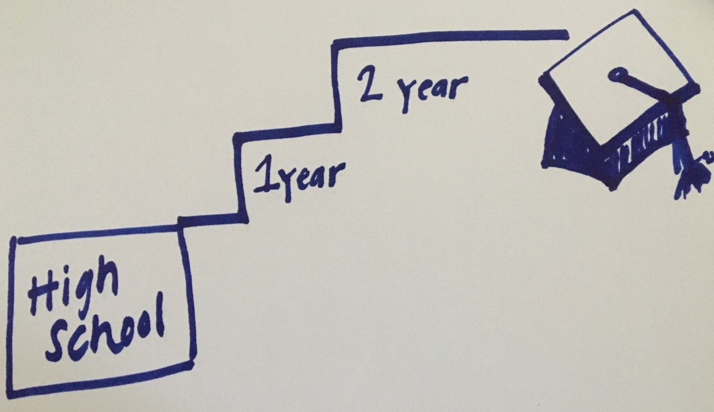
VOCABULARY ACTIVITY
DRAW OR DESIGN A FUN WAY TO SHARE THE VOCABULARY!
Group 1: ASVAB, Financial Aid
Group 2: ACT, Dual Credit
Group 3: Community Service, Student Loan
Group 4: Scholarship, Word Study
Group 5: Tuition, GPA
Group 6: Letter of Recommendation, Overload
Group 7: Bachelor’s Degree, College Major
Example: Extracurricular Activities
Example: Associate’s Degree
Notes:
Vocabulary Activity: Divide students into groups, based on size. Each group is assigned two vocabulary words. You will need to work as a group to design/draw a definition for both of your vocabulary words. After you have completed both of your vocabulary words, we will display them and see if each word can be guessed correctly based on the design/drawing shown.
Closing: Now you have a college and career reference guide when discussing college and career options! This is a lot of new terms that you may or may not have heard yet. As you continue to explore your next steps moving forward, keep in mind that you can continue to practice and review the definitions as you get closer to opening those doors!

Slide 9
REVIEWING COLLEGE & CAREER TERMINOLOGY
Date here
Date here
WHAT TERMS DO YOU KNOW ALREADY?

Slide 10
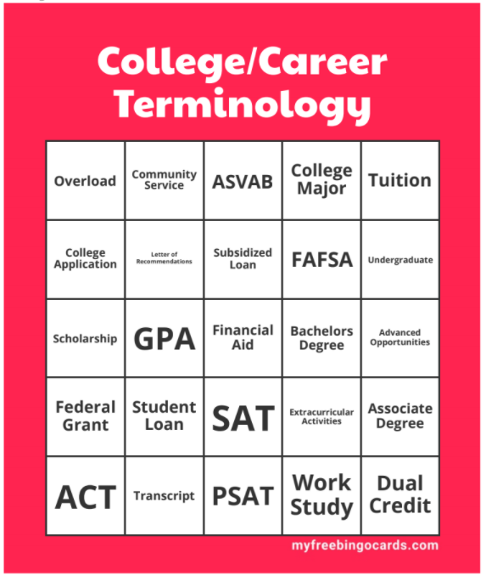
BINGO REVIEW ACTIVITY
Get ready to explore and review college and career vocabulary!
Try to match the definition to the college and career vocabulary word!
Raise your hand & call out “Bingo” when you have 5 in a row vertically or horizontally!
Notes:
Part 2: Reviewing College & Career Vocabulary
Materials Needed: 2 copies of caller card; 1 x Handout_Teacher Copy College & Career Vocabulary; 1 bingo card for each student (30 available cards); beans/markers to cover space
Print two copies of the caller’s card. Cut one copy up, fold the squares in half, and put them in a hat. Use your Bingo Caller’s Card to call the bingo and keep track of which words you have already called.
To call the bingo, pull a square out of the hat, unfold it, and read it out. Pair with the Teacher copy of hand out and read the definition with the vocabulary word as well.

