Slide 1
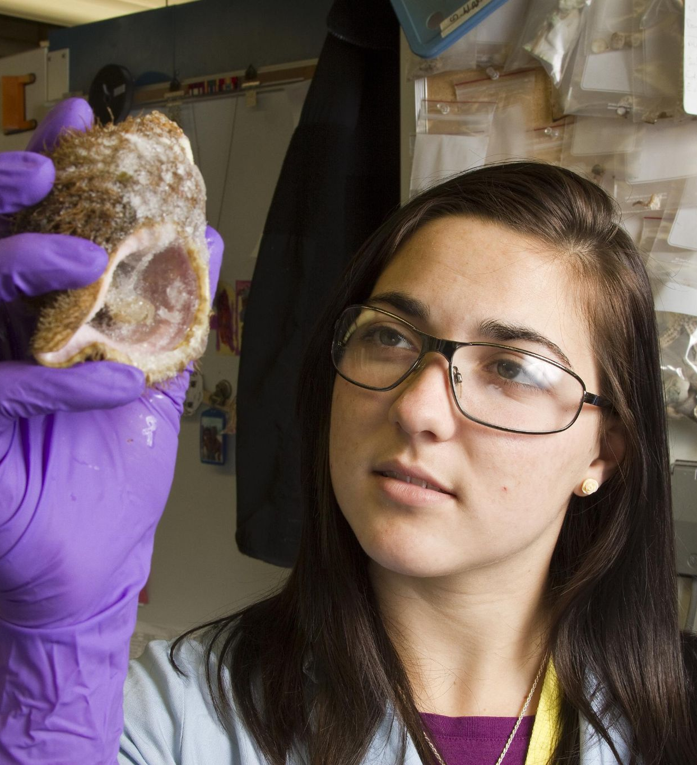
CAREER FAMILY TREE
Date here
WHAT CAREERS HAS YOUR FAMILY HAD?
Notes:
Career Activity: Career Family Tree
Activity Summary: This lesson will help students look at the careers chosen by family members to gain more understanding in career choice.
Estimated Time: 15-30 minutes *Homework Required*
Learning Plan Activity: 8th Grade Additional Activities:
Learning Outcomes: Students will interview family members about their careers and education to complete a career family tree. Students will evaluate how their family may or may not be an influence on their own career choices and decisions for the future.
Materials Needed: Powerpoint, Handout, Pen, Computer

Slide 2
“BY REPLACING FEAR OF THE UNKNOWN WITH CURIOSITY WE OPEN OURSELVES UP TO AN INFINITE STREAM OF POSSIBILITY.”
ALAN WATTS
Notes:
Academic Vocabulary
N/A

Slide 3
INTRODUCTION
CAREER FAMILY TREE ACTIVITY
What is your goal or a career that you might want to pursue?
Use your interests to help you explore and choose a career
Notes:
Introduction: [Use Powerpoint] A conversation with family members usually is a great place to start to help provide suggestions to look at in your quest in making plans for life after high school. Those close to you can hold opinions, experiences, dreams, and concerns about previous careers they have held. These experiences shared may be able to help you in making more informed decisions about your future. Once the assignment is completed, we will discuss as a class what you learned about your Career Family Tree.

Slide 4
CAREER FAMILY TREE ACTIVITY
INTERVIEWS
Interview as many family members as you can!
Record:
Name
Relationship to you
Occupation
Education Level
Other information
Like/dislikes about the job
Other jobs they have held
How many years they have been in their job
Remember to have this information brought back by: ______________
Notes:
Career Family Tree Activity: Interview as many family members as you can to gain the most insight on the different careers your family has held. Please make sure it is completed by --/-- so we can discuss your findings!

Slide 5
REFLECTION
CAREER FAMILY TREE DISCUSSION
Are there areas that several of your relatives have pursued?
If so, what?
How many of your family members’ career choices changed over time?
What do your relatives tell you about reasons to choose or not choose careers like theirs?
Is there a career that a family member had that you found interesting? One that you found you would NOT like to do?
Notes:
Career Family Tree Discussion: Part of the process of figuring out what you want to do in the future can be informed by interviewing your family members and learning more about their career or job history in their own work lives.
Now that you have dived deeper into your Career Family Tree, what did you find out?
Are there areas that several of your relatives have pursued? If so, what?
How many of your family members’ career choices changed over time?
What do your relatives tell you about reasons to choose or not choose careers like theirs?
Is there a career that a family member had that you found interesting?

Slide 6
OTHER WAYS TO EXPLORE
Notes:
Closing: After taking a deeper look into your Career Family Tree, you may have noticed similarities or differences in your families career paths. Remember that you get to create your own path based on your own interests so continue to move forward in the path that is the best fit for you and explore all your options. Think about what things you can do now to start exploring more and beginning to set goals for your future! You are on the right track!

