Slide 1
CAREER CLUSTER INTEREST SURVEY
Date here
WHAT CAREER CLUSTER STANDS OUT TO YOU?
Notes:
Career Activity: Establishing a Strong Support System
Activity Summary: This lesson will help students understand the concept of career clusters and help them identify which career clusters best fit their interests. The activities will also provide students with a deeper understanding of specific pathways and occupations within their identified career clusters.
Estimated Time: 45-60 minutes
Learning Plan Activity: 12th Grade Additional Activities:
Learning Outcomes: All students will understand the concept of career clusters and be able to identify which career clusters are the best fit for them. Students will complete the Career Cluster Survey and identify their top three clusters based on the survey results. Students will investigate and compare career pathways and occupations in each of their top three career clusters. As students identify the work values and skills for each occupation, they will begin to connect their education to the world of work.
Materials Needed: Powerpoint, Handout, Pen, Paper, Computer

Slide 2
“CHOOSE A JOB YOU LOVE, AND YOU WILL NEVER HAVE TO WORK A DAY IN YOUR LIFE.”
CONFUCIUS
Notes:
Academic Vocabulary
Career Cluster: an organizational tool that can be used to help group different types of occupations based on their similar characteristics.
Career Pathway: small groups of occupations within a career cluster. Occupations within a pathway share common skills, knowledge, and interests.
Occupation: a job or profession.

Slide 3
ACTIVITY: CAREER CLUSTER INTEREST SURVEY
TAKE THE CAREER CLUSTER SURVEY
Go to:
https://nextsteps.idaho.gov/career-clusters
Scroll through all options and select all that apply to you
What activities do you like to do?
Which personal qualities describe you?
What are your favorite subjects?
Notes:
Introduction: [Use powerpoint] This year you’ll take the first steps to think about what kind of career you might enjoy. Learning about your interests and how they fit within one of the nationally recognized Career Clusters is a great starting point to explore occupations. Career Clusters group careers or occupations with common features (like knowledge and skills) together into topic areas. Each cluster includes a variety of career options to show you what you might expect in terms of necessary education as well as an outlook for pay and growth opportunities.
Activity: Career Cluster Interest Survey: Sift through dozens of activities and career tasks to determine which roles you already enjoy, or those which you think you might. Take the Career Cluster Interest Survey linked below to see which cluster might be right for you. Finding a cluster that interests you can help you map out your high school classes to focus on related subjects. Once you complete the survey, review your results then come back here to reflect on your top three Career Clusters.
Have all students log into the 8th Grade Learning Plan Activities: Career Cluster Interest Survey: https://nextsteps.idaho.gov/career-clusters and Click “Take the Survey” and then click “Try on a few futures, today →”. You could have students take the survey independently or have students take turns reading each statement out loud for all students. As the statements are read, have students select it if that is something that they like. Remind them to choose as many as apply to their interests to get the best results.

Slide 4
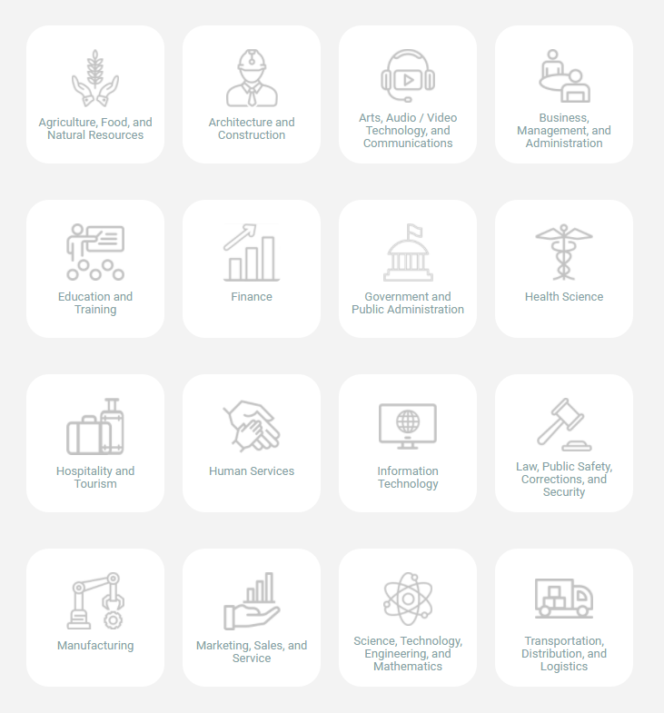
TOP THREE HIGHEST-RANKING CAREER CLUSTERS
Notes:
Results Page: You have identified several activities that you enjoy, or think you might. Now take a few minutes to learn more about your top 3 career clusters and how they connect with those interests. Have students record their top 3 (if there is a tie, they can choose their top 3) on the handout_Career Clusters.

Slide 5
ACTIVITY: GETTING TO KNOW YOUR FAVORITE CAREER CLUSTERS
DIG DEEPER INTO CAREER PATHWAYS
Go to www.onetonline.org/find/career
Search in your top 3 Career Clusters
Find one career/pathway in each of your 3 career cluster areas that interests you
Answer the information about each on your handout
Notes:
Activity: Getting to Know your Favorite Career Clusters: Now that you have identified your top 3 career clusters based on your interests. Let’s learn more about career pathways in each career cluster!
Have all students log into O*Net Online: https://www.onetonline.org/find/career. Students will search in their top 3 career clusters for a career/pathway that they find interesting and answer the questions on the handout. Some of the careers/pathways don’t show all the information. Encourage them to choose another pathway or if they have time at the end, they can search for the answers.
Closing: No software can tell you what you should or should not do with your life. However, by considering the day-to-day realities of various professions—and examining all 16 career clusters—you have gained a better understanding of the types of work that will most appeal to you.

