Slide 1
ACHIEVING YOUR GOALS
WHAT IS YOUR DREAM/VISION FOR YOUR FUTURE?
Notes:
Career Activity: Identifying Goals & Setting SMART Goals
Learning Plan Activity: 8th Grade; Additional Activities: 9, 10, 11
Estimated Time: 90-120 minutes (Can be split into two 45-60 minute lessons)
Activity Summary: This lesson will help students identify SMART (Specific, measurable, attainable, results-focused, time-bound) goals.
Learning Outcomes: Students will identify a list of their own life goals and turn a few of them into SMART goals.

Slide 2
IDENTIFYING GOALS
Date here
Date here
ACHIEVING YOUR GOALS

Slide 3
“SOME PEOPLE WAIT SO LONG FOR THEIR SHIP TO COME IN, THEIR PIER COLLAPSES.”
JOHN GODDARD
Notes:
Academic Vocabulary:
SMART Goal: accomplishments you set to achieve that are specific, measurable, attainable, results-focused, and time-bound.

Slide 4
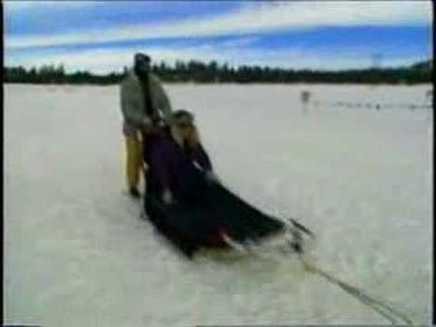
JOHN GODDARD
1924-2013
World’s Greatest Goal Achiever
World-renowned Adventurer, Explorer, Author, Lecturer
Notes:
Introduction: [Use Powerpoint] Today we are going to talk about John Goddard and learn about the process of examining your dreams and goals for your future after high school. Does anyone know who John Goddard was and what he accomplished? Play Video: John Goddard - Dateline NBC Clip (~7 minutes)

Slide 5
John Goddard’s Life List
TAKE A LOOK AT HIS LIFE LIST
Go to:
https://johngoddard.info/life_list.htm
REVIEW THE LIST
Look at what goals Goddard achieved
Look at what goals Goddard didn’t achieve
Write down or circle the goals that you found interesting or like the most
Notes:
John Goddard’s “Life List”: One rainy day afternoon at the age of 15 an inspired John Goddard sat down at his kitchen table and wrote three words, “My Life’s List”
Under those words he wrote 127 goals.
They were not simple and easy goals.
They included climbing some of the world’s major mountains, flying a plane, running a mile in 5 minutes, and reading an entire Encyclopedia Britannica (old school way of finding information in the dark ages when the internet did not exist)
He accomplished 109 of his 127 goals.
Have all students go to https://johngoddard.info/life_list.htm OR give them the handout_Achieving Your Goals.
Review the list looking at what Goddard completed and did not complete that he set as goals for his life.
Write down or circle the goals Goddard created that you found interesting or liked the most.
Out loud, have each student go around the room and name one of Goddard’s goals that stood out for them, discussing why they found it interesting, and if it is something they would like to do or not do in the future.

Slide 6
ACTIVITY: CREATE YOUR OWN LIFE LIST
EXAMPLE: “Bob Smith’s Life List”
Create your own “Life List” of all anything you can dream of for life.
Barriers/Obstacles (Ex: Money/travel/time) is no concern
Have fun and dream big
Include at least 10 goals
Notes:
Activity: Create your own Life List: Students Create Their Own “Life List”: Tell students to get out a piece of paper and have them write at the top “Your first and last name” and then “Life’s List”. (Example: “Bob Smith’s Life’s List”)
Tell students no holds bar when creating their own list (Meaning not to worry about barriers such as money when creating their own dream list).
Encourage students to have fun doing the activity, and express that it is all about what they want to accomplish in their lifetime. (Ex. Climbing Mt. Everest, working at Disney, learning to play the guitar, going to Iceland, attending Montana State University studying Business, becoming a mechanic, having a Family of 5, etc.)
There is no set number of goals a student needs to complete, but ten goals would be a good amount to shoot for during the time provided. (15-20 minutes is a good amount of time, but that time can be altered for what works best for the class)
Ask students to volunteer to share a couple of their own dreams.

Slide 7
WHAT IS YOUR DREAM/VISION FOR YOUR FUTURE?
Notes:
Closing: Today you have taken the first step in achieving goals by starting a list of dreams for your future just like John Goddard did as a teen. Keep thinking about how you might turn these dreams into actual goals and make a plan to make them happen. Also think about how you might advocate for yourself, and with whom you might recruit to provide you with the best support in getting your goals accomplished.

Slide 8
SETTING SMART GOALS
Date here
Date here
ACHIEVING YOUR GOALS

Slide 9
“TO DARE IS TO DO --- TO FEAR IS TO FAIL ”
JOHN GODDARD

Slide 10
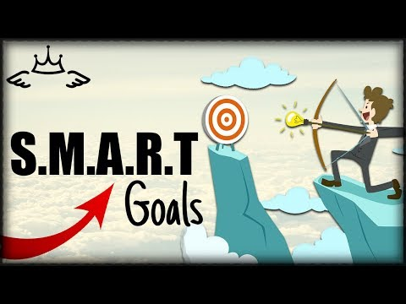
SMART Goals
Specific
Measurable
Attainable
Results-focused
Time-bound
Notes:
Introduction: [Use Powerpoint] Today we are going to turn our “LIFE LISTS” into SMART goals. Does anyone know the difference between a goal and a “SMART” goal?
Play Video: How to Set SMART Goals (~4 minutes)

Slide 11
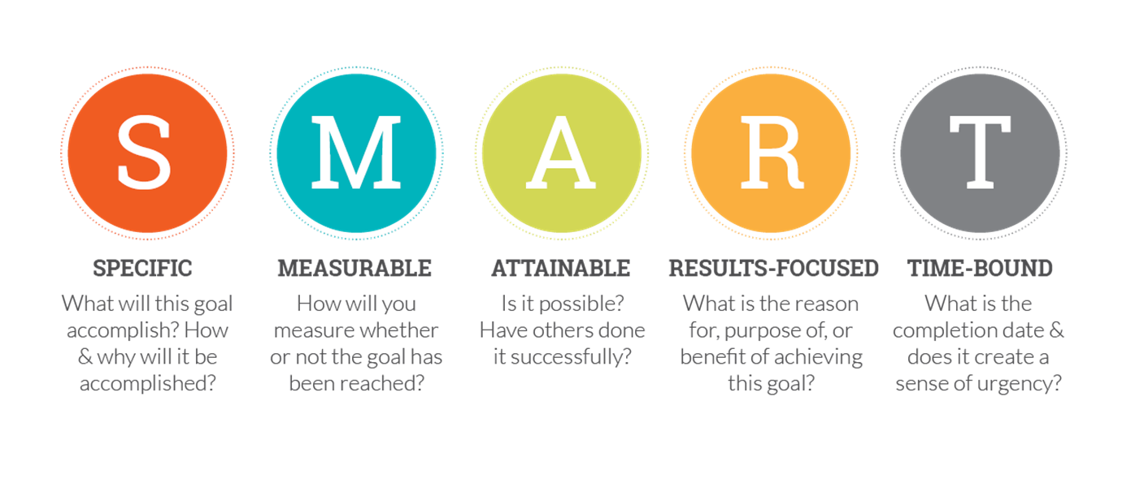
Everybody has dreams, or at least a vision for where they see themselves in the future. The first step to making your dream a reality is to clarify what you want to accomplish. That’s where SMART goals come in.
Notes:
Have students pull out their “Life List” created in Part 1: Setting Goals.
Students should have had at least 10 goals listed
Have students choose 1-2 of their goals that they would like to focus on to turn into“SMART” goals.
Use the Smart Goals Examples as a class discussion for students to understand examples using the SMART acronyms.

Slide 12
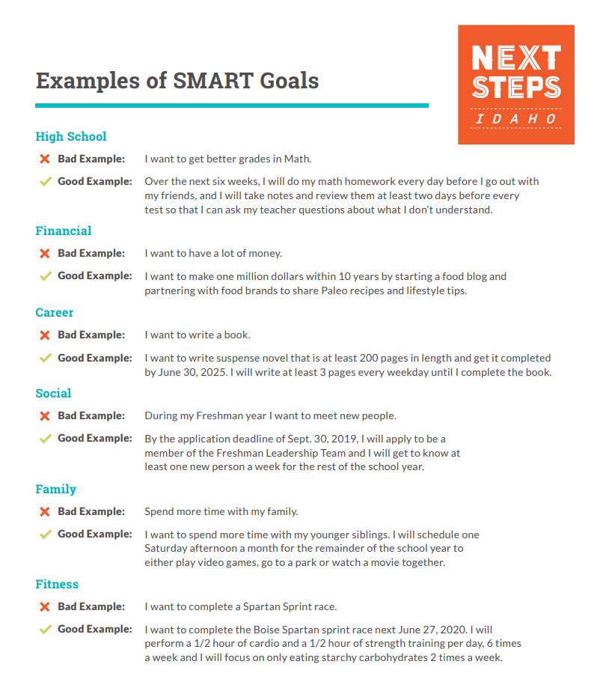
SMART GOALS EXAMPLES
Notes:
Review these Smart Goals examples

Slide 13
TURNING YOUR GOALS INTO SMART GOALS
Notes:
Restate the goal in one to two complete sentences.
Closing: Keep thinking about how you can modify your goals and make a plan to make them happen by turning them into SMART goals. Everybody has dreams, or at least a vision for where they see themselves in the future. The first step to making your dream a reality is to clarify what you want to accomplish. That’s where SMART goals come in.

