Slide 1

Brigham Young University-Idaho
Fall 2020 Opening Plans and COVID-19 Protocols
© Brigham Young University–Idaho

Slide 2
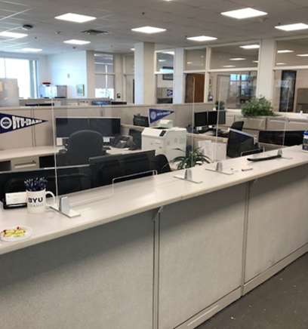
BYU-Idaho: Fall 2020 COVID-19 Protocols
We will be live, on-campus for Fall semester
  Monday, September 14th
Buildings
  Distributed seating
  Building traffic patterns
  Plexiglass barriers
Events
  Virtual orientation
  Many small activities ( < 50 people)
  Alternating weeks for church
Personal care
  Masks in buildings
  Sanitation supplies in classrooms

Slide 3

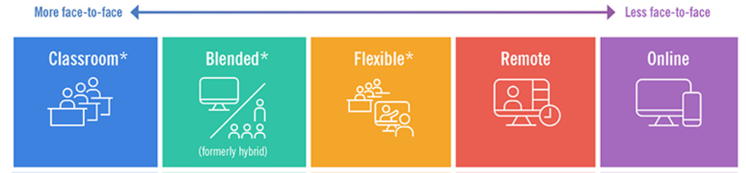
BYU-Idaho: Fall 2020 Course Delivery Methods
  Five different course delivery methods, varying levels of in-person interaction.
  Physical distancing protocols required for in-classroom meetings

Slide 4
BYU-Idaho: Admission Accommodations
ACT/SAT exemptions available in the BYU-Idaho admission application
  BYU (Provo, UT) is also test-optional for 2021-2022
  BYU applicants can add BYU-Idaho to their BYU application easily at the point of application submission.
  BYU-Idaho still uses ACT/SAT scores for English and Math placement, students are encouraged to report scores if they have them.
We collect a self-reported high school GPA, students are instructed to submit transcript post-admission
Fall 2021 application is open at http://apply.churchofjesuschrist.org. We encourage early application, priority deadline of Feb. 1st for BYU-Idaho. (BYU freshman application deadline for Fall 2021 is Dec. 15th 2020, same application website.)

Slide 5
BYU-Idaho: Financial Aid information
We are working with our Financial Aid office to consider applicants for merit-based financial awards on the basis of unweighted GPA.
To be considered for BYU-Idaho awards, applicants must submit the Thomas E. Ricks Grant application by March 1st. More info at www.byui.edu/financial-aid.

Slide 6
BYU-Idaho: Additional info
COVID-19 has resulted in a big increase in Online Concurrent Enrollment applications
  $30 per credit hour
  Fast Forward funds eligible
  Up to 9 credits per semester
  Must be 16+ years old and Junior or Senior standing
  www.byui.edu/concurrent-enrollment
Campus Tours: Virtual tours offered by appointment at www.byui.edu/campus-tours. We hope to resume in-person tours very soon, stay tuned!
We are available! Find out about virtual events by contacting your rep at www.byui.edu/admissions

